Slide 1
I Will Build My Church
Bible references are from the King James Version unless otherwise indicated.
Copyright © 2013 by Church of Jesus Christ – Restoration Branches. Unauthorized use or duplication of this material without express and written permission from the Church of Jesus Christ – Restoration Branches is strictly prohibited.

Slide 2
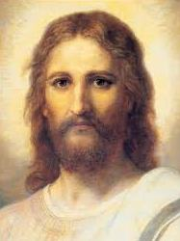
Notes:
Jesus Christ is referred to in scripture as the “author and finisher” of our faith. He made it clear that, before he died on the cross for our sins, he wanted to establish a church on earth.

Slide 3
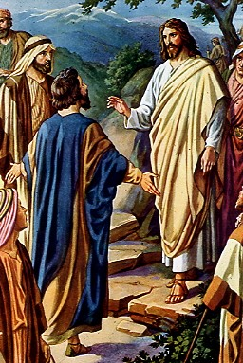
The Rock of the Revelation of Jesus Christ
Thou art the Christ, the Son of the living God . . . Blessed art thou, Simon Bar-jona: for flesh and blood hath not revealed it unto thee, but my Father which is in heaven . . . Thou art Peter, and upon this rock I will build my church . . .
Matthew 16:16-18
Notes:
Jesus built his church on the rock of the revelation of Jesus Christ.
Here on the coast of Caesarea Philippi, Jesus proclaimed, “I will build my church.”
Peter was blessed, not because he was the rock the church would be built on, but because he relied on revelation from God to guide him. So the rock that Christ’s church would be built on was the rock of the revelation of Jesus Christ.
Some churches believe that revelation ceased with the end of the New Testament apostles, but we do not.
Wherever Christ’s true church is, it must rely on the rock of revelation as its foundation.

Slide 4
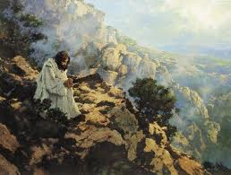
Jesus Often Took Time to Receive Direction from God
And when he had sent the multitudes away, he went up into a mountain apart to pray: and when the evening was come, he was there alone.
Matthew 14:23
Notes:
Jesus sought revelation from the Father to guide him in his ministry.

Slide 5
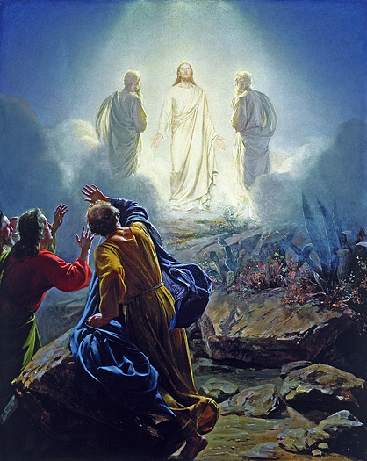
The
Transfiguration
The Power and Divine Nature of Jesus Was Revealed to Three Witnesses
Notes:
Jesus used revelation to show his disciples his nature and power.

Slide 6
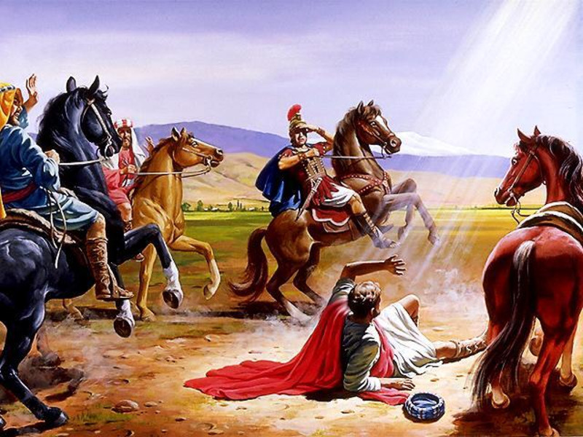
Revelation on the Road to Damascus
. . . and suddenly there shined round about him a light from heaven. And he fell to the earth, and heard a voice saying unto him, Saul, Saul, why persecutest thou me?
Acts 9:3-4
Notes:
Acts 9:1-8 tells us how Jesus used revelation to convert Saul to the gospel on the road to Damascus.

Slide 7
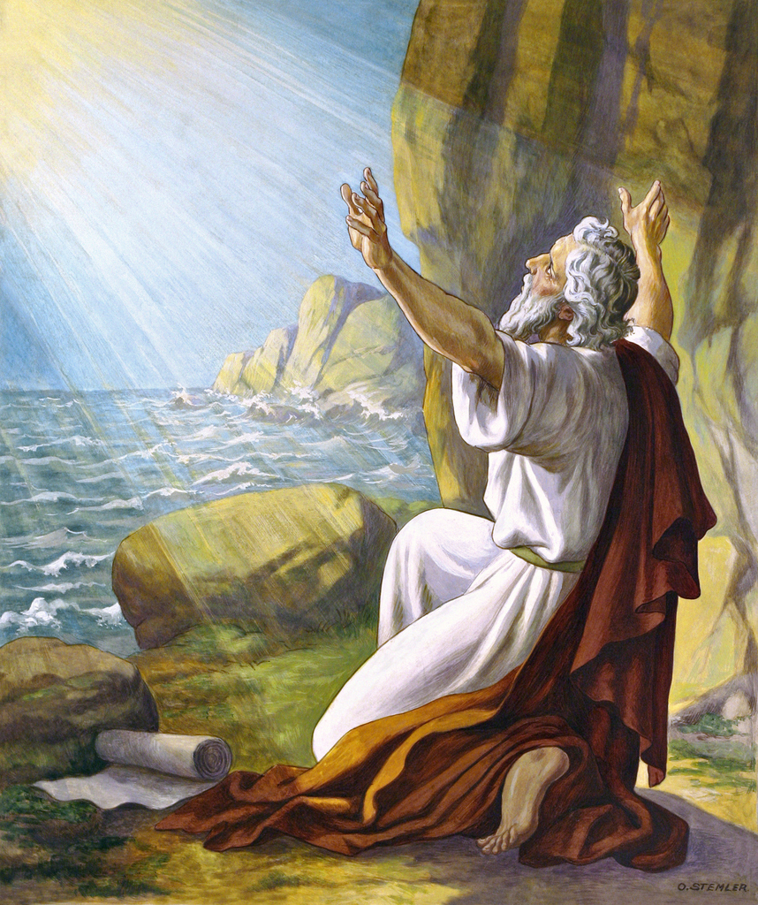
Revelation Given to John at Patmos
I, John, who also am your brother, and companion in tribulation, and in the kingdom and patience of Jesus Christ, was in the isle that is called Patmos, for the word of God, and for the testimony of Jesus Christ. Revelation 1:9
Notes:
The Book of Revelation is one of the most dramatic examples of God revealing his will to man.

Slide 8
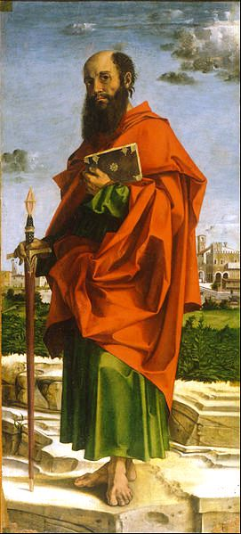
Even though Paul was Highly Educated, He Was Taught the Gospel by Revelation .
But I certify you, brethren, that the gospel which was preached of me is not after man. For I neither received it of man, neither was I taught it, but by the revelation of Jesus Christ. Galatians 1:11-12
Notes:
Paul grew up in Tarsus and was taught the Law by one of the great scholars of his day, Gamaliel. However, he was taught the gospel by revelation.

Slide 9
Has Revelation Ceased?
Some churches believe that revelation ended after the first century and that God no longer revealed his will in the form of scripture that would apply to all believers.
However, the restored gospel maintains that God wishes to reveal his will to man today just as he has in times past.
Notes:
We sometimes compare pauses in revelatory insight to being in a spiritual desert. But God wants to reveal his will to man.

Slide 10
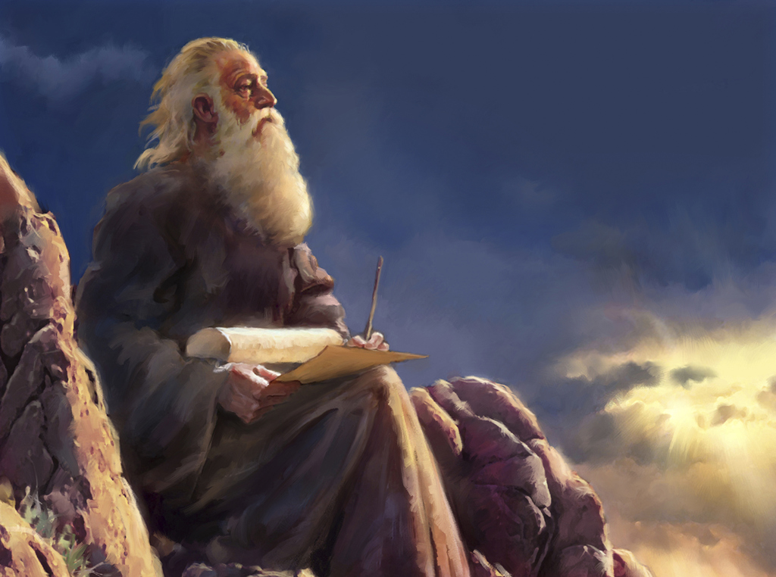
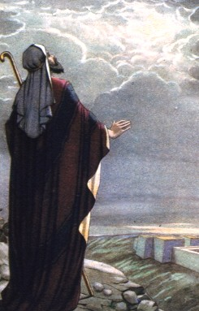
Surely the Lord God will do nothing, but he revealeth the secret unto his servants the prophets.
Amos 3:7
For behold, the time cometh, and is not far distant, that with power, the Lord Omnipotent who reigneth, who was, and is from all eternity to all eternity, shall come down from heaven, among the children of men, and shall dwell in a tabernacle of clay.
Mosiah 1:97
Notes:
God speaks to us through prophets
There have been times when the Lord took away prophets for a period of time, but there is nothing in scripture that suggests this method of communicating would cease.

Slide 11
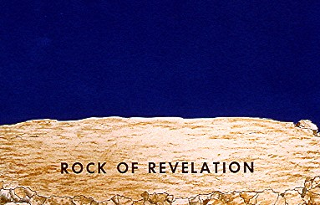
Upon this rock, I will build my church.
Matthew 16:18
Notes:
So his church is built on the rock of the revelation of Jesus Christ.

Slide 12
Jesus Christ the Cornerstone
Now therefore ye are no more strangers and foreigners, but fellow citizens with the saints, and of the household of God;
and are built upon the foundation of the apostles and prophets, Jesus Christ himself being the chief cornerstone.
Ephesians 2:19-20
Notes:
Apostles and prophets are the foundation, and Jesus is the cornerstone.

Slide 13
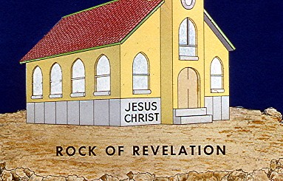
Notes:
The cornerstone was always the first stone laid and the reference point for any building.
Jesus is that reference point for Christ’s church.

Slide 14
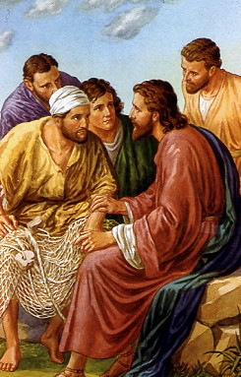
Ministerial Authority
And they were astonished at his doctrine; for he taught them as one that had authority, and not as the scribes.
Mark 1:22
Notes:
None of us has ever experienced hearing someone speak with such authority. Every time Jesus spoke, every word was 100% truth and carried tremendous significance.

Slide 15
Helps and Governments
In the New Testament church, 1 Corinthians 12 tells us that God provided “helps and governments,” such as ministers and spiritual gifts, to bless his people:
And God hath set some in the church, first apostles, secondarily prophets, thirdly teachers, after that miracles, then gifts of healings, helps, governments, diversities of tongues.
1 Corinthians 12:28
Notes:
Apostles, prophets, miracles and spiritual gifts.

Slide 16
A Call to Ministry
And no man taketh this honor unto himself, but he that is called of God as was Aaron. Hebrews 5:4
In other words, a person does not simply “feel” a call to ministry, but one in authority must call him. Exodus 28:1 tells us that Aaron’s call included the following elements:
God was speaking.
Through one in spiritual authority (Moses).
God named a specific candidate (Aaron).
From among the body of believers (children of Israel).
God indicated a specific office (priest).
Notes:
In most churches today, an individual simply “feels” a call to ministry on his own. There is no requirement that a person in spiritual authority present his call or even confirm that it is true. However, Hebrews 5:4 says that, in the New Testament Church, any call to ministry must follow the pattern by which Aaron was called to the office of priest in the Old Testament. When Aaron was called, five things occurred. God presented the call to ministerial office through Moses (I’m sure he confirmed it to Aaron). God named Aaron. God chose Aaron from the body of believers. God indicated a specific ministerial office.

Slide 17
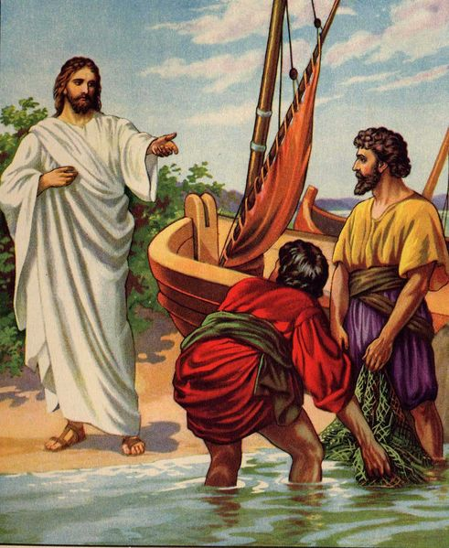
A Call to Ministry
Follow me, and I will make you fishers of men.
Matthew 4:19
A Call to Ministry
Follow me, and I will make you fishers of men.
Matthew 4:19
Notes:
Today, Jesus still wants to make us fishers of men, to bring the light of the gospel to others.
After Jesus called the first four disciples, Jesus and they departed for Galilee
Andrew ran and told his brother, Simon Peter, that he had found the Messiah, or the Christ. (John 1:41).
Andrew brought Peter to meet Jesus. Jesus told Peter that he would be called Cephas, which refers to a seer or a stone (John 1:42).
Andrew and Simon apparently returned to their work as fishermen.
Later, in Matthew 4:18 (pictured above), Jesus was walking by the sea of Galilee, and he saw Peter and Andrew once again. He called out to them, “Follow me, and I will make you fishers of men.” They immediately left their nets there and followed him and became his disciples.
John 1:43: Jesus went unto Bethsaida, the home of Andrew and Peter, in Galilee. There he found Phillip and commanded him to “follow me.”
John 1:45: Phillip told Nathanael, a man in whom there was no guile, about Jesus.

Slide 18
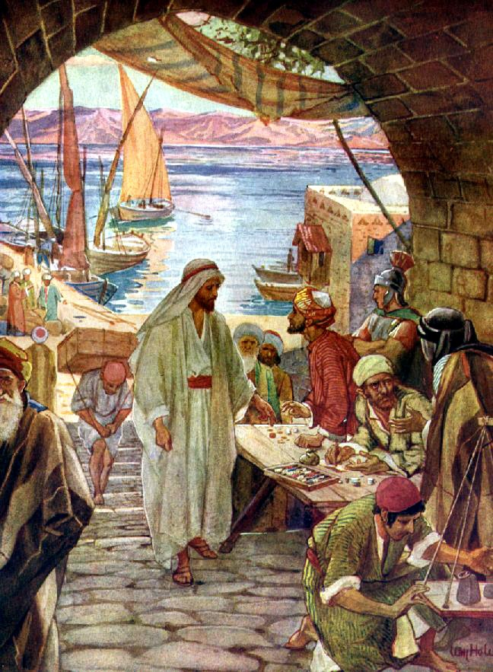
Jesus Called Matthew the Publican, One of the Most Despised People in Society
And as Jesus passed forth from thence, he saw a man, named Matthew, sitting at the receipt of custom: and he saith unto him, Follow me. And he arose, and followed him. Matthew 9:9
Notes:
You might be aware of the story of the rich, young ruler in Matthew 19. He was one of the most admired men in society, yet he did not follow Jesus. Matthew, a tax collector was one of the most despised members of that culture and yet Jesus called him to ministry, and he went with him.

Slide 19
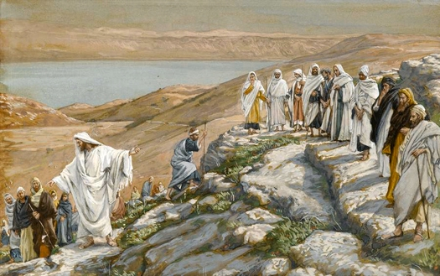
Choosing and Ordaining Ministers
Ye have not chosen me, but I have chosen you, and ordained you, that ye should go and bring forth fruit, and that your fruit should remain. John 15:16
Notes:
Jesus called and empowered his apostles to work mighty miracles.

Slide 20
Jesus Empowered Twelve Apostles
And when he had called unto him his twelve disciples, he gave them power against unclean spirits, to cast them out, and to heal all manner of sickness and all manner of disease. Matthew 10:1
Notes:
This passage says Jesus gave his ministers power.

Slide 21
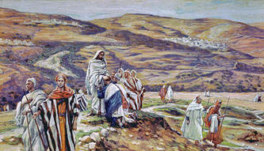
Jesus Called Seventy to Preach and Heal
After these things the Lord appointed other seventy also, and
sent them two and two . . . Luke 10:1
Notes:
Jesus called 70 men as special witnesses to preach the gospel and heal the sick.

Slide 22
Calling vs. Ordaining
Some churches believe that “calling” and “ordaining” are the same thing and that both words simply mean “to appoint.” However, John 15:16 indicates that calling and ordination are separate functions:
Ye have not chosen me, but I have chosen you, and ordained you, that ye should go and bring forth fruit, and
that your fruit should remain . . . John 15:16
Notes:
The word “and” indicates that “calling” and “ordaining” are two separate functions.

Slide 23
Ordaining Ministers
And the saying pleased the whole multitude: and they chose Stephen, a man full of faith and of the Holy Ghost, and Philip, and Prochorus, and Nicanor, and Timon, and Parmenas, and Nicolas a proselyte of Antioch, whom they set before the apostles: and when they had prayed, they laid their hands on them. And the word of God increased: and the number of the disciples multiplied in Jerusalem greatly. Acts 6:5-7
Notes:
This scripture in Acts describes how ministers were given power: by ordination (laying on of hands).

Slide 24
Calling and Ordaining
1 Now there were in the church that was at Antioch certain prophets and teachers; as Barnabas, and Simeon that was called Niger, and Lucius of Cyrene, and Manaen, which had been brought up with Herod the tetrarch, and Saul.
2 As they ministered to the Lord, and fasted, the Holy Ghost said, Separate me Barnabas and Saul for the work whereunto I have called them.
And when they had fasted and prayed, and laid their hands on them, they sent them away.
Acts 13:1-3
Notes:
In verse 2, Barnabas and Saul were called to ministry. In verse 3, they were ordained.

Slide 25
Apostles and Prophets
Some churches believe that:
apostles ceased to exist after the first century, and
prophets were no longer needed to reveal the mind and
will of God to his people in the form of scriptural guidance.
However, Ephesians 4:11-13 makes it clear that apostles, prophets and other ministers should continue to function in Christ’s church.
Notes:
Note: Ephesians 4:11-13 is on the next slide.

Slide 26
Ephesians 4:11-13
Ministerial Offices
“And he gave some, apostles; and some prophets;
and some, evangelists; and some pastors and teachers;”
What is their Purpose?
“For the perfecting of the saints, for the work of the ministry, for the edifying of the body of Christ;”
How long will they remain in the Christ’s Church?
“Till we:
in the unity of the faith,
all come to the knowledge of the Son of God,
unto a perfect man, unto the measure of the stature of the fullness of Christ.”
Notes:
Ephesians 4:11-13 says that the ministerial functions, including apostles and prophets, will continue in Christ’s church until the church is perfected in Christ. This passage refers to five offices, but this scripture would apply generally to all the offices in Christ’s church. We need to remember that the blueprint for church structure and governance is not exactly the same in every era. However, we believe that the structure of our church very closely approximates that of the New Testament church.

Slide 27
Priesthood
The term “priesthood” denotes the existence of the office of priest. Ministerial offices are an extension of priestly authority.
For every high priest is ordained for men in things pertaining to God, that he may offer both gifts and sacrifices for sins.”
Hebrews 5:1
Hebrews is speaking in present tense indicating that high priests continued to be ordained in the New Testament church.
The sacrifices of God are a broken spirit: a broken and a contrite heart, O God, thou wilt not despise.
Psalm 51:17
Notes:
Other churches frequently suggest that Hebrews 5:1 is referring to the high priest of Aaron. Keep in mind that Hebrews was written after the cross and that it refers to offering sacrifices. It is doubtful that a high priest of the Aaronic order would continue to be ordained after the cross for the purpose of offering physical sacrifices as prescribed by the Old Testament. Yet this passage says that “every high priest . . . is ordained” (present tense). We believe that Hebrews 5:1 is referring to high priests of the Melchizedec order. Other churches attempt to stretch the meaning of Hebrews 7:24 to suggest that Jesus was the last high priest of the Melchizedec order because Jesus’ high priesthood could not be passed on to another. However, the original Greek wording for Hebrews 7:24 does not even suggest that such an interpretation is correct. Jesus’ high priesthood could be passed on to successors.

Slide 28
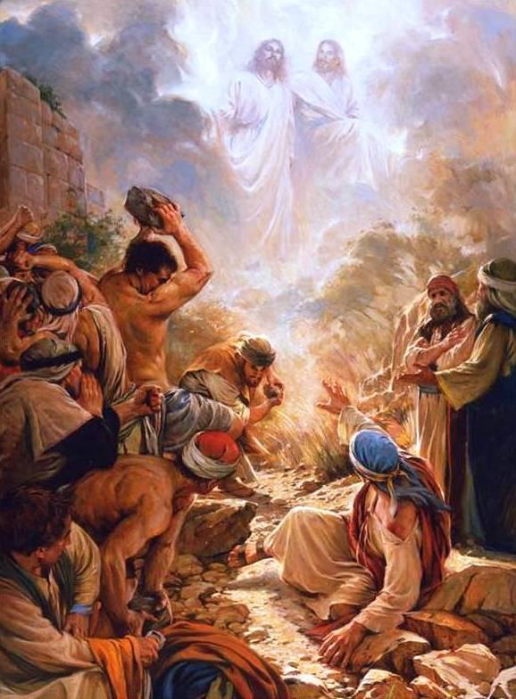
Stephen, an Ordained Minister, Making the Ultimate Sacrifice
When they heard these things, they were cut to the heart, and they gnashed on him with their teeth . . . Then they cried out with a loud voice, and stopped their ears, and ran upon him with one accord, and cast him out of the city, and stoned him . . . And they stoned Stephen, calling upon God, and saying, Lord Jesus, receive my spirit. And he kneeled down, and cried with a loud voice, Lord, lay not this sin to their charge. And when he had said this, he fell asleep.
Acts 7:55-56
Notes:
Stephen was an ordained minister who made the ultimate sacrifice to bring the gospel to men.

Slide 29
Priestly Duty
In the NIV Bible, Paul talks about his “priestly duty” that he hoped would result in an acceptable offering to God:
I have written you boldly on some points, as if to remind you of them again, because of the grace God gave me to be a minister of Christ Jesus to the Gentiles with the priestly duty of proclaiming the gospel of God so that the Gentiles might become an offering acceptable to God, sanctified by the Holy Spirit. Romans 15:15-16 (NIV)
There is a sense in which every ministerial office is an extension of the priest’s office in that they all seek to win souls who will bring an offering of a broken and contrite heart before the Lord.
Notes:
The Protestant Reformation does not have priests, per se. However, the New International Version (a Protestant version) contains this reference to Paul’s priestly duty. This NIV reference is included to lend legitimacy to the existence of priests and therefore priesthood. It is Protestants’ contention that ministerial priesthood ended at the cross – that the Aaronic priesthood ended – and that at that time, all members of Christ’s church were then empowered to perform all of the holy ordinances. However, in this passage Paul is referring to his “priestly duty” as if there were still certain functions exclusive to ministers in the church.
Note: See Appendix for more on this subject.

Slide 30
Holy Ordinances
Holy ordinances, that follow the pattern given in the New Testament church, provide a blessing to God’s people and a means for us to align our lives with the will of God. God’s ministers are given the responsibility to bring holy ordinances to the body of Christ, such as:
Water Baptism
Baptism of the Holy Spirit
Communion
Administration to the Sick
Marriage
Blessing Children
Ordaining Ministers
Patriarchal Blessing
Notes:
It is the responsibility of ministers in Christ’s church to properly administer holy ordinances for the welfare of the entire body of Christ. These duties are exclusive to ministers and not to be administered by the general membership.

Slide 31
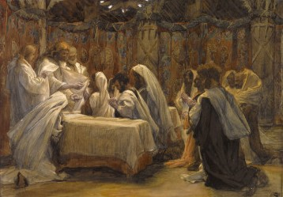
Holy Ordinances
I am the bread of life . . . Then said Jesus unto them, Verily, verily I say unto you, Except ye eat the flesh of the Son of man, and drink his blood, ye have no life in you. Whoso eateth my flesh, and drinketh my blood, hath eternal life . . . He that eateth my flesh, and drinketh my blood, dwelleth in me, and I in him. John 6:48, 53, 54, 56
Notes:
The holy ordinance of Communion provides a way for Christ to dwell in us and to have an ongoing relationship with us.
This is not the Last Supper. This is an earlier Communion in which Jesus taught the disciples about the ordinance.
At Caperneum, Jesus taught the disciples that they must partake of his flesh and his blood or they would not have eternal life.
The holy ordinance of Communion provides a way to examine our lives, to purify our thoughts and motives, and to have an ongoing relationship with the Master where he can dwell in us.

Slide 32
Ministers in Christ’s Church
Apostle
Prophet
Bishop
Evangelist
High Priest
Seventy
Elder
Priest
Teacher
Deacon
Notes:
Apostle – Matthew 10:1-4 Seventy - Luke 10:1-17
Prophet - Ephesians 4:11-13 Elder - Acts 14:23
Bishop - 1 Timothy 3:1-7 Priest – Acts 6:1-7, Matthew 3:11 (John the Baptist baptized but did not impart the gift of the Holy Spirit)
Evangelist - Ephesians 4:11-13 Acts 8:12-17 – Philip preached gospel; Peter and John laid on hands to give the gift of the Holy Spirit.
High Priest - Hebrews 5:1-6 Teacher - Ephesians 4:11-13
Deacon – 1 Timothy 3:8-13

Slide 33
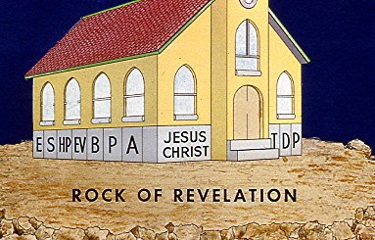
Notes:
The offices represented by the foundation are: elder, seventy, high priest, evangelist, bishop, prophet, apostle, teacher, deacon and priest.

Slide 34
Whosoever transgresseth, and abideth not in the doctrine of Christ, hath not God. He that abideth in the doctrine of Christ, he hath both the Father and the Son.
2 John 1:9
Notes:
If we do not abide in the doctrine of Christ, we do not have God. We need to clearly identify the doctrines of Christ.

Slide 35
I marvel that ye are so soon removed from him that called you into the grace of Christ unto another gospel. Which is not another; but there be some that trouble you, and would pervert the gospel of Christ. Galatians 1:6-7
Notes:
Here we see an example of how easily and quickly God’s people can wander from the truth. This would imply that we must constantly guard against any attempt to alter the doctrines that Jesus taught.

Slide 36
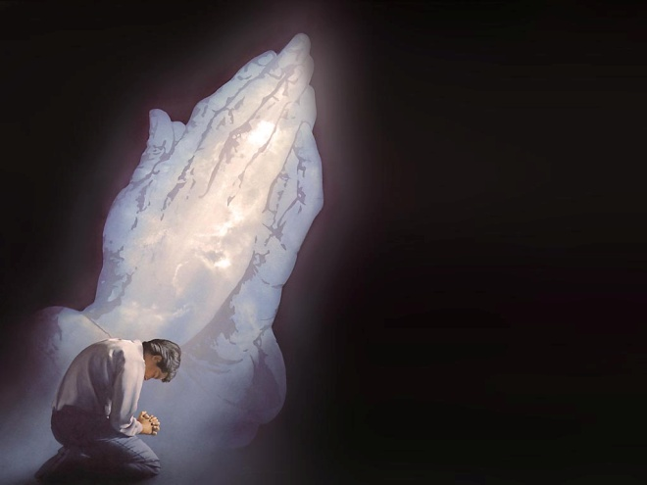
The Doctrine of Christ
Therefore [not] leaving the principles of the doctrine of Christ, let us go on unto perfection; not laying again the foundation of:
repentance from dead works,
and of faith toward God.
of the doctrine of baptisms,
and of laying on of hands,
and of the resurrection of the dead,
and of eternal judgment.
Hebrews 6:1-2 (IV)
Notes:
The gospel of Christ rests upon the foundation of these six principles of Christ’s doctrine. The first of these is repentance.

Slide 37
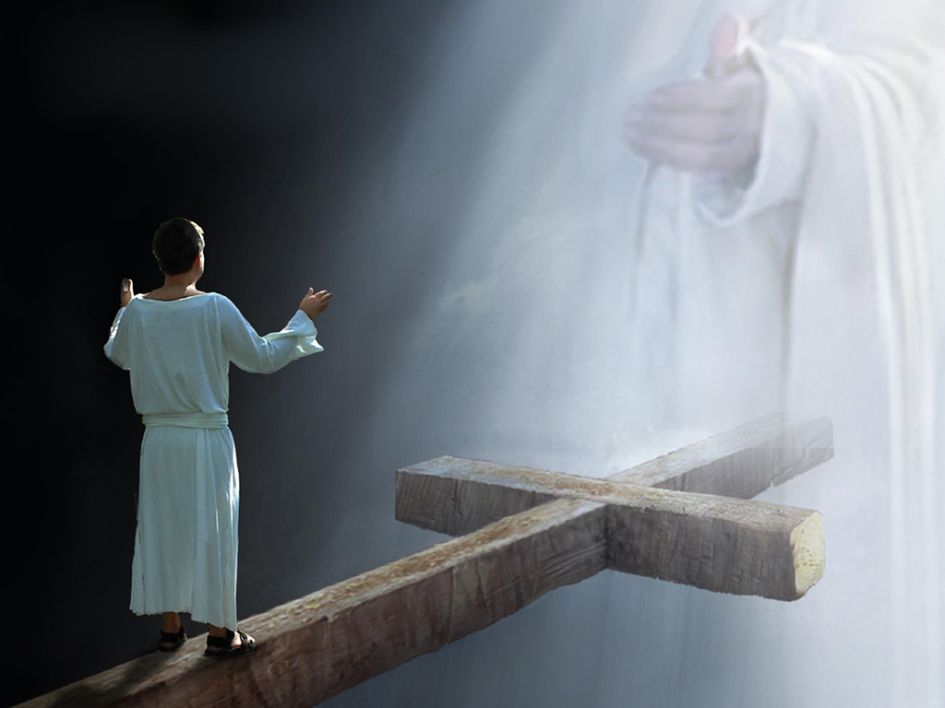
The consequence for sin is eternal separation from God – a spiritual death. But God is merciful and can forgive our sin.
Notes:
“Spiritual death” is eternal separation from God. Without the gospel, that is where we would all go.

Slide 38
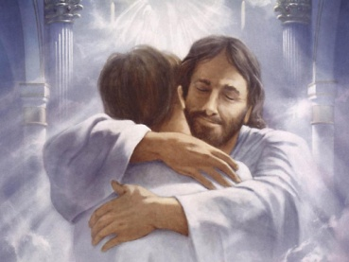
Repentance
Behold, he sendeth an invitation unto all men; for the arms of mercy are extended toward them, and he saith, Repent, and I will receive you. Alma 3:57
Notes:
The way we return to him is through repentance.

Slide 39
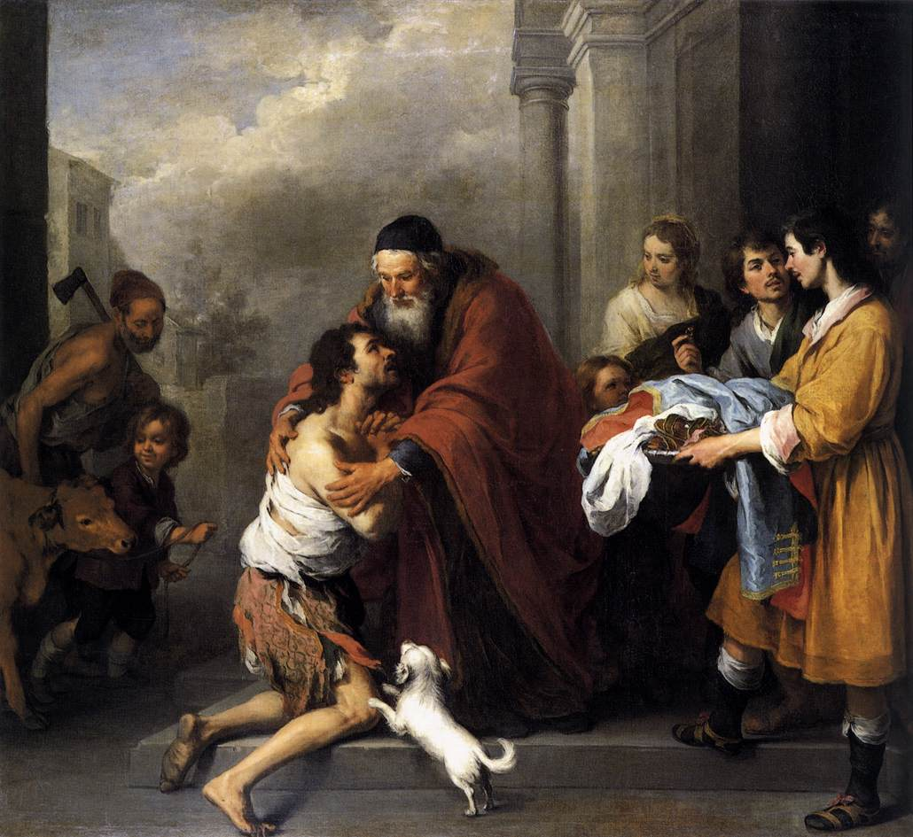
Father, I have sinned against heaven, and in thy sight, and am no more worthy to be called thy son. Luke 15:21
Notes:
The story of the prodigal son illustrates the principle of repentance and our relationship with our Heavenly Father.

Slide 40
Repentance
19 Repent ye therefore, and be converted, that your sins may be blotted out . . .
26 . . . turning away every one of you from his iniquities.
Acts 3:19 & 26
Notes:
This scripture makes clear the direct relationship between repentance and salvation.
Repentance means a “turning away” from sin.
Other churches teach that repentance is merely “a change of mind about who Christ is” (the literal meaning of the Greek term for repentance).
But from Acts 3:26, we see that it includes a “turning away from sin.” In other words, a change in the pattern of sin.
Repentance must bear fruit.

Slide 41
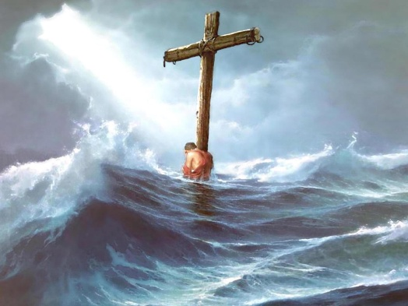
The Doctrine of Christ
Therefore [not] leaving the principles of the doctrine of Christ, let us go on unto perfection; not laying again the foundation of:
repentance from dead works,
and of faith toward God.
of the doctrine of baptisms,
and of laying on of hands,
and of the resurrection of the dead,
and of eternal judgment.
Hebrews 6:1-2 (IV)
Notes:
The second doctrine of Christ mentioned here is faith toward God.

Slide 42
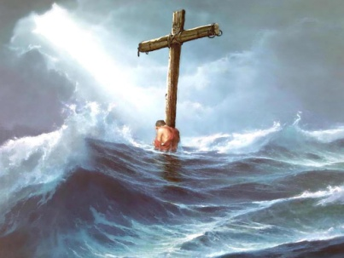
Faith
But behold, if ye will awake and arouse your faculties, even to an experiment upon my words, and exercise a particle of faith; yea, even if ye can no more than desire to believe, let this desire work in you, even until ye believe in a manner that ye can give place for a portion of my words.
Alma 16:151
. . . believe on the Lord Jesus Christ, and thou shalt be saved...
Acts 16:31
. . . whosoever believeth in Him should not perish, but have everlasting life. John 3:16
Notes:
In some churches, faith involves a one-time acceptance of Jesus as savior (sometimes called “intellectual assent”). However, in Matthew 14, we see that Peter had to act on his faith. He had to step out on the water to walk to Jesus. The Lectures on Faith by Joseph Smith indicate that faith involves belief, assurance, action and power. We believe that faith is more than just a momentary acceptance or intellectual assent.

Slide 43
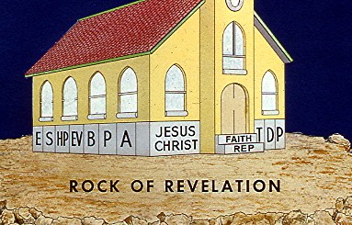
Notes:
So we see illustrated here the first two principles of the doctrine of Christ: repentance and faith.

Slide 44
The Doctrine of Christ
Therefore [not] leaving the principles of the doctrine of Christ, let us go on unto perfection; not laying again the foundation of:
repentance from dead works,
and of faith toward God.
of the doctrine of baptisms,
and of laying on of hands,
and of the resurrection of the dead,
and of eternal judgment.
Hebrews 6:1-2 (IV)
Notes:
The third doctrine of Christ mentioned in Hebrews is the doctrine of baptisms [plural]. This refers to both water baptism and receiving the gift of the Holy Spirit.

Slide 45
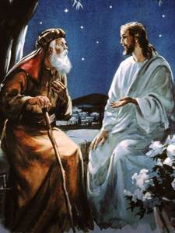
Baptism
3 . . . Except a man be born again, he cannot see the kingdom of God.
4 Nicodemus saith unto him, How can a man be born when he is old? Can he enter the second time into his mother’s womb, and be born?
5 . . . Except a man be born of water and of the Spirit, he cannot enter into the kingdom of God.
John 3:3-5
Notes:
Jesus explains to Nicodemus that we must be born of water and the spirit to enter the kingdom of God.
Some churches believe that “born of water” refers to the bag of waters that breaks when we are originally born (amniotic sac).
Jesus demonstrated that born of water refers to water baptism when he was baptized by John the Baptist (Matthew 3).
Some churches believe that “born of the Spirit” refers to our initial conversion to Christ, but Acts 8 makes it apparent that the gift of the H.S. can be granted through the laying of hands.

Slide 46
Baptism
4 Therefore we are buried with him by baptism into death: that like as Christ was raised up from the dead by the glory of the Father, even so we also should walk in newness of life.
5 For if we have been planted together in the likeness of his death, we shall be also in the likeness of his resurrection.
Romans 6:4-5
Notes:
Baptism by immersion represents the death and resurrection of Christ.

Slide 47
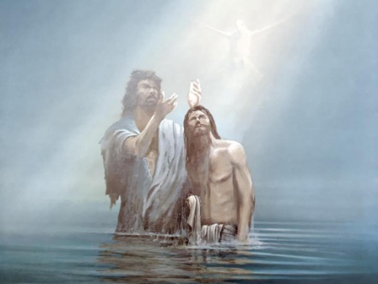
Baptism
Then cometh Jesus from Galilee to Jordan unto John, to be baptized of him . . .
16 And Jesus, when he was baptized, went up straightway out of the water: and lo, the heavens were opened unto him . . .
Matthew 3:13,16
Notes:
Jesus came all the way from Galilee to Jordan to be baptized by John the Baptist. Why? Because John had authority from God to baptize.
The restored gospel makes clear that this function of baptizing is exclusive to the ministers of Christ’s church.
The order of events is important in this story. Why? Because many churches believe that you always receive the baptism of the Holy Spirit first and then, if you want to, water baptism is an option you can pursue (but water baptism does not save you).
The restored gospel says that Christ has commanded his ministers to baptize by water and then convey the gift of the Holy Spirit and that both of these are doctrines of Christ that have a direct bearing on salvation.

Slide 48
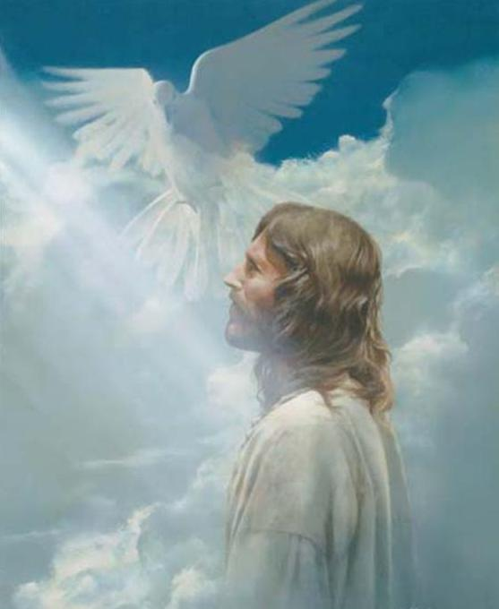
Baptism of the Holy Spirit
. . . and he saw the Spirit of God descending like a dove
. . . and lo a voice from heaven, saying, This is my beloved Son, in whom I am well pleased.
Matthew 3:16-17
Notes:
Jesus showed us the way to become sons and daughters of God, and this event fulfilled prophecy.
Matthew 3:16-17: “And Jesus, when he was baptized, went up straightway out of the water: and lo, the heavens were opened unto him, and he saw the Spirit of God descending like a dove, and lighting upon him. And lo a voice from heaven, saying, This is my beloved Son, in whom I am well pleased.”
This fulfilled the prophecy given in Psalm 2:7: “Thou art my Son: this day have I begotten thee.”
Baptism in the proper manner is how we become sons and daughters of God.
Jesus was baptized by water and then the Spirit bore witness that he really was the Son of God.

Slide 49
Baptism
32 Whosoever therefore shall confess me before men, him will I confess also before my Father which is in heaven.
33 But whosoever shall deny me before men, him will I also deny before my Father which is in heaven.
Matthew 10:32-33
Notes:
Baptism provides one way to confess him before men.

Slide 50
Baptism and the Gift of the Holy Spirit
Now when they heard this, they were pricked in their heart, and said unto Peter and to the rest of the apostles, Men and brethren, what shall we do?
Then Peter said unto them, Repent, and be baptized every one of you in the name of Jesus Christ for the remission of sins, and ye shall receive the gift of the Holy Ghost.
For the promise is unto you, and to your children, and to all that are afar off, even as many as the Lord our God shall call.
Acts 2:37-39
Notes:
1. Notice that Peter’s audience in Jerusalem was convinced by his message about Jesus’ resurrection and the redemption he could give them. They were converted, yet they had still not received the gift of the Holy Spirit. (This runs directly counter to Protestants’ view that, at the moment of conversion, every person has received this gift automatically).
2. Secondly, notice that Peter instructs them to repent and be baptized for the remission of sins. (Protestants suggest it is only the repentance part that saves, but John the Baptist administered a baptism that was for the “remission of sins.”)
3. Thirdly, note that water baptism occurred and then they were given the gift of the Holy Spirit.

Slide 51
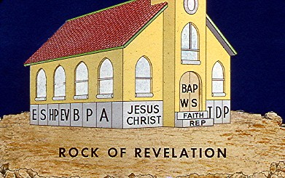
Notes:
This illustration conveys that baptisms of water and the Spirit are the doors through which we must enter.

Slide 52
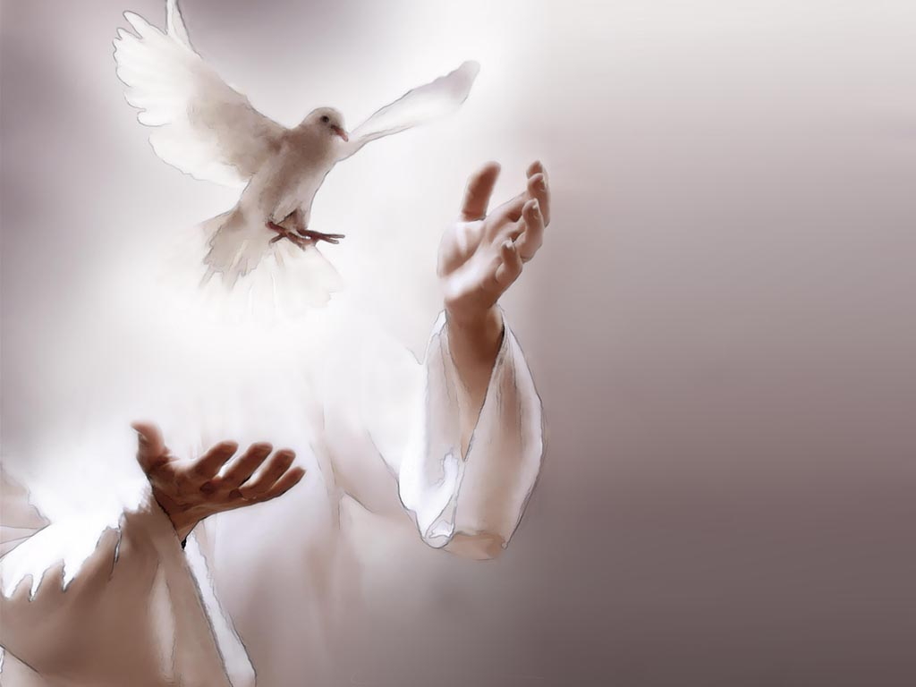
The Doctrine of Christ
Therefore [not] leaving the principles of the doctrine of Christ, let us go on unto perfection; not laying again the foundation of:
repentance from dead works,
and of faith toward God.
of the doctrine of baptisms,
and of laying on of hands,
and of the resurrection of the dead,
and of eternal judgment.
Hebrews 6:1-2 (IV)
Notes:
The fourth doctrine of Christ concerns laying on of hands. This refers to several types of ministry that we will discuss in the next few slides.

Slide 53
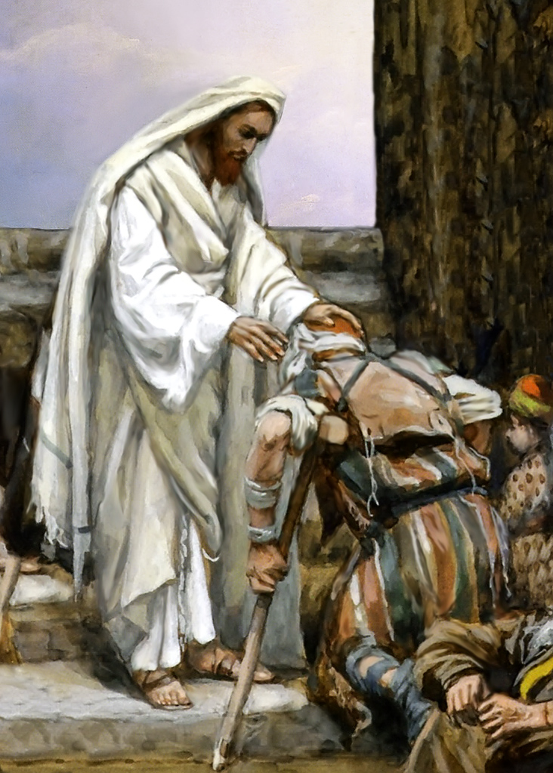
Healing the Sick
Now when the sun was setting, all they that had any sick with divers diseases brought them unto him; and he laid his hands on every one of them, and healed them. And devils also came out of many, crying out, and saying, Thou art Christ the Son of God.
Luke4:40-41
Notes:
Jesus laid on hands to heal the sick.

Slide 54
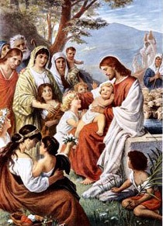
Blessing Children
Then there were brought unto him little children, that he should put his hands on them, and pray: and the disciples rebuked them. But Jesus said, Suffer little children, and forbid them not, to come unto me: for of such is the kingdom of heaven. And he laid his hands on them, and departed thence.
Matthew 19:13-15
Notes:
Jesus laid on hands to bless little children. It did not mention that he baptized little children. He blessed them.

Slide 55
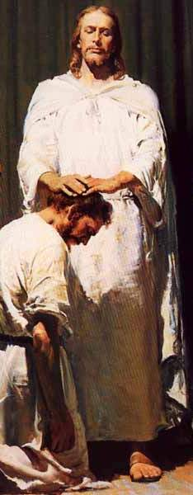
Ordaining Ministers
And the saying pleased the whole multitude: and they chose Stephen, a man full of faith and of the Holy Ghost, and Philip, and Prochorus, and Nicanor, and Timon, and Parmenas, and Nicolas a proselyte of Antioch, whom they set before the apostles: and when they had prayed, they laid their hands on them. And the word of God increased: and the number of the disciples multiplied in Jerusalem greatly. Acts 6:5-7
Notes:
In this passage, the New Testament church laid on hands to ordain these seven men to ministerial responsibility. In some earlier slides, we quoted passages like John 15:16 in which Jesus says that he ordained the twelve disciples. Another passage says that he “gave them power.” Ordination is how ministers are empowered to fulfill their calling.

Slide 56
Giving the Gift of the Holy Spirit
But when they believed Philip preaching the things concerning the kingdom of God and the name of Jesus Christ, they were baptized . . Now when the apostles which were at Jerusalem heard that Samaria had received the word of God, they sent unto them Peter and John, who when they were come down, prayed for them, that they might receive the Holy Ghost. (For as yet he was fallen upon none of them: only they were baptized in the name of the Lord Jesus.) Then laid they their hands on them, and they received the Holy Ghost.
Acts 8:12-17
Notes:
In Samaria, the people believed but they had not yet received the gift of the Holy Spirit. They were then baptized in water by Philip, but Philip did not confirm them. Peter and John came to lay on hands to convey the gift of the Holy Spirit.

Slide 57
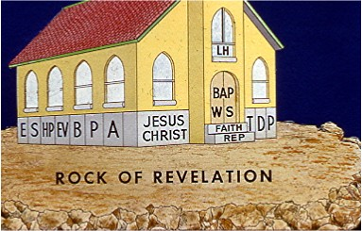
Notes:
In this illustration, the fourth principle in the doctrine of Christ is laying on of hands.

Slide 58
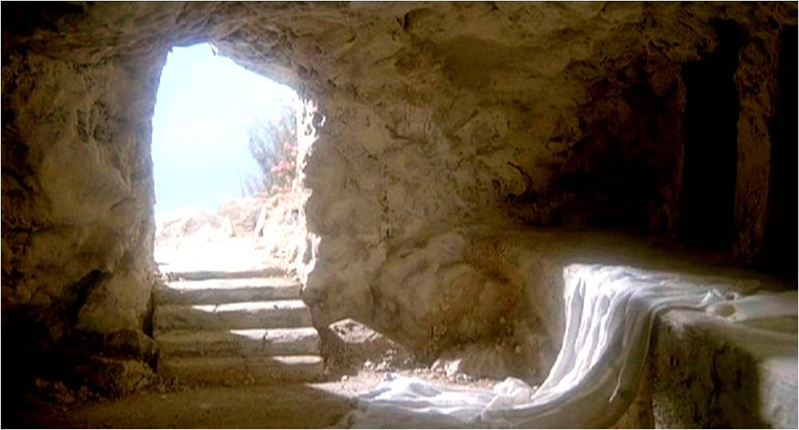
The Doctrine of Christ
Therefore [not] leaving the principles of the doctrine of Christ, let us go on unto perfection; not laying again the foundation of:
repentance from dead works,
and of faith toward God.
of the doctrine of baptisms,
and of laying on of hands,
and of the resurrection of the dead,
and of eternal judgment.
Hebrews 6:1-2 (IV)
Notes:
The fifth principle mentioned in Hebrews is resurrection of the dead.

Slide 59
Resurrection
. . . he is risen, as he said.
Matthew 28:6
Notes:
Jesus predicted that he would be resurrected, and then he actually was.

Slide 60
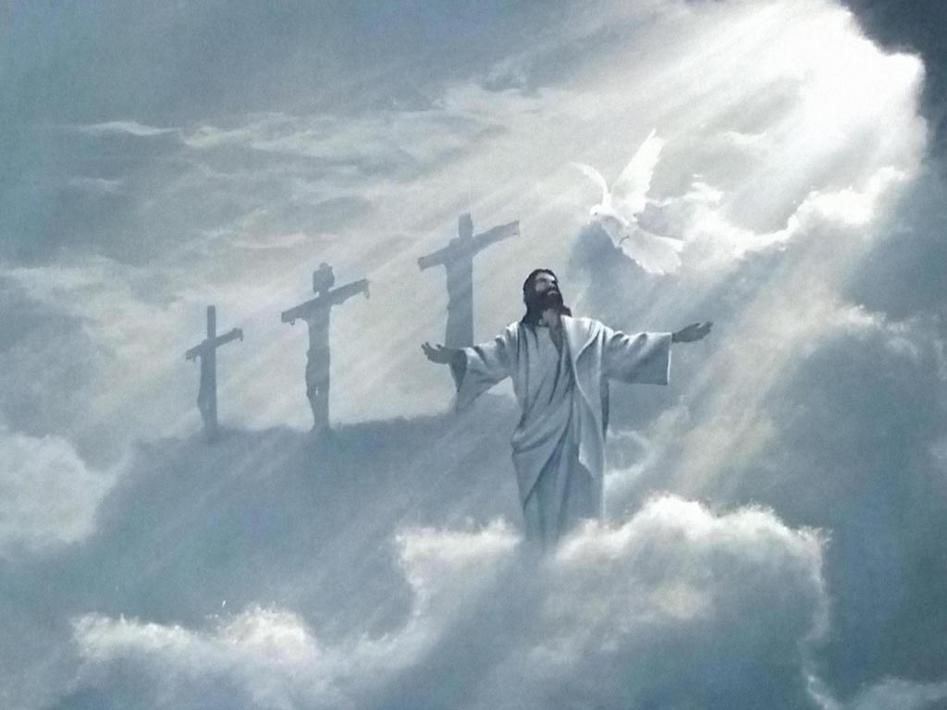
Resurrection
And then [in the last days] shall they see the Son of man coming in a cloud with power and great glory. And when these things begin to come to pass, then look up, and lift up your heads; for your redemption draweth nigh.
Luke 21:27-28
Notes:
Jesus’ Return in the Last Days
Just as Christ ascended in glory, he shall once again return in the same manner to claim those who have committed their lives to him.

Slide 61
Resurrection
Resurrection
This is the first resurrection. Blessed and holy is he that hath part in the first resurrection: on such the second death hath no power, but they shall be priests of God and of Christ, and shall reign with him a thousand years. Revelation 20:5-6
Notes:
The apostle John, writing in the book of Revelation, calls this the first resurrection and says that faithful believers will reign with him 1,000 years.

Slide 62
Resurrection
If in this life only we have hope in Christ, we are, of all men, most miserable. But now is Christ risen from the dead, and become the firstfruits of them that slept. For since by man came death, by man came also the resurrection of the dead. For as in Adam all die, even so in Christ shall all be made alive. 1 Corinthians 15:19-22
Notes:
In the garden of Eden, Adam sinned and experienced a spiritual separation from the presence of God. That original sin was passed down to all generations of people. Christ, who willingly took on the form of a man and was sacrificed on a cross, brought redemption to all of humanity.

Slide 63
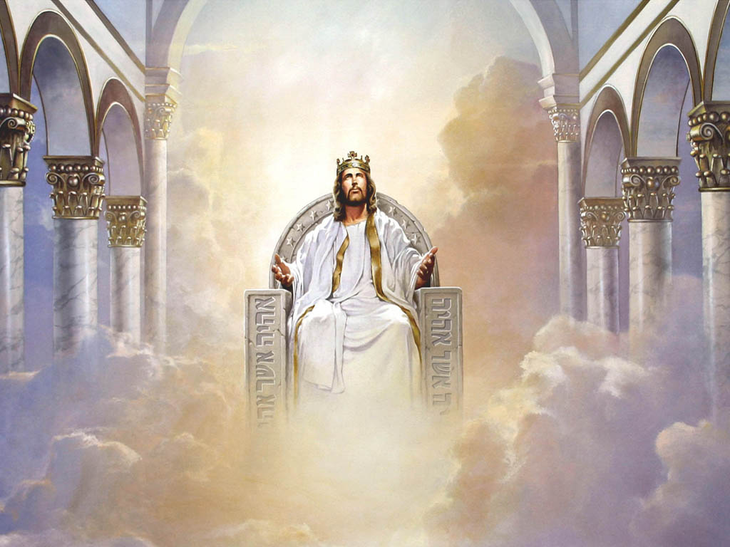
The Doctrine of Christ
Therefore [not] leaving the principles of the doctrine of Christ, let us go on unto perfection; not laying again the foundation of:
repentance from dead works,
and of faith toward God.
of the doctrine of baptisms,
and of laying on of hands,
and of the resurrection of the dead,
and of eternal judgment.
Hebrews 6:1-2 (IV)
Notes:
The final doctrine mentioned in Hebrews 6 is eternal judgment.

Slide 64
Eternal Judgment
For we must all appear before the judgment seat of Christ; that everyone may receive the things done in his body, according to that he hath done, whether it be good or bad.
2 Corinthians 5:10
Notes:
Everyone will stand before the judgment seat. Everyone will be called to give an accounting for what they have done on this earth.

Slide 65
Eternal Judgment
And I saw the dead, small and great, stand before God; and the books were opened: and another book was opened, which is the book of life: and the dead were judged out of those things which were written in the books, according to their works. Revelation 20:12
Notes:
There is a detailed record being kept in heaven.

Slide 66
Eternal Judgment
When the Son of man shall come in his glory, and all the holy angels with him, then shall he sit upon the throne of his glory. And before him shall be gathered all nations . . .
Matthew 25:31-32
Notes:
Jesus will sit on his throne in glory to judge.

Slide 67
Eternal Judgment
. . . and he shall separate them one from another, as a shepherd divideth his sheep from the goats. And he shall set the sheep on his right hand, but the goats on the left. Then shall the King say unto them on his right hand, Come, ye blessed of my Father, inherit the kingdom prepared for you from the foundation of the world. Matthew 25:32-34
Notes:
The sheep on his right hand and the goats on his left hand. The sheep shall receive eternal life. How do we fall into the category of a sheep or goat? See the next slide.

Slide 68
Eternal Judgment
. . . Then shall he say also unto them on the left hand, Depart from me, ye cursed, into everlasting fire, prepared for the devil and his angels: for I was an hungered, and ye gave me no meat; I was thirsty, ye gave me no drink. I was a stranger, and ye took me not in: naked, and ye clothed me not: sick, and in prison, and ye visited me not . . . And these shall go away into everlasting punishment: but the righteous into life eternal. Matthew 25:41-43 & 46
Notes:
Goats on his left hand will be condemned to hell for eternity. In this analogy, a goat is one who never bothered to served Christ in any way.

Slide 69
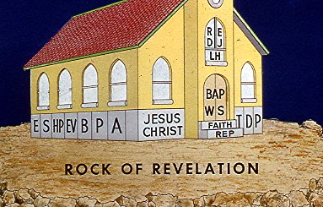
Notes:
So resurrection of the dead and eternal judgment are added to the doctrines of Christ in this illustration of Christ’s church.

Slide 70
Gifts of the Spirit
For our gospel came not unto you in word only, but also in power, and in the Holy Ghost, and in much assurance.
1 Thessalonians 1:5
Notes:
This power was the distinguishing and edifying feature of the Christian movement.

Slide 71
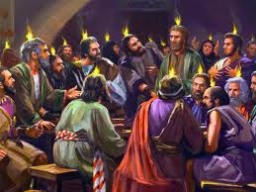
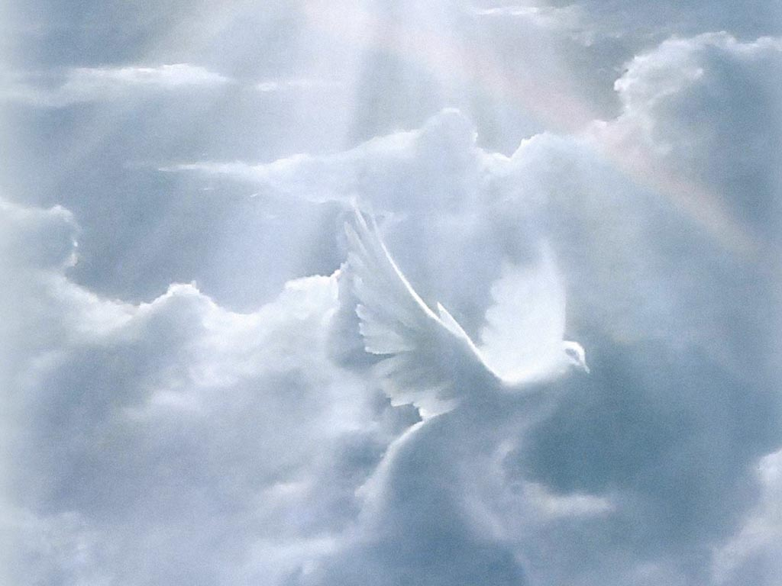
Day of Pentecost
And suddenly there came a sound from heaven as of a rushing mighty wind, and it filled all the house where they were sitting. And there appeared unto them cloven tongues like as of fire, and it sat upon each of them. And they were all filled with the Holy Ghost, and began to speak with other tongues . . . the multitude came together and were confounded, because that every man heard them speak in his own language. Acts 2:2-4
And suddenly there came a sound from heaven as of a rushing mighty wind, and it filled all the house where they were sitting. And there appeared unto them cloven tongues like as of fire, and it sat upon each of them. And they were all filled with the Holy Ghost, and began to speak with other tongues, as the Spirit gave them utterance . . . . the multitude came together and were confounded, because that every man heard them speak in his own language. Acts 2:2-4

Slide 72
Gifts of the Spirit
And it shall come to pass in the last days, saith God, I will pour out of my Spirit upon all flesh; and your sons and your daughters shall prophesy, and your young men shall see visions, and your old men shall dream dreams.
Acts 2:17
Notes:
In the last days, it is prophesied that we will once again witness the gifts of the Spirit, such as prophecy and visions.

Slide 73
Gifts of the Spirit
8 For to one is given by the Spirit the word of wisdom; to another the word of knowledge by the same Spirit;
9 To another faith by the same Spirit; to another the gifts of healing by the same Spirit;
10 To another the working of miracles; to another prophecy; to another discerning of spirits; to another divers kinds of tongues; to another the interpretation of tongues;
11 But all these worketh that one and the selfsame Spirit, dividing to every man severally as he will.
1 Corinthians 12:8-11
Notes:
Spiritual gifts are designed by God to uplift and edify the body of Christ. Though it was manifested in various ways, every gift originated from one and the same Spirit.

Slide 74
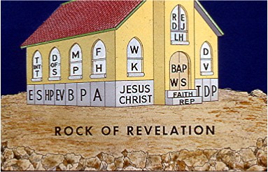
Notes:
The gifts of the Spirit are like the light that shines into the windows of the church. They include:
Tongues and Interpretation of Tongues Healing
Discerning of Spirits Wisdom
Miracles Knowledge
Prophecy Dreams
Faith Visions

Slide 75
Stewardship
As every man hath received the gift, even so minister the same one to another, as good stewards of the manifold grace of God. 1 Peter 4:10
So then every one of us shall give account of himself to God.
Romans 14:12
Notes:
As a result of the ministry received as a part of Christ’s church, it is a natural result that we recognize God’s ownership of our time, our talents and possessions. We are merely stewards over that which he has given us.

Slide 76
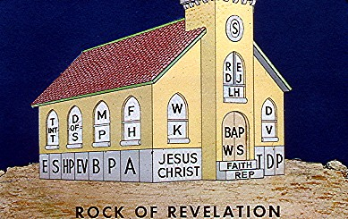
Notes:
Here we see the principle of stewardship is one characteristic of Christ’s church.

Slide 77
Love
Jesus said unto him, Thou shalt love the Lord thy God with all thy heart, and with all thy soul, and with all thy mind. This is the first and great commandment. And the second is like unto it; Thou shalt love thy neighbor as thyself. Matthew 22:36-38

Slide 78
Love
We know that we have passed from death unto life, because we love the brethren. He that loveth not his brother abideth in death.
1 John 3:14
Notes:
This actually is the real test of salvation, the way that we can discern a true believer – that he has a genuine love for the body of Christ.

Slide 79
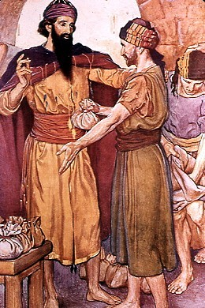
The Needs of All Were Met
And they continued steadfastly in the apostles’ doctrine and fellowship, and in breaking of bread, and in prayers. And fear came upon every soul: and many wonders and signs were done by the apostles. And all that believed were together, and had all things common, and sold their possessions and goods, and parted them to all men, as every man had need.
Acts 2:42-45
Notes:
Since there were righteous men to lead the people of Christ’s New Testament church, the people felt confident that they could share all of their possessions to help their fellow believers.

Slide 80
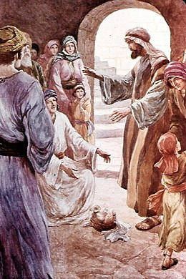
The Power of God’s Spirit Was So Strong That They Were Willing to Sacrifice Everything
Neither was there any among them that lacked: for as many as were possessors of lands or houses sold them, and brought the prices of the things that were sold, and laid them down at the apostles’ feed: and distribution was made unto every man according as he had need. Acts 4:34-35
Notes:
This was a total, unreserving sacrifice on the part of believers who owned houses.

Slide 81
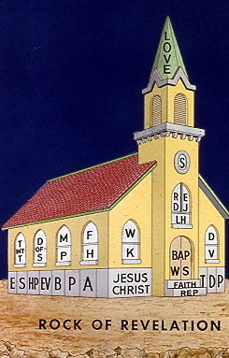
. . . I will build my church.
Matthew 16:18
Notes:
We started this lesson by quoting Jesus in Matthew 16 stating that he would build his church.

Slide 82
Therefore whosoever heareth these sayings of mine, and doeth them I will liken him unto a wise man, which built his house upon a rock. And the rain descended, and the floods came, and the winds blew, and beat upon that house: and it fell not: for it was founded upon a rock.
Matthew 7:26-27
Notes:
It is not enough to simply hear Christ’s gospel and do nothing. We are all called to put the principles he has taught us into practice.

Slide 83
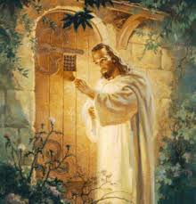
Behold, I stand at the door, and knock: if any man hear my voice, and open the door, I will come in to him, and will sup with him, and he with me.
Revelation 3:20

Slide 85
APPENDIX

Slide 86
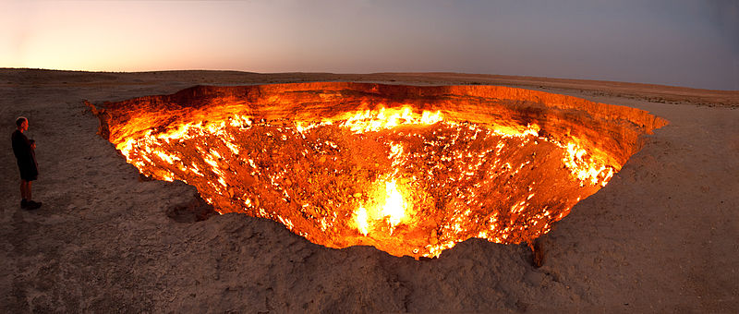
The Gates of Hell Shall Not Prevail Against the Church

Slide 87
The Gates of Hell Shall Not Prevail Against the Church
And I say also unto thee, That thou art Peter, and upon this rock I will build my church; and the gates of hell shall not prevail against it. Matthew 16:18
The phrase “and the gates of hell shall not prevail against it” is often used by certain people to suggest that Christ’s church will remain intact without interruption throughout history. They point to, what they believe to be, a continuous succession of the church down through the centuries until our day. Therefore, there was no apostasy; all the church needed was a little reforming.

Slide 88
The Gates of Hell Shall Not Prevail Against the Church
But what does it mean to “prevail”? Does that necessarily mean that the church will remain intact throughout history?
Consider the analogy of a football game that lasts for one hour. Let’s say that the other team dominates the score and maintains a 20-point lead for 55 minutes of the game. Suddenly, in the last five minutes, our team scores three quick touchdowns and wins the game. Which team has “prevailed” in that example? It would be the team that was ahead at the end of the game. Even though the opposition had the higher score continuously for 55 minutes, our team “prevailed.”

Slide 89
The Gates of Hell Shall Not Prevail Against the Church
It is true that “the gates of hell shall not prevail against” Christ’s church. But it is misleading to infer that there will never be an apostasy and therefore no need for a restoration of Christ’s gospel. Christ leaves people’s agency or free will intact, and the battle between good and evil continues.
Just like the score in a football game, the lead can potentially swing back and forth, but we know who will eventually win the struggle. The Lord Jesus will be victorious. He will conquer his enemies. All of creation will submit to his will. Eventually, every knee will bow and every tongue will confess that he is Lord. In this sense, the gates of hell shall not prevail against his church.

Slide 91
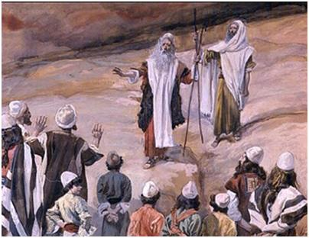
Korah’s Rebellion

Slide 92
Priesthood of All Believers
Ye also, as lively stones, are built up a spiritual house, an holy priesthood, to offer up spiritual sacrifices, acceptable to God by Jesus Christ . . . But ye are a chosen generation, a royal priesthood, an holy nation, a peculiar people; that ye should show forth the praises of him who hath called you out of darkness into his marvelous light.
1 Peter 2:5 & 9
Protestant churches frequently use 1 Peter to suggest that when Jesus died on the cross, a priesthood of all believers replaced the priesthood of Aaron.
The above passage tells us that members of Christ’s church have sacred duties, but nowhere does it state that ministerial duties were passed to the general membership of Christ’s church.

Slide 93
Priesthood of All Believers
Church members have sacred duties that are described in scripture, but that does not mean responsibilities of the minister were passed to the general membership. The duties of membership can co-exist with the ministerial role. The two are not mutually exclusive.
For example, there was an Old Testament church, and Exodus 19 tells us that the Lord also referred to that church as a kingdom of priests:
And ye shall be unto me a kingdom of priests, and an holy nation. Exodus 19:6
In the Old Testament church, the ministry had exclusive duties which co-existed with the duties of the individual believers. In the New Testament church, ministers had exclusive responsibilities. In Christ’s church today, the ministry have exclusive duties as well.

Slide 94
Korah’s Rebellion
Korah's Rebellion refers to a revolt in Moses' time in which 250 famous leaders among the “priesthood of all believers” attempted to replace the ministerial priesthood that God had called:
And they rose up before Moses, with certain of the children of Israel, two hundred and fifty princes of the assembly, famous in the congregation, men of renown. And they gathered themselves together against Moses and against Aaron, and said unto them, Ye take too much upon you, seeing all the congregation are holy, every one of them, and the Lord is among them. Wherefore then lift ye up yourselves above the congregation of the Lord?
Numbers 16:2-3
This is the very same argument that
Protestants use today.

Slide 95
Korah’s Rebellion
Much like today, Korah and his followers attempted to usurp the authority of God's ministers by calling themselves to minister. How did God respond to their demand that all believers administer holy ordinances?
All 250 were swallowed by the earth, and 14,700 of their supporters were stricken by a plague (Numbers 16:31-50).

Slide 96
Korah’s Rebellion
In Jude, the NIV Bible warns us that a rebellion like Korah’s will happen again in the future:
v. 4 “godless men, who change the grace of our God into a license for immorality . . .”
v. 10 “Yet these men speak abusively against whatever they do not understand; and what things they do understand by instinct, like unreasoning animals – these are the very things that destroy them.”
v. 11 “Woe to them! They have taken the way of Cain; they have rushed for profit into Balaam’s error; they have been destroyed in Korah’s rebellion.”
(The IV and KJV Bibles say “Core’s rebellion.”)

Slide 97
Korah’s Rebellion
Today, we see a Protestant culture that rebels against the idea of priesthood ministry and their exclusive duties.
This was not pleasing to God in Numbers 16, but Jude warns us that Korah’s rebellion will occur again.

Slide 99
Is Baptism Necessary for Salvation?

Slide 100
Does Baptism Save?
And now why tarriest thou? arise, and be baptized, and wash away thy sins, calling on the name of the Lord.
Acts 22:16
20 Which sometime were disobedient, when once the longsuffering of God waited in the days of Noah, while the ark was a preparing, wherein few, that is, eight souls were saved by water.
21 The like figure whereunto even baptism doth also now save us (not the putting away of the filth of the flesh, but the answer of a good conscience toward God,) by the resurrection of Jesus Christ.
1 Peter 3:20-21

