Slide 1
What Difference Does the Gospel Make?
Bible references are from the King James Version unless otherwise indicated.
Copyright © 2013 by Church of Jesus Christ – Restoration Branches. Unauthorized use or duplication of this material without express and written permission from the Church of Jesus Christ – Restoration Branches is strictly prohibited.

Slide 2

Why Am I Here?
Philosophers say that life is meaningless, but Jesus tells us that we were created and placed here for a divine purpose.
Notes:
For example, existentialism, which was taught by philosophers like Jean Paul Sartre, is the predominant view being taught in schools today.
This philosophy includes the idea that life is meaningless, that there is no such thing as a good person or a bad person. But Jesus gives us a message of hope and tells us that there is a divine purpose in this mortal existence.

Slide 3
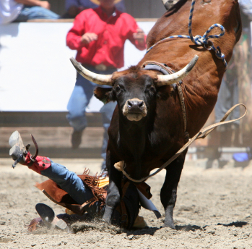
Why do bad things happen? Is there hope for me? Where can I find the strength to deal with life’s challenges?
Notes:
Everyone wants to find answers to problems they are dealing with, or at least, to find the strength to endure difficult circumstances.

Slide 4

Philosophers say that life is meaningless, but Jesus tells us that we were created and placed here for a divine purpose.
I am come that they might have life, and that they might have it more abundantly. John 10:10
. . men are that they might have joy.
2 Nephi 1:115
And this is life eternal, that they might know thee the only true God, and Jesus Christ, whom thou hast sent. John 17:3
Notes:
Scripture tells us that there is a Creator who wants us to have a more abundant life, filled with joy, a life that will last forever, and that comes from a relationship with Jesus Christ.

Slide 5
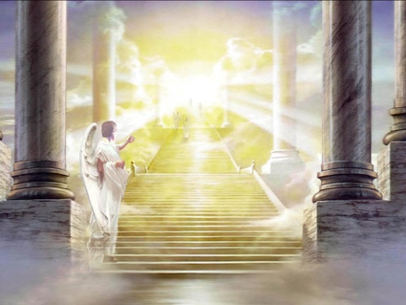
The Promise of Eternal Life
Atheists say that at death we simply cease to exist, but Jesus tells us there is a spirit in each person that will continue after death. The spirit leaves the physical body and goes before the Creator to be judged.
Notes:
What happens when we die? Do we simply cease to exist? Is there really a spirit inside of us that continues after this physical body is gone? Will we really have to give an account for what we have done in this life?

Slide 6
The Promise of Eternal Life
T
Then shall the dust return to the earth as it was: and the spirit shall return unto God who gave it. Ecclesiastes 12:7
. . . it is appointed unto men once to die, but after this the judgment. Hebrews 9:27
Notes:
Scripture tells us that, when we leave this earth, we will return to the God who created us.

Slide 7
The Promise of Eternal Life
For God so loved the world, that he gave his only begotten Son, that whosoever believeth in him should not perish, but have everlasting life. John 3:16
Notes:
“Everlasting life” means to live in God’s presence. If we believe in him, we will live in his presence.

Slide 8
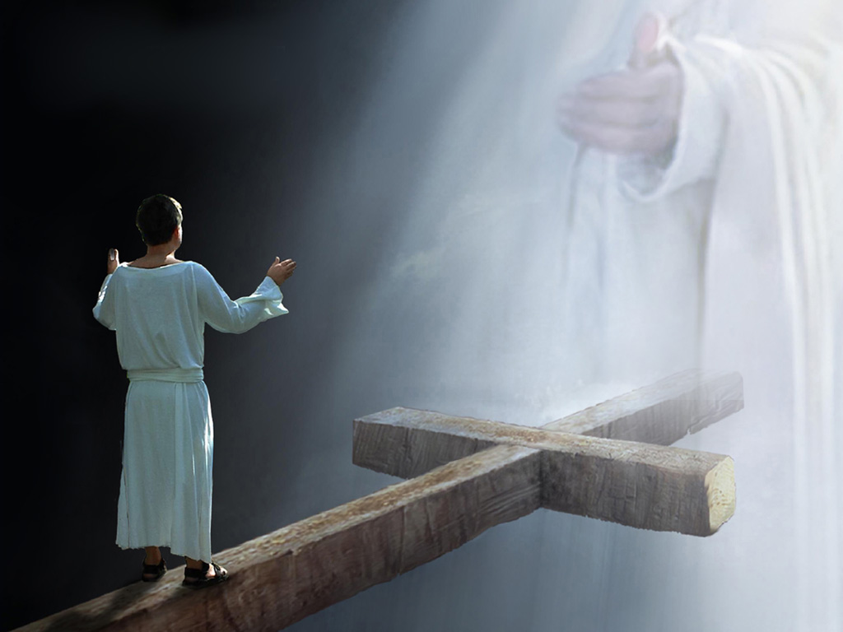
A loving God gives us laws to teach and guide us. “Sin” occurs when we violate his law. Sin separates us from him.
God is a God of justice and mercy
Notes:
“Justice” refers to the fact that there are laws that let us know the right way to live. “Sin” occurs when we violate his commandments. “Mercy” refers to the fact that God provides a way for sinners to return to him. But to be a just God, he must do this without compromising his law.

Slide 9
The consequence for sin is eternal separation from God – a spiritual death. But God is merciful and can forgive our sin.
God is a God of justice and mercy
Notes:
“Physical death” means that our mortal bodies will come to an end. “Spiritual death” refers to the fact that our sins have the potential to separate us from the presence of God for eternity. But there is a way back represented, in this picture, by the cross of Christ.

Slide 10
For all have sinned, and come short of the glory of God. Romans 3:23
God is a God of justice and mercy
Notes:
This applies to every person. We are all sinners, and we need a way to find our way back to God.

Slide 11
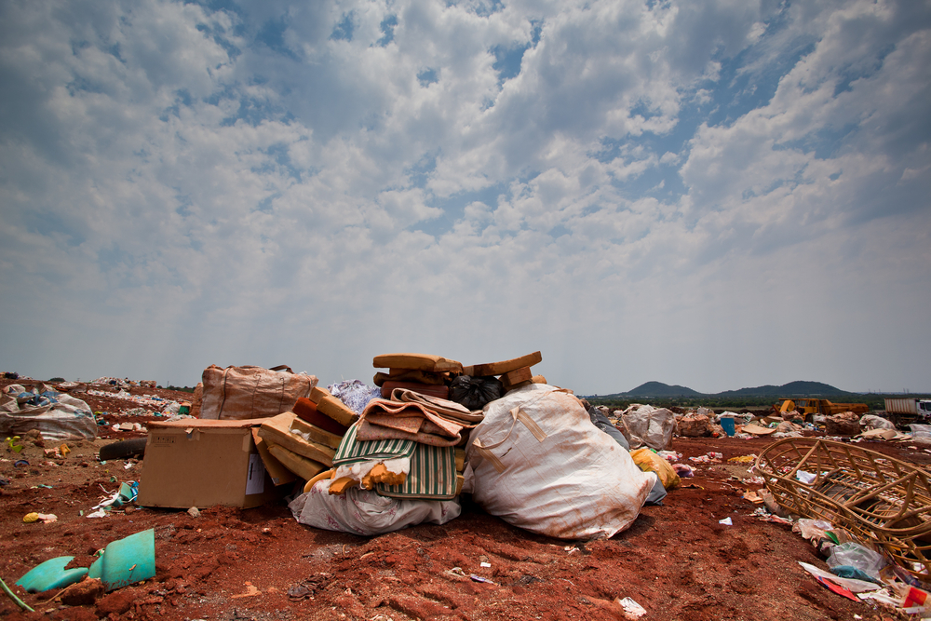
We like to think that we are basically good people, but everyone has sinned. Our sin is like filthy, repulsive trash to God. Through the gospel of Jesus Christ, he wants to help us remove that impurity from our lives.
But we are all as an unclean thing, and all our righteousnesses are as filthy rags; and we all do fade as a leaf; and our iniquities like the wind, have taken us away.
Isaiah 64:6
Notes:
Often we think we have performed a good work that will somehow outweigh the bad we have done. But God says that even the good that we think we are doing is actually like filthy rags. In other words, no amount of good works can possibly undo the damage that our sin has caused. And that sin is repulsive to God. God is 100 % goodness, and his virtue cannot dwell in the presence of our sin.

Slide 12
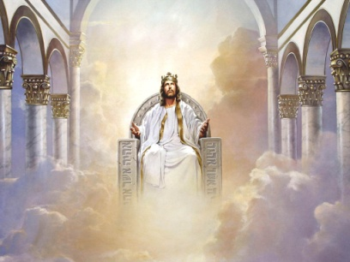
GOD’S JUSTICE
And I saw the dead, small and great, stand before God: and the books were opened: and another book was opened, which is the book of life: and the dead were judged out of those things which were written in the books, according to their works. Revelation 20:12
Notes:
There is a record in heaven of everything we have ever done, every thought, every private moment, even things we have forgotten. We will one day stand before God to account for those works.

Slide 13
GOD’S JUSTICE
And we shall be brought to stand before God, knowing even as we know now, and have a bright recollection of all our guilt.
Notes:
Every sin in our lives will be exposed to the light of day. As we stand before God, there will suddenly be a bright recollection of every bad thing we ever did. Nothing will be forgotten.

Slide 14
GOD’S JUSTICE
And [all people] shall be brought and be arraigned before the bar of Christ the Son, and God the Father, and the Holy Spirit, which is one eternal God, to be judged according to their works, whether they be good or whether they be evil. Alma 8:101 & 104
Notes:
We will be judged before the Father, Son and Holy Spirit.
Note: If necessary, explain the Godhead, which can be confusing: First, there is only one God. Second, God is comprised of three distinct, but equal, persons: the Father, the Son and the Holy Spirit. Thirdly, all three persons in the Godhead have the same essence or nature (i.e., all three are omnipotent, omnipresent and omniscient). This is not three gods, but one God. That is why we frequently use the term “Godhead” to describe this difficult concept.

Slide 15
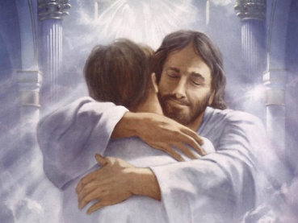
GOD’S MERCY
  Behold, he sendeth an invitation unto all men; for the arms of mercy are extended toward them, and he saith, Repent, and I will receive you. Alma 3:57
Notes:
The choice is ours, but God invites us to choose him. His requirement is that we repent, and he will receive us.

Slide 16
GOD’S MERCY
1 Have mercy upon me, O God, according to thy loving kindness: according unto the multitude of thy tender mercies blot out my transgressions,
2 Wash me thoroughly from mine iniquity, and cleanse me from my sin. Psalm 51:1-2
Notes:
If Christ has cleansed us from sin, we can stand before the judgment bar as forgiven sinners. This cleansing allows us to be in his presence.

Slide 17
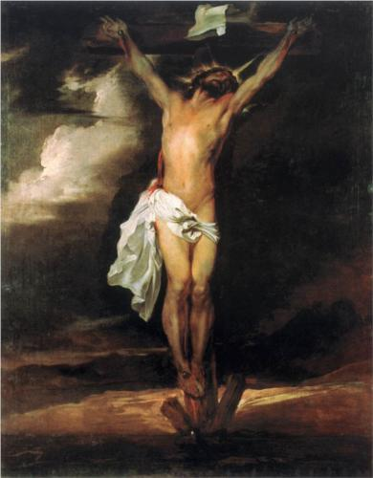
Jesus is the
Son of God
who died for
my sins that
I might have
eternal life.
Notes:
His death atoned for my sins, and by this I can have the gift of eternal life. Remember, in an earlier slide, how we said that God provided a plan of mercy for us to return to him, but he had to do this without compromising his law. He is a merciful God, but he must also simultaneously be a just God. As a result, a sacrifice had to be made on our behalf to fulfill the requirements of God’s law. So God sent his Son to accomplish this task.

Slide 18
96 And thus we see that all mankind were fallen, and they were in the grasp of justice; yea, the justice of God, which consigned them forever to be cut off from his presence;
Notes:
To be “in the grasp of justice” means that our sins have separated us from God for all eternity because we have violated his law.

Slide 19
97 And now the plan of mercy could not be brought about, except an atonement should be made; therefore God himself atoneth for the sins of the world, to bring about the plan of mercy, to appease the demands of justice, that God might be a perfect, just God, and a merciful God also. Alma 19:96-97
Notes:
Because God is a just God, a price had to be paid to save us. This is atonement. Christ paid our debt to God.

Slide 20
Jesus willingly came to earth and sacrificed his life on my behalf to answer the demands of justice.
There aren’t several roads to heaven.
He is the only way to salvation.
Notes:
For centuries, in Old Testament times, people exercised faith in the Messiah to come, and the same gospel saved them as well (this is called the “Antiquity of the Gospel”). Today, we are privileged to look back on Christ’s sacrifice as an actual historical fact. If everyone has sinned and rightly deserves eternal punishment, then Jesus is the only way out of that predicament. There is only one plan of salvation.

Slide 21
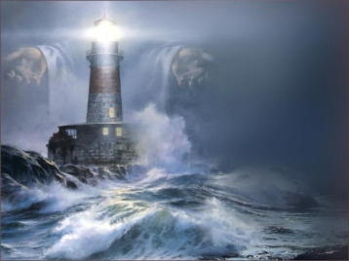
JESUS IS THE WAY
. . . I am the light of the world: he that followeth me shall not walk in darkness, but shall have the light of life.
John 8:12
I am the way, the truth and the life: no man cometh unto the Father, but by me.
John 14:6
Notes:
Jesus is the light and the source of truth. There are not several roads to heaven; Jesus is the only way.

Slide 22
JESUS IS THE WAY
I am the door. If anyone enters by me, he will be saved . . .
John 10:9 (NKJV)
Neither is there salvation in any other: for there is none other name under heaven given among men, whereby we must be saved.
Acts 4:12
Notes:
There is no other name or way by which we can enter the kingdom of God except Jesus Christ.

Slide 23
JESUS IS THE WAY
. . . there is no flesh that can dwell in the presence of God, save it be through the merits, and mercy, and grace of the holy Messiah.
2 Nephi 1:73
. . . there is no other way nor means whereby man can be saved, only in and through Christ.
Alma 18:11
Notes:
Our salvation is entirely due to the merits of Christ and what he has done for us.

Slide 24
JESUS IS THE WAY
. . . for ye have not come thus far, save it were by the word of Christ, with unshaken faith in him, relying WHOLLY upon the merits of HIM who is might to save.
2 Nephi 13:28
Notes:
The word “wholly” means that we rely 100% on the merits of Christ for our salvation. People often mistakenly think that salvation is a formula: my good works plus God’s works = salvation. But any good thing I might do is only due to the grace of God operating in my life. For example, I could not repent or exercise faith or be baptized except by the impulse of his Spirit and his merciful grace toward me. He deserves 100% of the credit for my salvation.

Slide 25
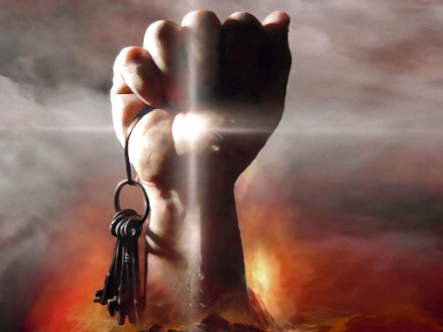
GOD’S GRACE IS THE KEY THAT UNLOCKS HIS POWER IN OUR LIVES
Notes:
How can I have more spiritual power in my life?

Slide 26
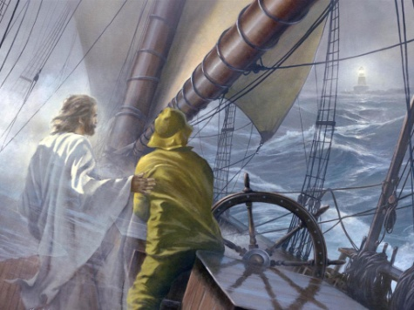
GRACE
God’s power guides us through the storms of life. We obtain more grace through humility.
Notes:
If we want more of God’s power in our lives, we must increase in humility.

Slide 27
Grace is “unmerited favor,” but based on the following scriptures, we see that it is more specifically “the desire and power to do God’s will.”
GRACE
Notes:
When God pours out his blessings upon us, he is showing favor toward us even though we do not deserve it. But grace is more than simply unmerited favor. Grace is the force operating in every person’s life that causes them to do good. This occurs even before we make a commitment to Him.

Slide 28
Nevertheless, the Lord God showeth us our weakness, that we may know that it is by his grace, and his great condescensions unto the children of men, that we have power to do these things.
Jacob 3:8
GRACE
And remember after ye are reconciled unto God, that it is only in and through the grace of God that ye are saved.
2 Nephi 7:42
Notes:
Living with God in eternity is dependent on having his grace in our lives. Power comes by his grace.

Slide 29
But by the grace of God I am what I am: and his grace which was bestowed upon me was not in vain; but I laboured more abundantly than they all: yet not I, but the grace of God which was with me.
1 Cor. 15:10
GRACE
. . . no man can come unto me, except it were given unto him of my Father.
John 6:65
Notes:
It is God’s grace that initially plants the desire in our hearts to come unto him. When we actually do something good in this life, it is entirely due to his grace operating in our lives.

Slide 30
I give unto men weakness, that they may be humble; and my grace is sufficient for all men that humble themselves before me; for if they humble themselves before me, and have faith in me, then will I make weak things become strong unto them. Ether 5:28
GRACE
God resisteth the proud, but giveth grace unto the humble.
James 4:6
Notes:
So the key that unlocks God’s power in our lives is humility. That is how we obtain more of his grace.

Slide 31
Yea, come unto Christ, and be perfected in him, and deny yourselves of all ungodliness, and love God with all your might, mind and strength, then is his grace sufficient for you, that by his grace ye may be perfect in Christ.
Moroni 10:28
GRACE
And you therefore, my son, be strong in the grace that is in Christ Jesus.
1 Timothy 2:1
Notes:
We are instructed to seek to “be strong in his grace.” In Matthew 5:48, we are called to be “perfect” as well. Though we are called to be perfect, this rarely occurs. People have the misconception that this is a call to pull ourselves up by our own strength and achieve perfection by sheer force of will. But being perfect can only occur by the supernatural, miraculous working of God’s power. He merely asks us to submit to his will in humility and allow his power to work in us. Perfection is not a work that we do in our strength. He receives 100% of the credit for perfecting us and molding our lives.

Slide 32
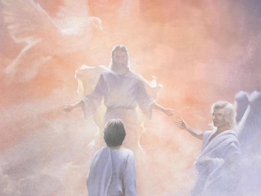
Because we have sinned, it is only by God’s mercy and grace that we can enter into his presence. He calls us to:
have faith in Jesus Christ as Lord and Savior
repent of our sins, and
embrace the holy ordinances of Christ’s gospel.
HOW CAN I HAVE ETERNAL LIFE?
Notes:
The next few slides will discuss faith, repentance and holy ordinances in greater detail.

Slide 33
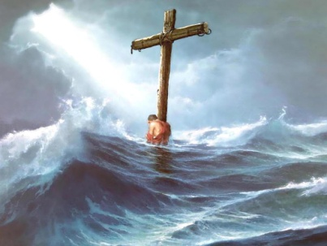
FAITH
FAITH IN JESUS CHRIST AS LORD AND SAVIOR
What if I have trouble believing?
Pray to God and ask him if the gospel of Jesus Christ is true. Ask him for just a small particle of faith that you might believe. God will give you a portion of his grace to grant that gift of faith.
Notes:
In Matthew 9:24, a man who was weak in faith prayed a simple, direct prayer. He said, “Lord, help mine unbelief.” In other words, give me the strength to fight against Satan’s tools of doubt and despair. In the midst of the storms of life – that is the time to cry out to God in utter dependence upon him, giving control entirely to God.

Slide 34
But behold, if ye will awake and arouse your faculties, even to an experiment upon my words, and exercise a particle of faith; yea, even if ye can no more than desire to believe, let this desire work in you, even until ye believe in a manner that ye can give place for a portion of my words.
Alma 16:151
FAITH
. . . believe on the Lord Jesus Christ, and thou shalt be saved...
Acts 16:31
. . . whosoever believeth in Him should not perish, but have everlasting life. John 3:16
Notes:
Faith saves us for eternity. We must let the desire to believe work in our hearts and allow God’s word into our hearts.

Slide 35
FAITH
28 Then said they unto him, What shall we do that we might work the works of God?
29 Jesus answered and said unto them, This is the work of God, that ye believe on him whom he hath sent.
John 6:28-29
44 No man can come to me, except the Father which hath sent me draw him: and I will raise him up at the last day . . .
47 Verily, verily, I say unto you, he that believeth on me hath everlasting life.
John 6: 44 & 47
Notes:
God’s grace first works in us to initiate belief in Jesus Christ. It is a work of God and not of man. The first step in the process of faith is that God draws us unto him. He calls out to every person to have faith. It is up to us to hear that call.

Slide 36
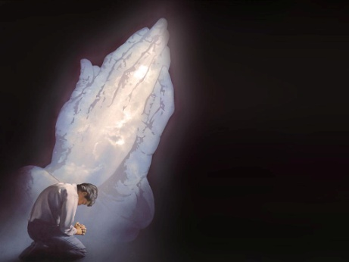
God’s grace plants a remorse for sin in our hearts. When we feel that remorse, we want to seek forgiveness and turn away from our old lives. Repentance will bear fruit. There will be a change in the pattern of sin in our lives. It is God who accomplishes this change in us by his grace.
REPENTANCE
Notes:
In the New Testament, the literal meaning of the Greek term for repentance is “ a change of mind about who Christ is.” Many churches believe that it stops right there, that repentance is simply a change of mind. However, the restored gospel tells us that repentance necessarily involves more than this. True repentance includes a “turning away” from sin – a change in the pattern of sin.

Slide 37
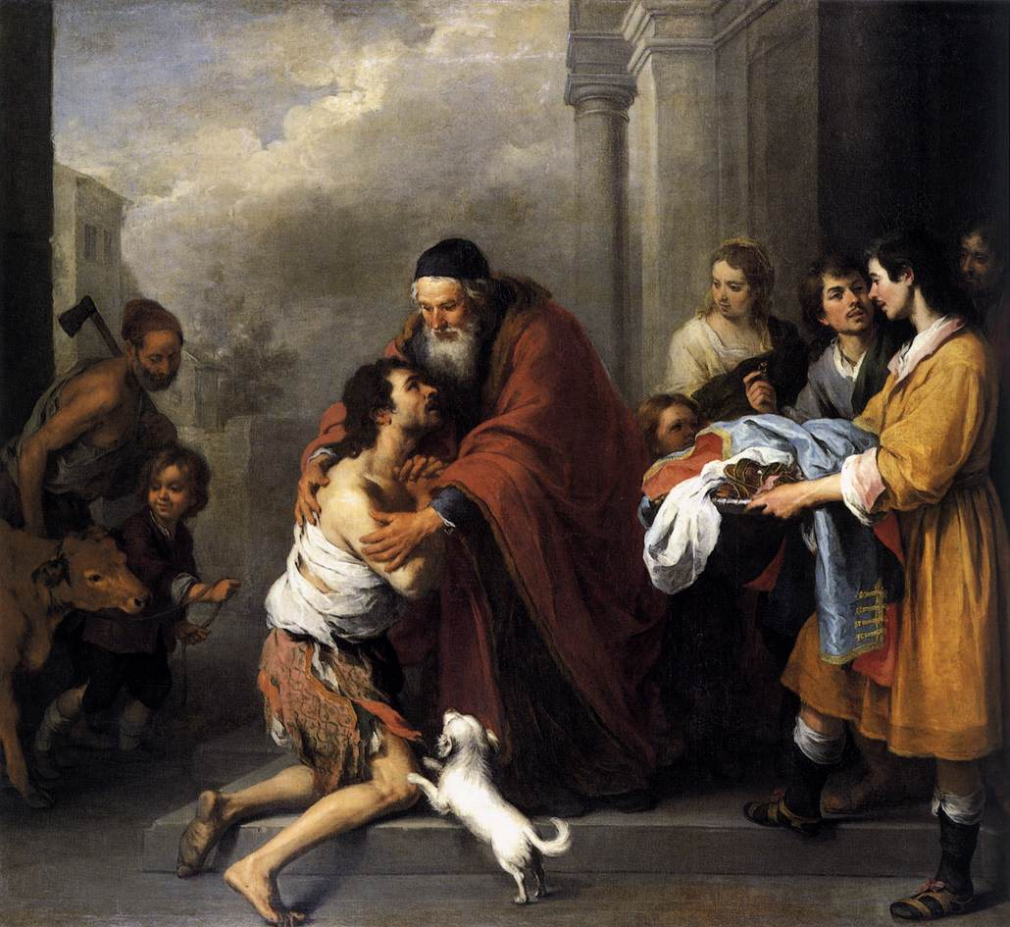
Father, I have sinned against heaven, and in thy sight, and am no more worthy to be called thy son. Luke 15:21
Notes:
The story of the prodigal son is one of the best illustrations of repentance and the relationship that we must have with our Heavenly Father. In the life of the prodigal son, there was a “turning away” from sin.

Slide 38
. . . let us go on unto perfection, not laying again the foundation of repentance from dead works, and of faith toward God . . .
Hebrews 6:3
19 Repent ye therefore, and be converted, that your sins may be blotted out . . .
26 . . . turning away every one of you from his iniquities.
Acts 3:19 & 26
REPENTANCE
Notes:
In our lives, we frequently find ourselves trapped in a repetitive pattern of sinning and repenting and sinning and repenting. Hebrews 6:3 calls us to progress beyond this repetitive pattern and to live a victorious life. Repentance and faith are the foundation that our lives should be built upon, but the Lord wants us to be so submissive to his will that a miraculous change occurs in us, a change that is significant enough for other people to recognize. That is how the world will be changed.

Slide 39
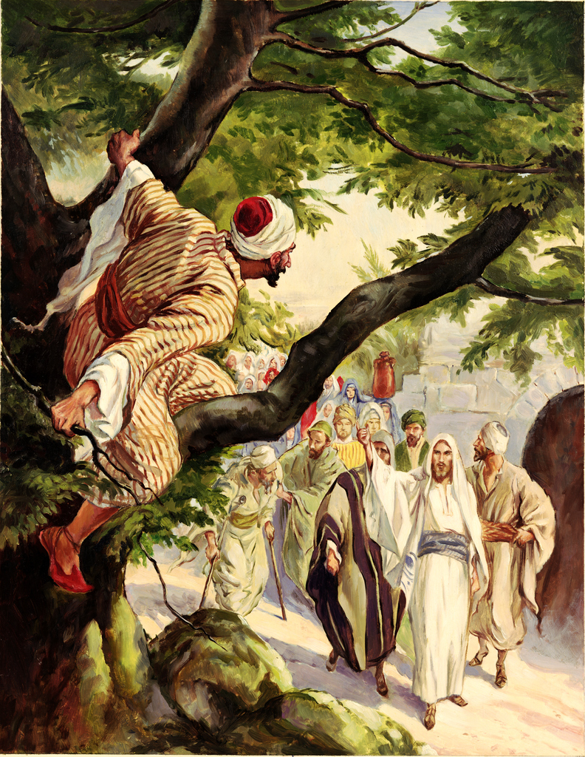
Zacchaeus, make haste, and come down; for today I must abide at thy house
. . . Behold, Lord, the half of my goods I give to the poor; and if I have taken anything from any man by false accusation, I restore him fourfold.
And Jesus said unto him, This day is salvation come to this house . . . for the Son of man is come to seek and to save that which was lost.
Luke 19:1-10
Notes:
The story of Zacchaeus illustrates what will happen when true repentance occurs. It is more than a change of mind about who Christ is. Zacchaeus felt a remorse for sin, but he also sought to make amends with those he had wronged. His repentance bore fruit.

Slide 40
Then hath God also to the Gentiles granted repentance unto life.
Acts 11:18
Bring therefore fruits meet for repentance.
Matthew 3:8
Bring forth therefore fruits worthy of repentance . . . Luke 3:8
REPENTANCE
Notes:
This passage in Acts 11 tells us that repentance has a direct bearing on our eternal destiny. By repentance we enter into eternal life. But true repentance must bear fruit in our lives.

Slide 41
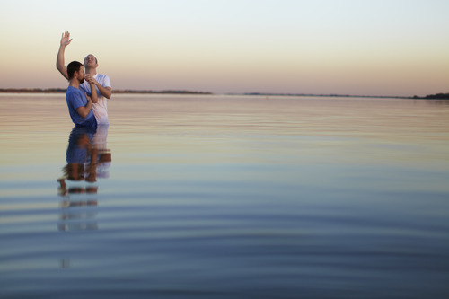
God’s grace stirs us to make a public commitment to him. By submitting to his will in this way, we become sons and daughters of God.
This is not a work that we perform; it is God’s grace operating in the life of the believer that causes this to happen.
BAPTISM
Notes:
Some churches believe that baptism is optional and that it has no bearing on salvation. However, the restored gospel tells us that baptism is a requirement for all believers. Not only is this holy ordinance of God required, but it must be performed in accordance with his will.

Slide 42
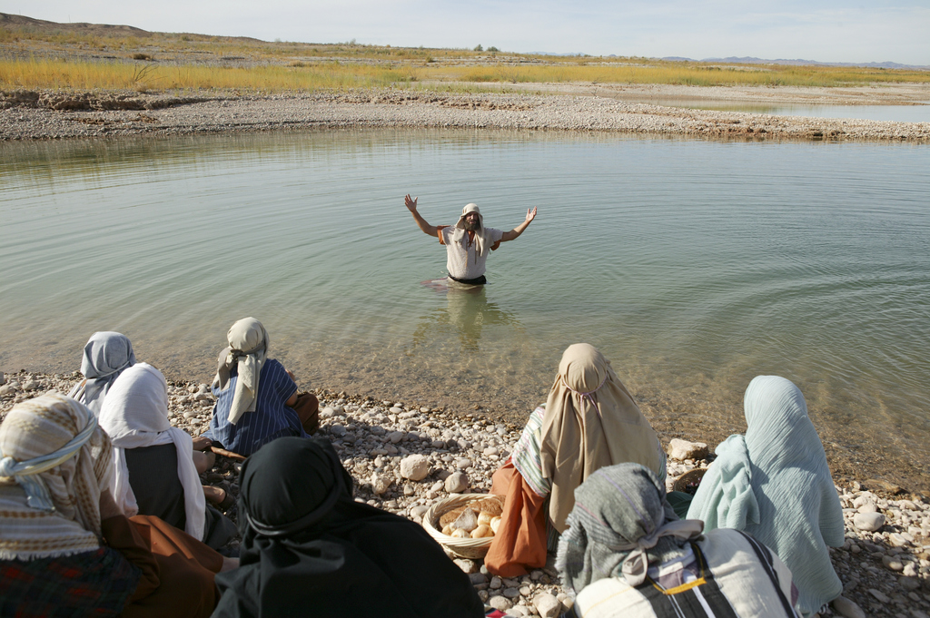
BAPTISM
And he [John the Baptist] came into all the country about Jordan, preaching the baptism of repentance for the remission of sins.
Luke 3:3
Notes:
“For the remission of sins” suggests that true baptism, properly performed, has the ability to save us and place us in a proper relationship with our Heavenly Father.

Slide 43
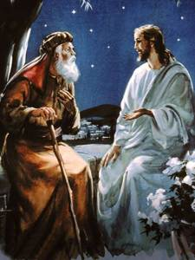
BAPTISM
3 . . . Except a man be born again, he cannot see the kingdom of God.
4 Nicodemus saith unto him, How can a man be born when he is old? Can he enter the second time into his mother’s womb, and be born?
5 . . . Except a man be born of water and of the Spirit, he cannot enter into the kingdom of God.
John 3:3-5
Notes:
To enter the kingdom of God, we must be “born again.” What does that mean? Also, what does it mean to be “born of water”? Some churches teach that “born of water” simply refers to the breaking of water at birth (the sac of amniotic fluid). But how could something like that have any bearing on our salvation? The restored gospel corrects this doctrinal error. It tells us that “born of water” refers to water baptism. We enter into the kingdom of God by being born of water and the Spirit.

Slide 44
4 Therefore we are buried with him by baptism into death: that like as Christ was raised up from the dead by the glory of the Father, even so we also should walk in newness of life.
5 For if we have been planted together in the likeness of his death, we shall be also in the likeness of his resurrection.
Romans 6:4-5
BAPTISM
Notes:
If you were baptized in another church and water was sprinkled or poured on you, that does not represent the death and resurrection of Christ. We must be planted in the likeness of his death and arise in the likeness of his resurrection. This is the only way to “walk in newness of life” as verse 4 instructs us.

Slide 45
48 And he commandeth all men that they must repent and be baptized in his name, having perfect faith in the Holy One of Israel, or they cannot be saved in the kingdom of God.
49 And if they will not repent and believe in his name, and be baptized in his name, and endure to the end, they must be damned.
2 Nephi 6:48-49
BAPTISM
Notes:
Simply being immersed in water is meaningless. Unless we bring the internal conditions of sincere faith and repentance to this holy ordinance, it is not truly baptism. The internal condition of my heart is the key element. This passage in Nephi makes a statement about baptism that is more direct and clear than anything we will find in the Bible. Repent, believe, be baptized and endure to the end in that belief.

Slide 46
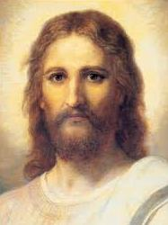
BAPTISM
32 Whosoever therefore shall confess me before men, him will I confess also before my Father which is in heaven.
33 But whosoever shall deny me before men, him will I also deny before my Father which is in heaven.
Matthew 10:32-33
Notes:
Why is baptism important? The Lord requires that we “confess him before men.”

Slide 47
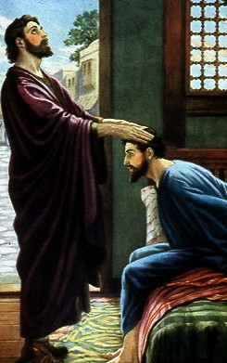
BAPTISM
And now why tarriest thou? Arise, and be baptized, and wash away they sins, calling on the name of the Lord.
Acts 22:16
Notes:
This is Ananias’ instruction to Paul after laying his hands on Paul to cure his blindness. True baptism washes away sin. It is part of God’s plan of salvation.

Slide 48
BAPTISM
The like figure whereunto even baptism doth also now save us (not the putting away of the filth of the flesh, but the answer of a good conscience toward God) by the resurrection of Jesus Christ.
1 Peter 3:21
Notes:
This is another scripture making the point that a proper baptism has an impact on one’s salvation.

Slide 49
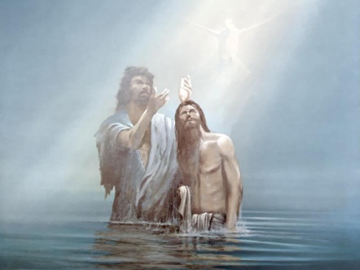
BAPTISM OF WATER
Then cometh Jesus from Galilee to Jordan unto John, to be baptized of him
. . .
16 And Jesus, when he was baptized, went up straightway out of the water: and lo, the heavens were opened unto him
. . .
Notes:
If our Lord Jesus insisted on being baptized, is there a reason why we should not also follow in his steps?

Slide 50
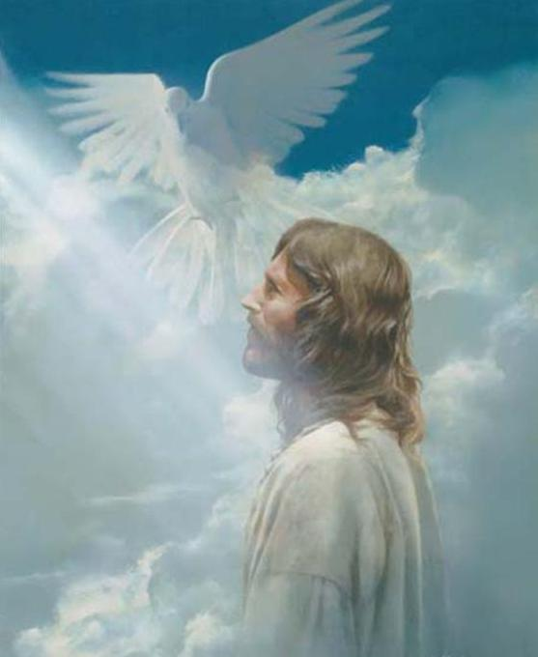
BAPTISM OF THE HOLY SPIRIT
. . . and he saw the Spirit of God descending like a dove
. . . and lo a voice from heaven, saying, This is my beloved Son, in whom I am well pleased.
Matthew 3:16-17
Notes:
Jesus showed us the way to become sons and daughters of God, and this event fulfilled prophecy.
Matthew 3:16-17: “And Jesus, when he was baptized, went up straightway out of the water: and lo, the heavens were opened unto him, and he saw the Spirit of God descending like a dove, and lighting upon him. And lo a voice from heaven, saying, This is my beloved Son, in whom I am well pleased.”
This fulfilled the prophecy given in Psalm 2:7: “Thou art my Son: this day have I begotten thee.”
Baptism in the proper manner is how we become sons and daughters of God.
Jesus was baptized by water and then the Spirit bore witness that he really was the Son of God.

Slide 51
WHAT IF I ALREADY MADE A COMMITMENT TO JESUS IN ANOTHER CHURCH?
Simply being immersed in water is not baptism. The believer must bring faith and a repentant heart and be willing to make a public commitment to Jesus Christ as Lord and Savior of his life (Acts 2:36).
And none were received unto baptism, save they took upon them the name of Christ, having a determination to serve him to the end. Moroni 6:3
BAPTISM
Notes:
Simply being immersed in water is not baptism. Again, the key element is what is in our hearts. What is the understanding that we have when we are baptized? Our understanding entirely alters the meaning of the ordinance. A true faith leads to action. A repentance that saves must include a “turning away from sin,” not just a change of mind about who Christ is. The believer cannot view this as a momentary “acceptance of Christ.” It is Christ who must accept us. We must have a determination to serve him to the end of our lives. In other words, true baptism involves the understanding that Jesus is not simply our Savior, but he must be Lord of our lives. Baptism must represent the death and resurrection of Christ. Scripture requires that holy ordinances be performed by God’s ministers, not as some churches suggest, by a “priesthood of all believers.” This passage in Moroni makes clear that true baptism involves bringing the proper understanding and condition of the heart to this holy ordinance. Otherwise, it is not really baptism.

Slide 52
You may have been baptized in another church but felt that it was ineffective. Baptism, performed properly, represents three things:
Remission of sins
(Acts 22:16; Mosiah 9:40)
Covenant to obey God’s commandments (Acts 2:42; Mosiah 9:41)
Method of entrance into Christ’s church (Acts 2:41; Mosiah 9:50)
If you were previously taught incorrectly about the meaning and purpose of baptism, please consider making a baptismal covenant that is in keeping with the gospel that Jesus taught.
BAPTISM
Notes:
Properly administered, baptism must accomplish all three functions described in this slide. For example, in many churches, they teach that baptism has no impact on salvation. This entirely undermines the meaning of this holy ordinance. If you were baptized in another church that did not teach the above principles, you should consider being re-baptized properly by a minister of Christ’s gospel.

Slide 53
Little children do not have the capacity to make this kind of commitment.
10 . . . I know that it is solemn mockery before God, that ye should baptize little children . . .
25 For behold that all little children are alive in Christ, and also all they that are without the law.
26 For the power of redemption cometh on all they that have no law; wherefore, he that is not condemned, or he that is under no condemnation, cannot repent; and unto such baptism availeth nothing.
Moroni 8:10, 25-26
BAPTISM
Notes:
Some churches baptize little children by pouring water on their heads to free them from the burden of Original Sin. However, this is an entirely meaningless exercise and has no basis in scripture. Little children and those who have never been taught the gospel cannot repent. And without repentance, baptism has no meaning.

Slide 54
1 Paul . . . came to Ephesus; and finding certain disciples,
2 He said unto them, Have ye received the Holy Ghost since ye believed? And they said unto him, We have not so much as heard whether there be any Holy Ghost.
3 And he said unto them, Unto what then were ye baptized? And they said, Unto John’s baptism.
BAPTISM
4 Then said Paul, John verily baptized with the baptism of repentance, saying unto the people, that they should believe on him which should come after him, that is, on Christ Jesus.
5 When they heard this, they were baptized in the name of the Lord Jesus.
And when Paul had laid his hands upon them, the Holy Ghost came on them . . . Acts 19:1-6
Notes:
Re-baptism has a precedent in scripture. Again, our understanding of the ordinance at the time we are baptized is the key element. These 12 men at Ephesus had been baptized without understanding the need for repentance and without looking to the Messiah to come for their salvation. In verse 4, Paul instructed them regarding the things they had not previously understood. He then baptized them and laid hands on them for the reception of the Holy Spirit. This is the order that God commands his ministers to follow today.

Slide 55
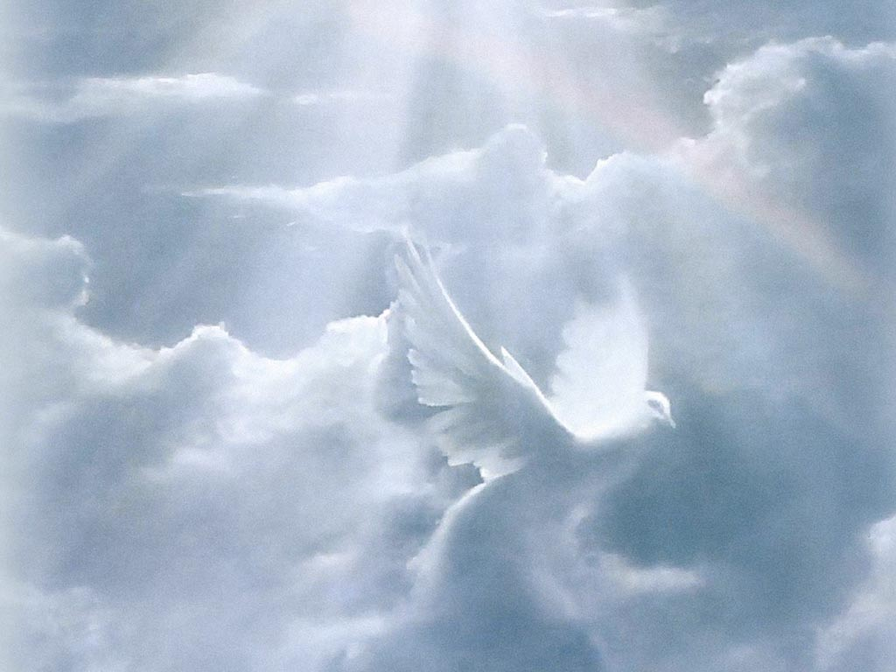
THE GIFT OF THE HOLY SPIRIT
Faith, repentance and water baptism are all evidences that God is operating in our lives by the power of his spirit. When we surrender to his will in this way, God wishes to bestow upon us a degree of his spirit called “the gift of the Holy Spirit.” This is the Comforter that Jesus promised would guide us throughout our lives.
Notes:
What is the gift of the Holy Spirit? When we look back on our lives, God’s Spirit has always been present to some degree. However, when we make a commitment to Christ, he wishes to bestow a greater degree of his Spirit upon us.
Protestant churches teach that, at the point of initial conversion (the moment that someone understands Jesus is the Savior), every person has received this degree of God’s Spirit. But in Acts 2, the people at Jerusalem had been converted and accepted the message that Peter was preaching, yet Peter promised them “ye shall receive the gift of the Holy Ghost [future tense].” They were converted but they had not yet received this gift of the Holy Spirit.
In the Catholic church, babies are baptized, and then around 12 to 14 years old they receive confirmation. Babies do not have the capacity to repent, and new believers need the gift of the Holy Spirit as soon as they can make a genuine commitment to Christ.

Slide 56
THE GIFT OF THE HOLY SPIRIT
But when the Comforter is come, whom I will send unto you from the Father, even the Spirit of truth, which proceedeth forth from the Father, he shall testify of me. John 15:26
3 . . . Except a man be born again, he cannot see the kingdom of God.
Except a man be born of water and of the Spirit, he cannot enter into the kingdom of God.
John 3:3 & 5
Notes:
The Holy Spirit, or Spirit of truth, will testify of Jesus Christ. We must ask God for that testimony.

Slide 57
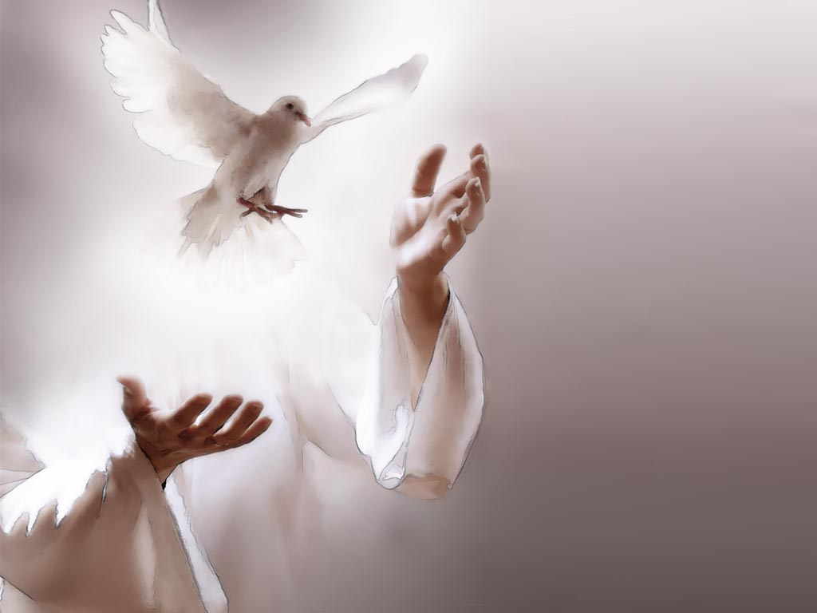
THE GIFT OF THE HOLY SPIRIT
But when they believed Philip preaching the things concerning the kingdom of God and the name of Jesus Christ, they were baptized. . . Now when the apostles which were at Jerusalem heard that Samaria had received the word of God, they sent unto them Peter and John, who when they were come down, prayed for them, that they might receive the Holy Ghost. (For as yet he was fallen upon none of them: only they were baptized in the name of the Lord Jesus.) Then laid they their hands on them, and they received the Holy Ghost. Acts 8:12-17
Notes:
This is another example of laying on hands to receive the gift of the Holy Spirit. The people in Samaria believed the preaching of Philip and embraced the gospel. Philip baptized them, but he did not grant the gift of the Holy Spirit. This indicates that there were different functions among church ministers because Peter and John came to Samaria to pray for them that they might receive this gift.

Slide 58
THE GIFT OF THE HOLY SPIRIT
And when Paul had laid his hands upon them, the Holy Ghost came on them; and they spake with tongues, and prophesied.
Acts 19:6
Neglect not the gift that is in thee, which was given thee by prophecy, with the laying on of the hands of the presbytery.
1 Timothy 4:14
. . . stir up the gift of God, which is in thee by the putting on of my hands.
2 Timothy 1:6
Notes:
When Paul laid hands on the 12 men at Ephesus to receive the gift of the Holy Spirit, the Spirit came upon them in such power that they spoke in tongues and prophesied.

Slide 59
THE GIFT OF THE HOLY SPIRIT
37 Now when they heard this, they were pricked in their heart, and said unto Peter and to the rest of the apostles, "Men and brethren, what shall we do?"
38 Then Peter said unto them, "Repent, and be baptized every one of you in the name of Jesus Christ for the remission of sins, and ye shall receive the gift of the Holy Ghost.
Acts 2:37-38
Notes:
Peter instructed his audience to be baptized for the remission of sins. He then promised that they would receive the gift of the Holy Spirit.

Slide 60
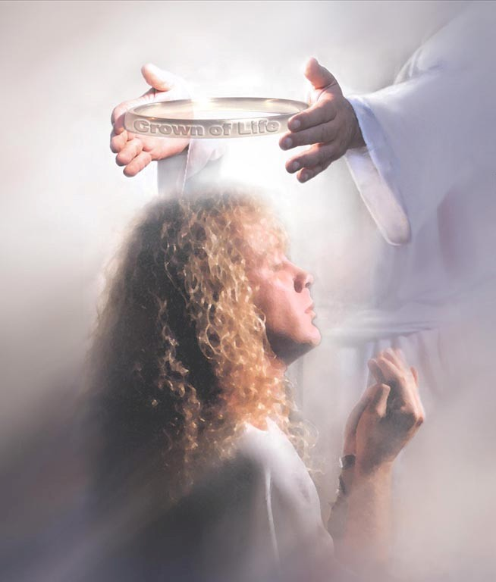
ENDURE TO THE END
God, in his grace, continues to extend the gift of agency to all people, even after we have made a commitment to him. Throughout our lives, we must continue to remain faithful to the testimony of Christ’s gospel.
ENDURE TO THE END
Notes:
Some churches teach the concept of “once saved, always saved.” The theological term for this is “perseverance” or “eternal security.” It is their mistaken notion that salvation has such a powerful hold on the believer that he can never fall from his saved condition. However, such a view undermines the role that agency or free will plays in the life of the believer and it lulls the faithful into a kind of spiritual complacency. After we have made our commitment to Christ, we must diligently resist the strategy of Satan who would have us fall from grace and who seeks to attack believers and frustrate the purposes of God.

Slide 61
ENDURE TO THE END
But he that shall endure unto the end, the same shall be saved.
Matthew 24:13
Notes:
This phrase “but he that shall endure to the end” suggests that there are those who do not endure to the end in their testimony of Christ’s gospel. Only those who endure to the end will be saved.

Slide 62
ENDURE TO THE END
20 He that endureth to the end, the same shall be saved.
21 And now, my beloved brethren, I know by this, that unless a man shall endure to the end, in following the example of the Son of the living God, he cannot be saved.
2 Nephi 13: 20-21
Notes:
Nephi seems to agree with Matthew that enduring to the end is a requirement for salvation.

Slide 63
4 For it is impossible for those who were once enlightened, and have tasted of the heavenly gift, and were made partakers of the Holy Ghost.
5 And have tasted the good word of God, and the powers of the world to come,
6 If they shall fall away, to renew them again unto repentance; seeing they crucify to themselves the Son of God afresh, and put him to an open shame. Hebrews 6:4-6
ENDURE TO THE END
Notes:
This passage in Hebrews is talking about believers who have received the gift of the Holy Spirit who then fall away from the truth. In other words, they did not endure to the end.
Many of our Protestant friends would say that, if someone fell away, they were never truly converted in the first place. However, if we examine this passage, it makes clear that the people described here were definitely “partakers of the Holy Ghost.” Hebrews is talking about those who were truly, genuinely converted to the gospel but then fell away from the truth. Why is this important? It is crucial to understand that, after we have made our commitment, we will still be tempted and tried and that we must continue to be faithful to the gospel of Christ.

Slide 64
ENDURE TO THE END
For if we sin willfully after that we have received the knowledge of the truth, there remaineth no more sacrifice for sins.
Hebrews 10:26
Notes:
It is entirely possible to embrace the truth of the gospel and then to willfully rebel against God.

Slide 65
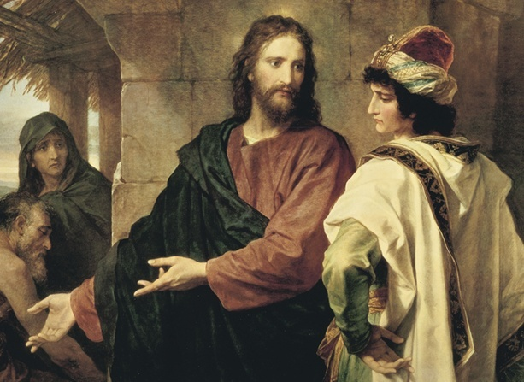
Good Master, what good thing shall I do, that I may have eternal life? . . . If thou wilt enter into life, keep the commandments . . .
If thou wilt be perfect, go and sell that thou hast, and give to the poor, and thou shalt have treasure in
heaven: and come and follow me. But when the young man heard that saying, he went away sorrowful . . . When his disciples heard it, they were exceedingly amazed saying, Who then can be saved? But Jesus beheld them, and said unto them, With men this is impossible; but with God all things are possible.
Matthew 19:16-26
Notes:
If thou wilt enter into life, keep the commandments.
The rich, young ruler asked Jesus how to obtain eternal life. Jesus answered, “Keep the commandments.”
The disciples held the young ruler in high esteem, perhaps as an example to be emulated. So when the ruler did not want to follow Jesus, they were not just amazed, but exceedingly amazed. To them, if anyone should be in the kingdom it would have been that young ruler.
Jesus gives a very interesting explanation at the end: “With men this is impossible; but with God all things are possible.” This means that we cannot do a good work in our own strength: only by God’s grace can we be saved or do any good thing in this life.

Slide 66
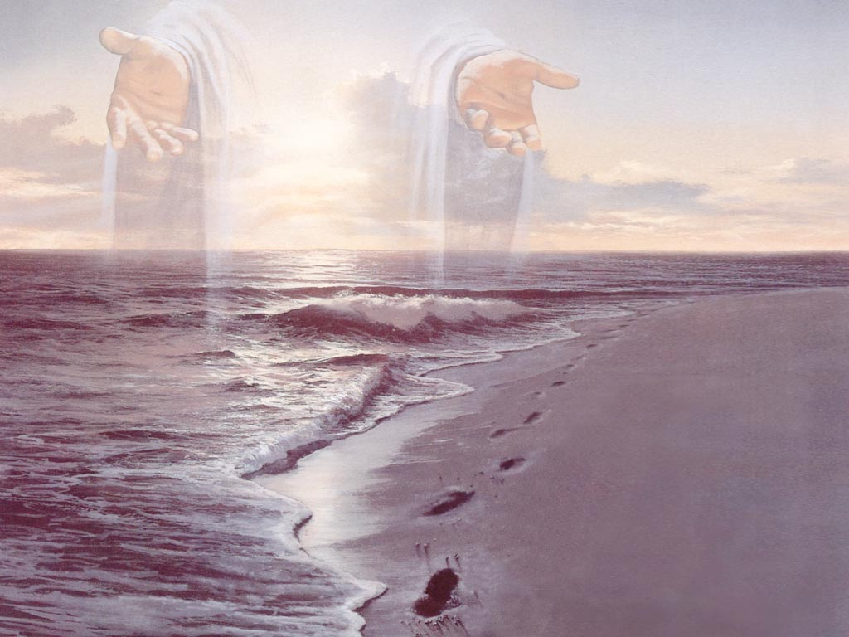
To endure to the end, we need a daily walk with Jesus as Lord of our lives.
A DAILY WALK WITH THE LORD
For even hereunto were ye called: because Christ also suffered for us, leaving us an example, that ye should follow his steps.
1 Peter 2:21
Notes:
Every day we must try to follow Christ’s example and seek his direction.

Slide 67
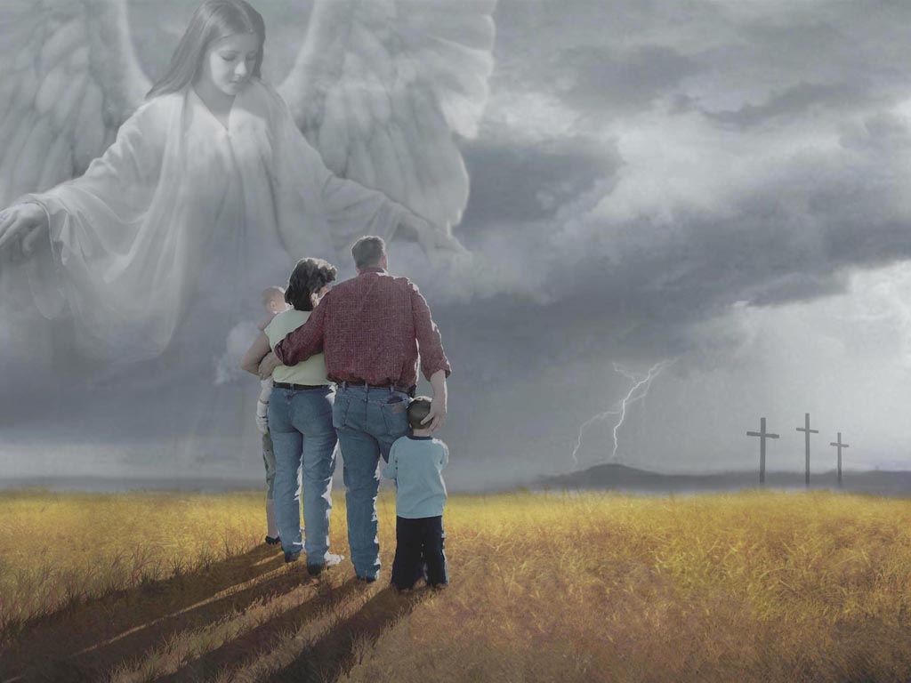
A DAILY WALK WITH THE LORD
To endure to the end, our families, time and possessions must be consecrated to God’s purposes.
. . . I count all things but loss for the excellency of the knowledge of Christ Jesus my Lord: for whom I have suffered the loss of all things, and do count them but dung, that I may win Christ.
Philippians 3:8
Notes:
We are merely stewards of the gifts that God has provided for us. Every resource that we have must be dedicated to his purposes.

Slide 68
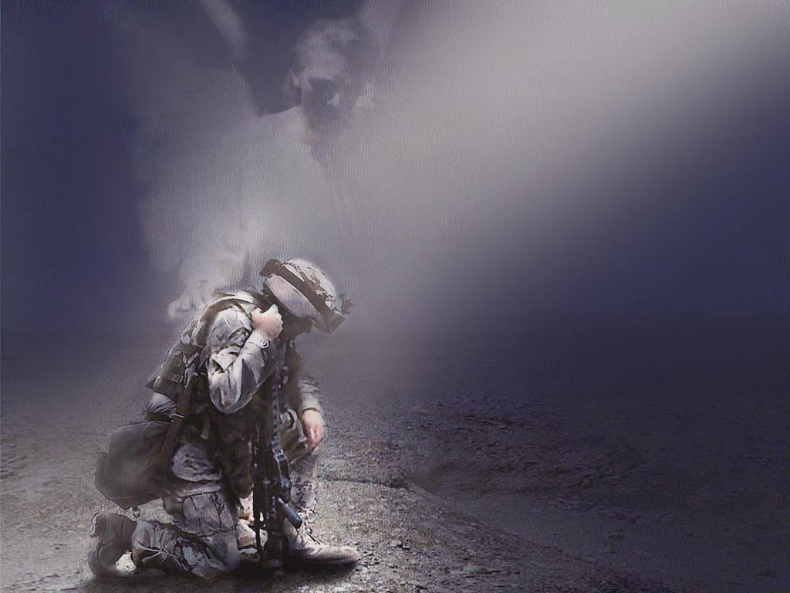
A DAILY WALK WITH THE LORD
To endure to the end, we need to be vigilant in our prayer life.
But behold I say unto you, that ye must pray always, and not faint: that ye must not perform anything unto the Lord, save in the first place ye shall pray unto the Father in the name of Christ, that he will consecrate thy performance unto thee, that thy performance may be for the welfare of thy soul.
2 Nephi 14:12
Notes:
We must pray over every endeavor.

Slide 69
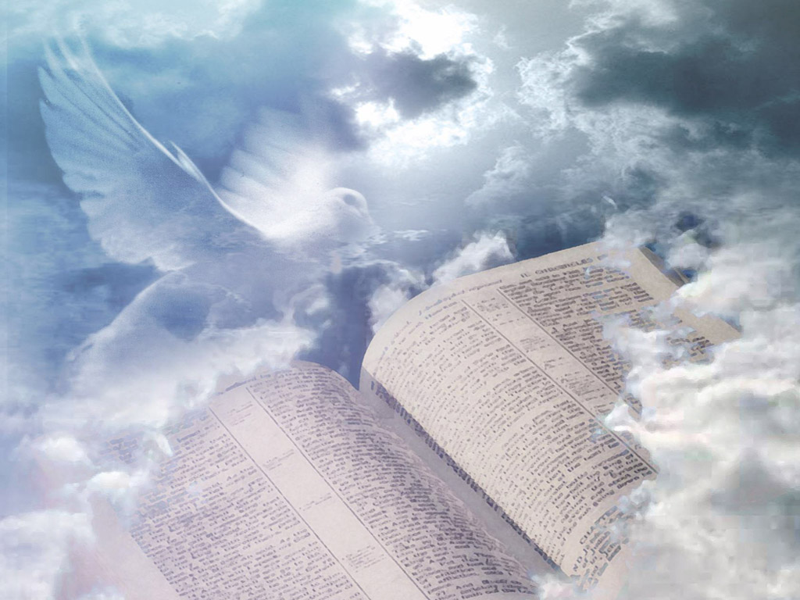
A DAILY WALK WITH THE LORD
To endure to the end, we need to be immersed in the word of God.
29 Wherefore, ye must press forward with a steadfastness in Christ, having a perfect brightness of hope, and a love of God and of all men.
30 Wherefore, if ye shall press forward, feasting upon the word of Christ, and endure to the end, behold, thus saith the Father: Ye shall have eternal life.
2 Nephi 13:29-30
Notes:
Feasting on the word includes internalizing scriptural principles, putting them into practice. We must maintain this discipline throughout our lives.

Slide 70
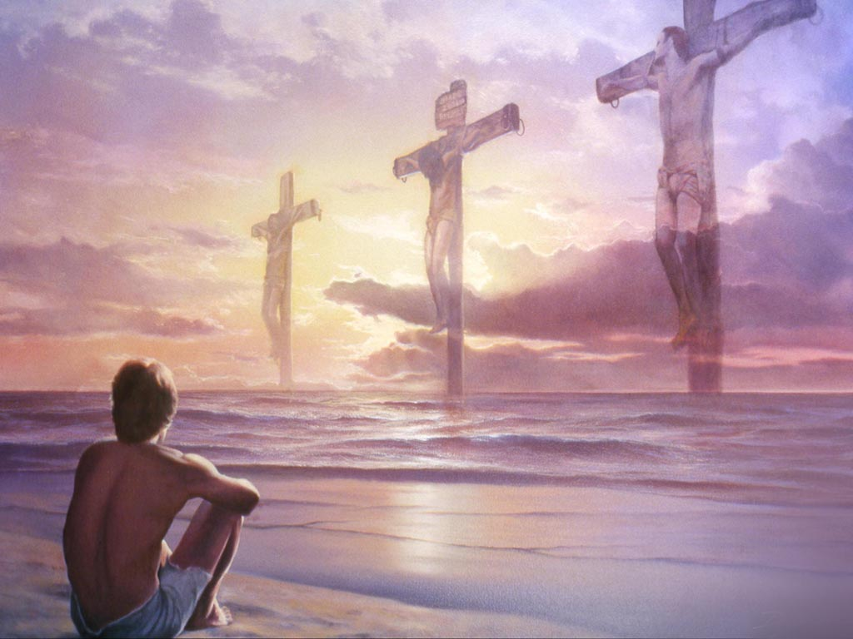
A DAILY WALK WITH THE LORD
To endure to the end, we need the holy ordinances of Christ’s gospel to help us maintain perspective in relation to the sacrificial life that Christ lived.
53 Then said Jesus unto them, Verily, verily, I say unto you, Except ye eat the flesh of the Son of man, and drink his blood, ye have no life in you.
54 Whosoeateth my flesh, and drinketh my blood, hath eternal life; and I will raise him up at the last day.
55 For my flesh is meat indeed, and my blood is drink indeed.
He that eateth my flesh, and drinketh my blood, dwelleth in me, and I in him.
John 6:53-56
Notes:
Holy ordinances provide a way for us to sense what righteousness feels like. Ordinances help us examine the sacrificial life that Christ lived and compare it to our present condition.

Slide 71
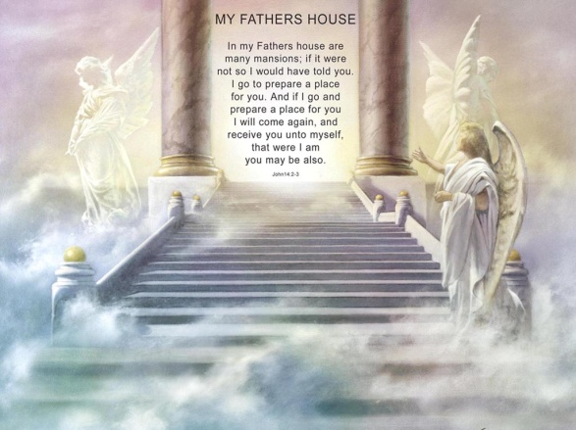
VALIANT IN TESTIMONY
We want the love of Jesus to be so evident in our lives that others might come unto him. Our willingness to share the gospel with others will directly impact our place in heaven.
Notes:
In my Father’s house are many mansions.

Slide 72
VALIANT IN TESTIMONY
6.a. And again, we saw the terrestrial world . . .
6.g. these are they who receive of the presence of the Son, but not of the fullness of the Father . . .
6.g. these are they who are not valiant in the testimony of Jesus . . . Doctrine & Covenants 76:6
Notes:
The highest glory in heaven is reserved for those who are valiant in their testimony of Jesus and his gospel.

Slide 73
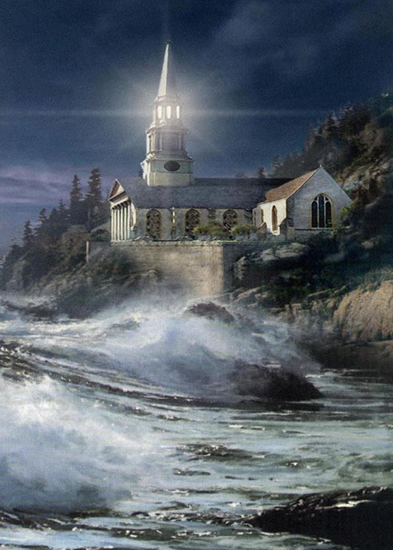
VALIANT IN TESTIMONY
Let your light so shine before men, that they may see your good works, and glorify your Father which is in heaven.
Matthew 5:16
Matthew 5:16 (KJV) is in heaven.
Matthew 5:16 (KJV)
Notes:
Let them see your good works and glorify God.

Slide 74
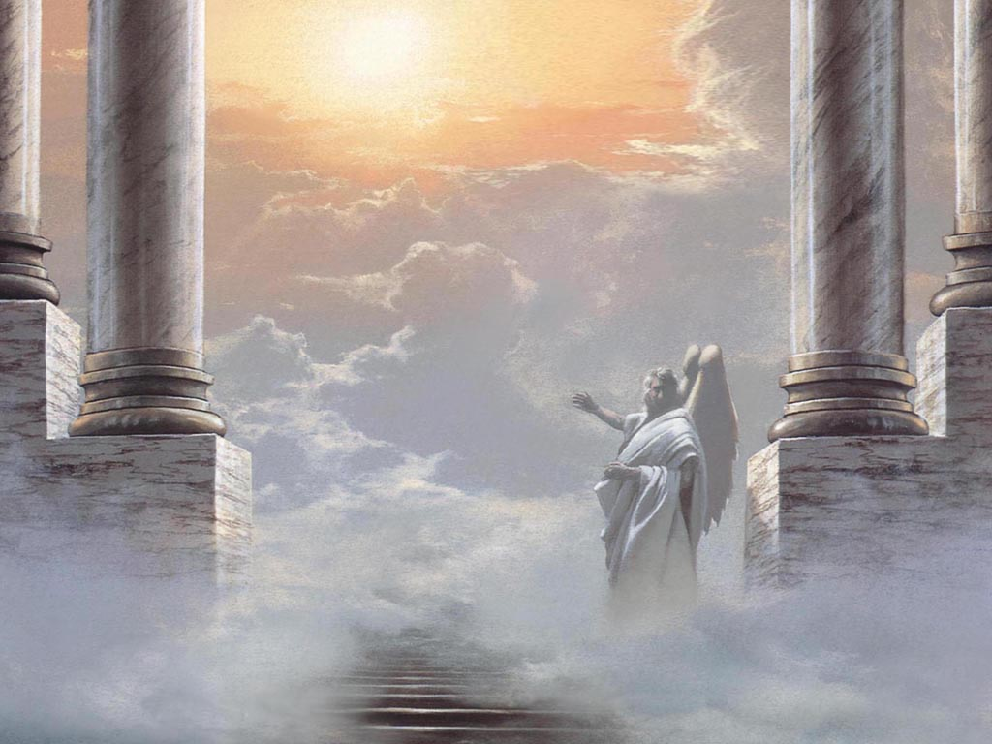
VALIANT IN TESTIMONY
I knew a man in Christ above fourteen years ago, (whether in the body, I cannot tell; or whether out of the body, I cannot tell: God knoweth;) such an one caught up to the third heaven.
2 Corinthians 12:2
Notes:
There are different privileges and places in heaven. This passage is referring to a “third heaven.”

Slide 75

8 Look to yourselves, that we lose not those things which we have wrought, but that we receive a full reward.
Whosoever transgresseth, and abideth not in the doctrine of Christ, hath not God. He that abideth in the doctrine of Christ, he hath both the Father and the Son. 2 John 1:8-9
VALIANT IN TESTIMONY
Notes:
To receive a full reward, we must adhere to the doctrine of Christ.

Slide 76
32 Whosoever therefore shall confess me before men, him will I confess also before my Father which is in heaven.
33 But whosoever shall deny me before men, him will I also deny before my Father which is in heaven.
Matthew 10:32-33
VALIANT IN TESTIMONY
Our testimony to others begins with the holy ordinance of water baptism.
Notes:
“Confessing him before men” begins with the act of water baptism.

Slide 77
13 Enter ye in at the strait gate: for wide is the gate, and broad is the way, that leadeth to destruction, and many there be which go in thereat:
14 Because strait is the gate, and narrow is the way, which leadeth unto life, and few there be that find it. Matthew 7:13-14
Notes:
Noah, a righteous man, preached the gospel for 120 years, and only seven souls embraced his teaching. In this day, there are many religions with many adherents. However, God is telling us there are few people in this world who will find eternal life. Why? What does “strait and narrow” refer to? It tells us that God is very particular about the doctrines of his church. That is why he had to restore his gospel.

Slide 78

WHAT DIFFERENCE DOES THE GOSPEL MAKE?
The gospel of Jesus Christ makes all the difference in the world. Our eternal destiny will be shaped by the choices that we make in this life. Our journey to heaven begins with a commitment to Jesus and his gospel.
Notes:
There is nothing that I can do in this life that is more significant than making a commitment to Jesus Christ. It impacts our lives on earth and in eternity.

Slide 79
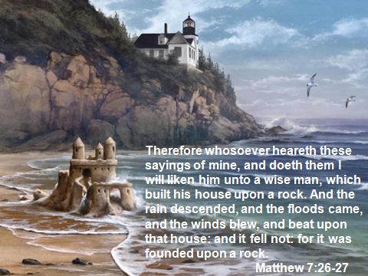

Slide 80
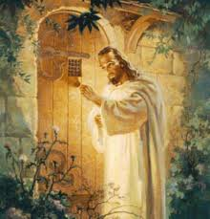
Behold, I stand at the door, and knock: if any man hear my voice, and open the door, I will come in to him, and will sup with him, and he with me.
Revelation 3:20

Slide 82
APPENDIX

Slide 83
What Happens to Those Who Have Never Heard the Gospel?

Slide 84
Other faiths say that those who have never heard the gospel are condemned to hell for eternity based on the following two scriptures:
They have the light of creation as a witness
For the invisible things of him from the creation of the world are clearly seen, being understood by the things that are made, even his eternal power and Godhead; so that they are without excuse. Romans 1:20
They have the light of their conscience as a witness
.... their conscience also bearing witness...
Romans 2:15
It is true that in Romans 1:20 we are held accountable for the witness of creation and in Romans 2:15 for the witness of our own conscience, but neither of these are sufficient to condemn a person to hell for eternity.

Slide 85
The perspective of other faiths:
“Therefore, the aborigine isolated in the jungle, who has never heard the gospel, will be condemned. Having had the witness of creation and conscience, he was given the ability to respond. We all rightly deserve hell. It is a gracious and sovereign God who, in mercy, chooses to save any of us.”

Slide 86
Based on the following scriptures, Christ’s restored gospel tells us that those who have never been taught the gospel will not necessarily be condemned for eternity:
Therefore to him that knoweth to do good, and doeth it not, to him it is sin. James 4:17
....for where no law is, there is no transgression. Romans 4:15
But sin is not taken into account when there is no law. Romans 5:13

Slide 87
But to him that knew not, and did commit things worthy of stripes, shall be beaten with few stripes. For unto whomsoever much is given, of him shall be much required.
Luke 12:48
Even though I was once a blasphemer and a persecutor and a violent man, I was shown mercy because I acted in ignorance and unbelief. 1 Timothy 1:13
51 Wherefore he hath given a law; and where there is no law given there is no punishment;
52 And where there is no punishment, there is no condemnation;
53 And where there is no condemnation, the mercies of the Holy One of Israel have claim upon them, because of the atonement. 2 Nephi 6:51-53

Slide 88
10 . . . I know that it is solemn mockery before God, that ye should baptize little children . . .
25 For behold that all little children are alive in Christ, and also all they that are without the law.
26 For the power of redemption cometh on all they that have no law; wherefore, he that is not condemned, or he that is under no condemnation, cannot repent; and unto such baptism availeth nothing.
Moroni 8:10, 25-26

Slide 89
Every person must be given an opportunity to hear and reject Christ’s gospel:
How, then, shall they call on him in whom they have not believed? And how shall they believe in him of whom they have not heard? And how shall they hear without a preacher?
Romans 10:14

