Slide 1
Did Jesus Rise From the Dead?
Notes:
The resurrection of Jesus is the capstone in the arch of Christianity. In this presentation, we will attempt to go back in time and examine the witnesses to reconstruct the most probable course of events. What really happened? Was Jesus’ body stolen from the tomb? Did witnesses who claimed to see the resurrected Jesus simultaneously experience group hallucinations? With each retelling of the story, were embellishments gradually added to the narrative over a period of years? Can the eyewitness accounts be trusted? Can the narrative of supernatural resurrection be trusted? We will explore these issues.

Slide 2
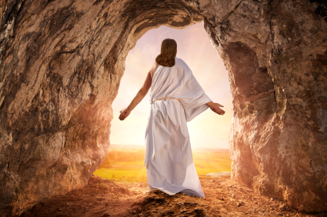
And if Christ be not risen, then is
our preaching vain, and your
faith is also vain.
1 Corinthians 15:14
Notes:
All of Christian belief rests on the historical fact that Jesus rose from the dead.
Without it, there is no hope in the gospel.

Slide 3

Stories are how we convey history and pass on values.

Slide 4

But how do we know those stories are true?

Slide 5

It is a natural human tendency to add embellishments and to speak with greater certainty about a historical event as time passes. So accounts that are closer in time to the actual event are thought
to be more
credible.
Notes:
It is a natural human tendency to add embellishments and to speak with greater certainty about a historical event as time passes.
So accounts that are closer in time to the actual event are thought to be more credible.
As a result, there is a continual struggle between conservative scholars, who believe that the books in the New Testament were written closer in time to the actual events (i.e., in order lend greater legitimacy to the scriptural record), and atheists and skeptics, who think that the those books were written much later in time (i.e., to provide time for embellishments and thus uphold the more skeptical view). So there is disagreement about the dates when NT books were written.

Slide 6

Secondly, if you have multiple, independent sources corroborating a set of facts, the resulting narrative is considered to be more credible.
Notes:
Multiple sources will lend greater credibility to a narrative.
It is important for a second narrator to corroborate what the first one has said. But it also lends greater credibility to the second narrator’s account if he doesn’t just parrot the first narrator and appears to be using other source material not available to the first one, in order to demonstrate a degree of independence from the first source.

Slide 7
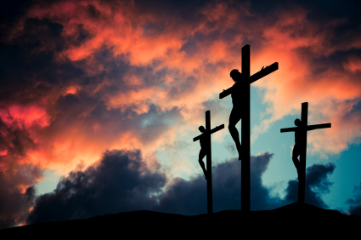
Jesus was crucified by order of Pontius Pilate around 30 to 33 A.D.
Notes:
According to historians, Jesus began his ministry in approximately 28-29 A.D. It lasted one to three years, at which point, Jesus was crucified by order of Pontius Pilate around 30 to 33 A.D.

Slide 8
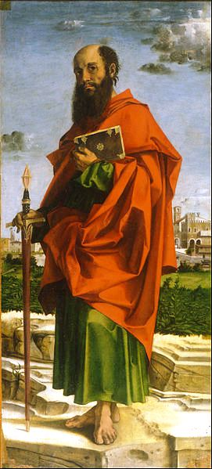
1 Corinthians 15:3-5 (KJV) states:
3 For I delivered unto you first of all that which I also received, how that Christ died for our sins according to the scriptures;
4 And that he was buried, and that he rose again the third day according to the scriptures:
5 And that he was seen of Cephas, then of the twelve.
Notes:
The Apostle Paul wrote the first Corinthian letter while he was in Ephesus somewhere between 53 AD and 57 AD, approximately 20 years after the death of Jesus.

Slide 9
In 1 Corinthians 15:3-5, Paul is quoting a tradition that was given to him by other Christians within two or three years of Jesus’ death.
Notes:
Remember that we are looking for sources that are as close in time to the actual event as possible. The story of Jesus’ death, burial and resurrection started within two years of his death! Absolutely no time for legendary embellishment to have developed.

Slide 10
Gerd Ludemann, an atheist New Testament scholar, said, “the elements in the tradition are to be dated to the first two years after the crucifixion of Jesus . . . not later than three years
. . . the formation of the appearance tradition mentioned in 1 Cor. 15:3-8 falls into the time between 30 and 33 C.E.”
Notes:
Gerd Ludemann is one of the foremost skeptics in the world regarding the resurrection. However, he concedes that the story about Jesus’ resurrection started within two years of his death!

Slide 11
If this tradition about Jesus’ burial, empty tomb and resurrection appearances was being taught by Christians within two years of Jesus’ death, this would be the oldest teaching in the New Testament.
Two years is not enough time for legendary embellishments to have been added. Paul is relaying information that was given to him as a new convert.

Slide 12
The three criteria that historians look for are:
accounts that appear as soon after the actual event as possible;
multiple sources that confirm the same set of facts;
independent sources that also relay unique details.
1 Corinthians 15:3-8 fulfills the first criterion because it contains the earliest known teaching in the New Testament.

Slide 13
Discussion
To determine if one aspect of a story is credible or authentic, historians want to see _m__________ sources that corroborate the facts.
Though two narrators might share aspects of a story that are the same, historians also want to be sure that the narrators are _i___________ , in other words, that there is evidence each narrator also had his own sources that he relied on as well.
Which is more reliable: an account that was given two years after an event or an account that was given 40 years after an event?
Notes:
multiple
independent
two years

Slide 14

Bible scholars have a wide variety of viewpoints: fundamentalist, liberal, and many agnostics and atheists.
Notes:
It is surprising how many scholars are agnostic or atheist.

Slide 15

The majority of biblical scholars in the world today -- not just fundamentalists or conservatives -- agree that the Bible clearly attests to the following four facts:

Slide 16
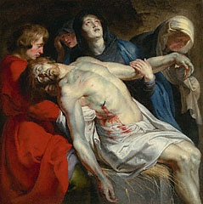
1. After his crucifixion and death, Jesus was buried by Joseph of Arimathea in the tomb.

Slide 17
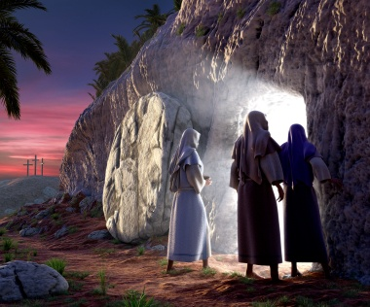
2. On the Sunday following his death, Jesus' tomb was found empty by a group of his women followers.

Slide 18
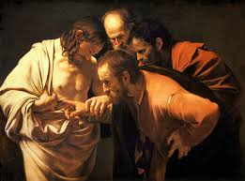
3. On more than one occasion after his death, several people experienced appearances of Jesus alive from the dead.

Slide 19
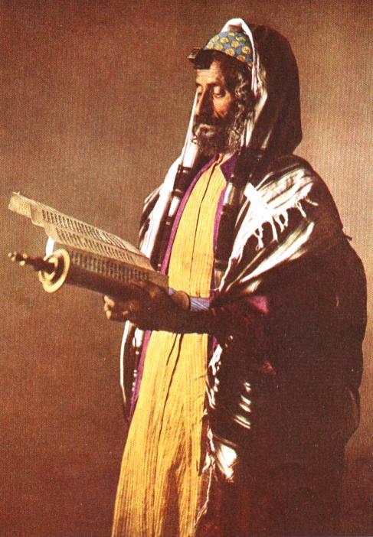
4. There was no existing tradition of an individual resurrection in the Jewish culture of that day that would explain the disciples' belief in Jesus' resurrection.

Slide 20
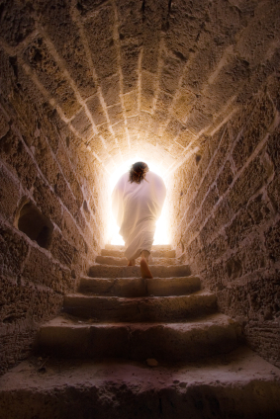
Conclusion
The best explanation for all four of these facts is that God raised Jesus from the dead by supernatural power.

Slide 21
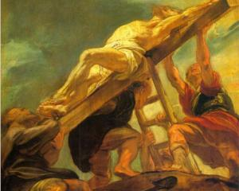
Jesus Was Crucified
John Dominic Crossan, co-founder of the Jesus Seminar, states, “That he was crucified is as sure as anything historical can ever be.”
Notes:
John Dominic Crossan is one of the most famous skeptics in the world regarding the burial and resurrection of Jesus, but he does affirm that Jesus was an actual historical figure and that he was crucified.

Slide 22
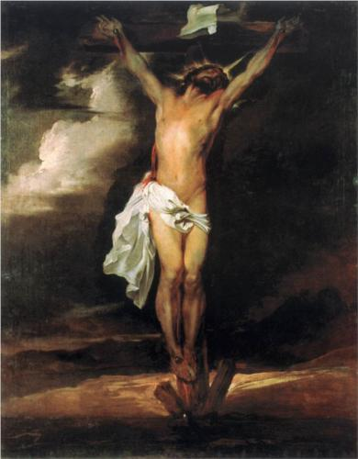
Jesus’ Death
Christ died . . .he was buried . .
I Corinthians 15:3-4
And though they found no cause of death in him, yet desired they Pilate that he should be slain.
Acts 13:28
And Jesus cried with a loud voice, and gave up the ghost.
Mark 15:37
Notes:
1 Corinthians 15 is based on a narrative that was being told in Jerusalem within two years of Jesus’ death.
Mark’s gospel is the next oldest source in the New Testament.
Acts was written prior to 62 A.D. according to more conservative Bible scholars.
These are three independent sources that each attest to Jesus’ crucifixion and death.

Slide 23
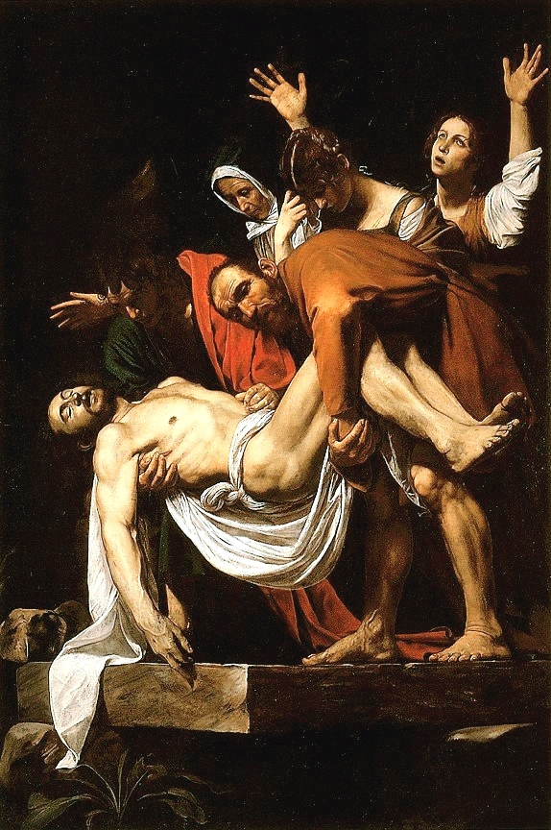
BURIAL
Notes:
Keep in mind that we are looking for multiple, independent sources who can establish that Jesus was actually buried.
The majority of Bible scholars agree that Jesus was buried in Joseph of Arimathea’s tomb because of the following:
Jesus’ burial is described in very old information handed down by Paul in his first letter to the Corinthians (1 Cor. 15:3-5).
Jesus’ burial is part of very old source material used by Mark in writing his gospel.
It is unlikely that Joseph of Arimathea was a fictional character since he was a member of the Jewish court that condemned Jesus.
The burial story itself lacks any traces of legendary development.
No other competing burial story exists.

Slide 24
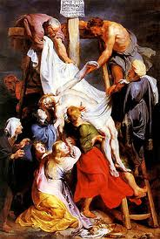
. . . they took him down from the tree, and laid him in a sepulchre.
Acts 13:29
And he [Joseph of Arimathea] bought fine linen, and took him down, and wrapped him in the linen, and laid him in a sepulchre . . .
Mark 15:46
Notes:
William Lane Craig, a conservative Bible scholar, says Acts was written prior to 62 A.D. Luke’s gospel had to be written before Acts. And Luke had to have used Mark’s gospel as one source to write the gospel of Luke. So Mark’s gospel was written within about 25 to 30 years of Jesus’ death. He also thinks that Mark, as the earliest gospel written, was using very old source material whose origin was much closer to the time of Jesus’ death in about 30 to 33 A.D.

Slide 25
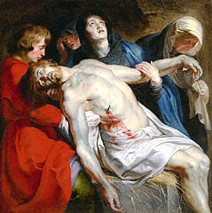
In debating William
Lane Craig, atheist New Testament scholar Gerd Ludemann said the following: “First, I think on the question of the burial, we are in basic agreement. I wouldn’t
call it an honorable burial, but Jesus was obviously buried.”
Notes:
So we have multiple, independent sources, some very close in time to the death of Jesus, all attesting that Jesus was an actual historical figure who was crucified, died and was buried. This fact is strengthened by the fact that Ludemann, as one of our sources, is an atheist.
There are no other competing narratives that contradict Mark’s description regarding how Jesus was buried.
If Jesus was crucified around 30 A.D. and Mark was written around 60 A.D. Per Craig, the idea that legendary embellishments could have developed in that short span is “unbelievable.” More generations are required to forget the specific details of Jesus’ death.

Slide 26
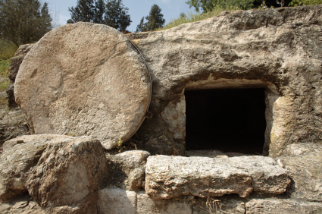
EMPTY TOMB
Notes:
Keep in mind that we are looking for multiple, independent sources who can establish that there was an empty tomb.
Most Bible scholars agree that, on the Sunday following, Jesus’ tomb was found empty by a group of his women followers because:
The empty tomb story is part of very old source material used by Mark.
The old information transmitted by Paul in 1 Corinthians implies the fact of the empty tomb.
The story is simple and lacks signs of legendary embellishment.
The fact that women’s testimony was worthless in first-century Palestine counts in favor of the women’s role in discovering the empty tomb.
The earliest Jewish allegation that the disciples had stolen Jesus’ body shows that the body was in fact missing from the tomb.

Slide 27

Mark 16:
1 And when the sabbath was past, Mary Magdalene, and Mary the mother of James, and Salome, had bought sweet spices, that they might come and anoint him.
2 And very early in the morning the first day of the week, they came unto the sepulchre at the rising of the sun . . .
5 And entering into the sepulchre, they saw a young man . . .
6 . . . Ye seek Jesus of Nazareth, which was crucified: he is risen; he is not here.
Notes:
Mark is oldest writing of the four gospels. Mark’s gospel was written about 25 to 30 years after the death of Jesus. That is not nearly enough time for legendary embellishments to occur.
Mark is written in a very straightforward statement of fact without flourishes or embellishments. The other gospels contain more detail, most likely because they used other sources for information than just the gospel of Mark.
The above quote is from the King James Version.

Slide 28
Luke 24:
3 And they entered in, and found not the body of the Lord Jesus.
Matthew 28:
He is not here: for he is risen, as he said.
John 20:
2 Then she runneth, and cometh to Simon Peter, and to the other disciple, whom Jesus loved, and saith unto them, They have taken away the Lord out of the sepulchre, and we know not where they have laid him.
Notes:
We see that four independent sources, the gospels, all mention the empty tomb. Matthew, Luke and John all used Mark as a source, but because they add details not found in Mark, it is obvious that the three writers used other independent sources to write their accounts.
If the Jewish authorities could have produced a body, they would love to have done that. Such a discovery would prove the Christian faith was false, and it would have ended the controversy.

Slide 29
1 Corinthians 15:
4 . . . he rose again the third day according to the scriptures.
Acts 13:
But God raised him from the dead.
Notes:
1 Corinthians 15:3-5 is the oldest teaching in the New Testament going back to within two years of Jesus’ death.
Acts, written by Luke, is in agreement with the four gospels and 1 Corinthians.

Slide 30
The primary criteria that New Testament scholars use to establish the authenticity of an event are:
multiple, independent sources, and
early sources
1 Corinthians quotes the earliest known tradition in the New Testament.
Mark, the earliest gospel, tells the story without embellishment.
These accounts of the “empty tomb” are corroborated by Luke, Matthew, John and Acts.
Notes:
If the Jewish authorities could have produced a body, they would love to have done that. Such a discovery would prove the Christian faith was false, and it would have ended the controversy.

Slide 31
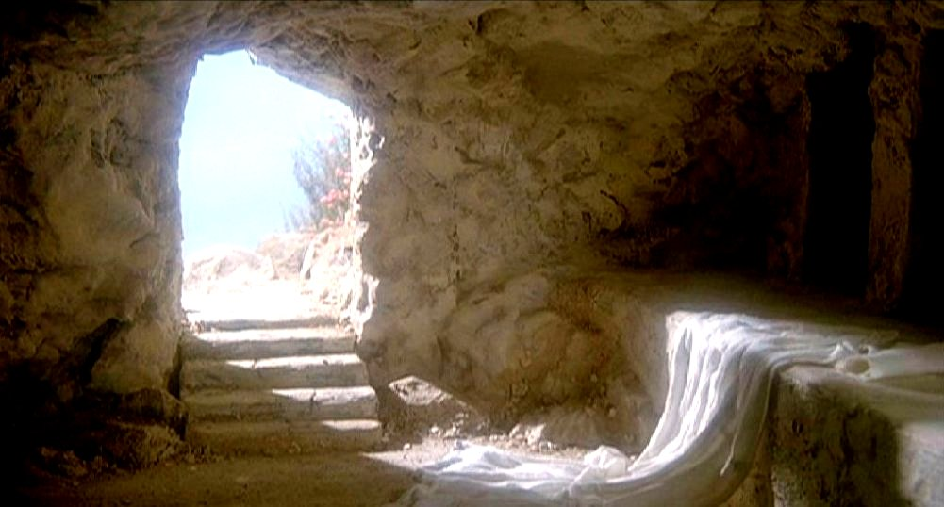
Atheist historian Michael Grant admits that “the historian . . . cannot justifiably deny the empty tomb.”
Notes:
To have an atheist affirm the “empty tomb” adds even greater credibility to the narrative.
Was Jesus’ body stolen from the tomb? If there were Roman soldiers camped at the site, it would have been very difficult to do something like that.

Slide 32
Post-Resurrection Appearances
Notes:
Bible scholars almost universally recognize that, on multiple occasions and under various circumstances, different individuals and groups of people experienced appearances of Jesus alive from the dead because:
The list of eyewitnesses to Jesus’ resurrection appearances that is quoted by Paul in 1 Corinthians guarantees that such appearances occurred. These included appearances to Peter, the twelve disciples, the 500 brethren and James.
The appearance traditions in the gospels provide multiple independent attestations of these appearances.

Slide 33
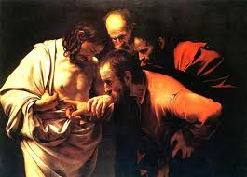
1 Corinthians 15:
4 . . . he rose again the third day according to the scriptures:
And that he was seen of Cephas, then of the twelve.
Acts 13:
31 And he was seen many days of them . . .
Mark 16:
But go your way, tell his disciples and Peter that he goeth before you into Galilee: there shall ye see him, as he said unto you. . .
Luke 24:
36 And as they thus spake, Jesus himself stood in the midst of them . . .
39 Behold my hands and my feet, that it is I myself: handle me . . .
Notes:
1 Corinthians 15: 4-5 is Paul’s recounting of the very oldest tradition ever taught anywhere in the New Testament.
Acts is consistent with the other sources in affirming Jesus’ resurrection.
Mark is the oldest gospel written 25 to 30 years after Jesus’ death (written prior to Acts).
Luke is the second oldest gospel written about 30 years after Jesus’ death.

Slide 34
Though he attributes it to group hallucinations, atheist New Testament scholar Gerd Ludemann says, “It may be taken as historically certain that Peter and the disciples had experiences after Jesus’ death in which Jesus appeared to them as the risen Christ.”
Notes:
When a skeptic or opponent concedes a specific fact, that fact is given greater credibility.
The idea of a group hallucination is difficult to fathom. How does a group simultaneously experience the same hallucination? How, for instance, would doubting Thomas be able to touch the wounds of Jesus as part of a group hallucination? How would they all agree on the exact words that they heard Jesus speak?

Slide 35
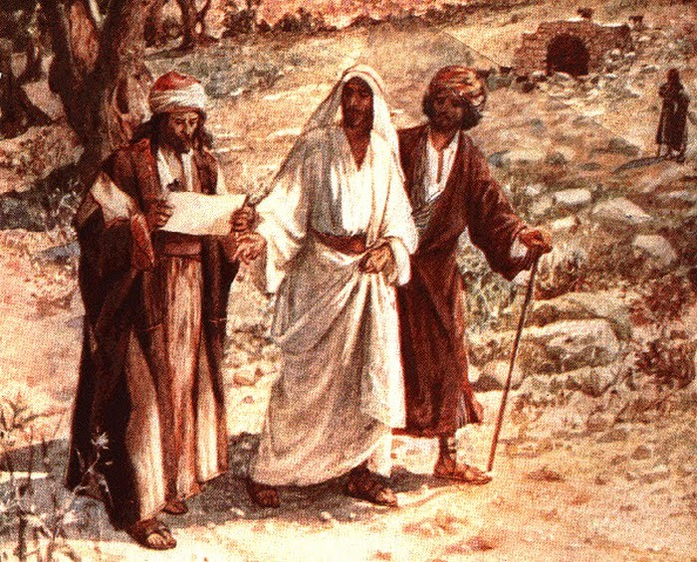
Luke 24 (NIV):
13 Now that same day two of them were going to a village called Emmaus . . .
15 . . . Jesus himself came up and walked along with them . . .
20 The chief priests and our rulers handed him over to
be sentenced to death, and they crucified him;
21 But we had hoped that he was the one who was going to redeem Israel. And what is more, it is the third day since all this took place.
Notes:
Luke’s gospel was written within 30 years of Jesus’ death.
In the previous three slides, we have multiple, independent and early eyewitness accounts of postmortem appearances of Jesus.

Slide 36
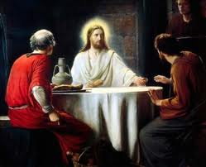
22 In addition, some of our women amazed us. They went to the tomb early this morning.
23 but didn’t find his body. They came and told us they had seen a vision of angels, who said he was alive.
24 Then some of our companions went to the tomb and found it just as the women had said, but him they did not see . . .
29 But they urged him strongly, “Stay with us, for it is nearly evening; the day is almost over.” So he went in to stay with them.
Notes:
Jesus stays and has a long conversation with the men at Emmaus.

Slide 37
No Existing Tradition of an
Individual Resurrection
Notes:
The majority of Bible scholars agree that the original disciples believed that Jesus was risen from the dead despite their having every reason not to. The situation the disciples faced after Jesus’ crucifixion:
Their leader was dead. And Jews had no belief in a dying, much less a rising, Messiah.
Jewish beliefs about the afterlife precluded anyone’s rising from the dead before the general resurrection at the end of the world.
Jesus suffered a humiliating failure to be executed as he was. In Jewish thinking, he was just another failed Messiah.
Nevertheless, the original disciples believed in, and were willing to die for, the fact of Jesus’ resurrection.

Slide 38
Regarding resurrection, Jews believed in a general resurrection of all the righteous at the end of the world. No individual resurrection.
Jews interpreted Deuteronomy 21:23 to say that any man who was crucified was a common criminal. Jesus was just another failed Messiah. In fact, it was a catastrophe because it meant that, far from being the Messiah and conquering Israel’s enemies, Jesus was an accursed heretic.
.
Notes:
The Jewish people believed in a general resurrection at the end of the world.
In their minds, Jesus was viewed as a miserable failure. He claimed to be the Messiah, and yet it did not appear to them that he had accomplished anything.

Slide 39
Despite cultural differences that were directly contrary, the Jewish disciples of Jesus strongly affirmed the resurrection of Jesus.
There was no existing tradition in Jewish culture that could possibly explain their belief that God raised Jesus from the dead.
.

Slide 40
The majority of biblical scholars in the world today -- not just fundamentalists or conservatives -- agree that the Bible clearly attests to the following four facts:
After his crucifixion and death, Jesus was buried by Joseph of Arimathea in the tomb.
On the Sunday following his death, Jesus' tomb was found empty by a group of his women followers.
On more than one occasion after his death, several people experienced appearances of Jesus alive from the dead.
There was no existing tradition of an individual resurrection in the Jewish culture of that day that would explain the disciples' belief in Jesus' resurrection.
Notes:
So in using our witnesses’ testimony to reconstruct what happened, we have established four facts that the majority of investigators seem to agree on. If we accept all of these four facts as being true, there really is no more viable explanation than a supernatural event.

Slide 41
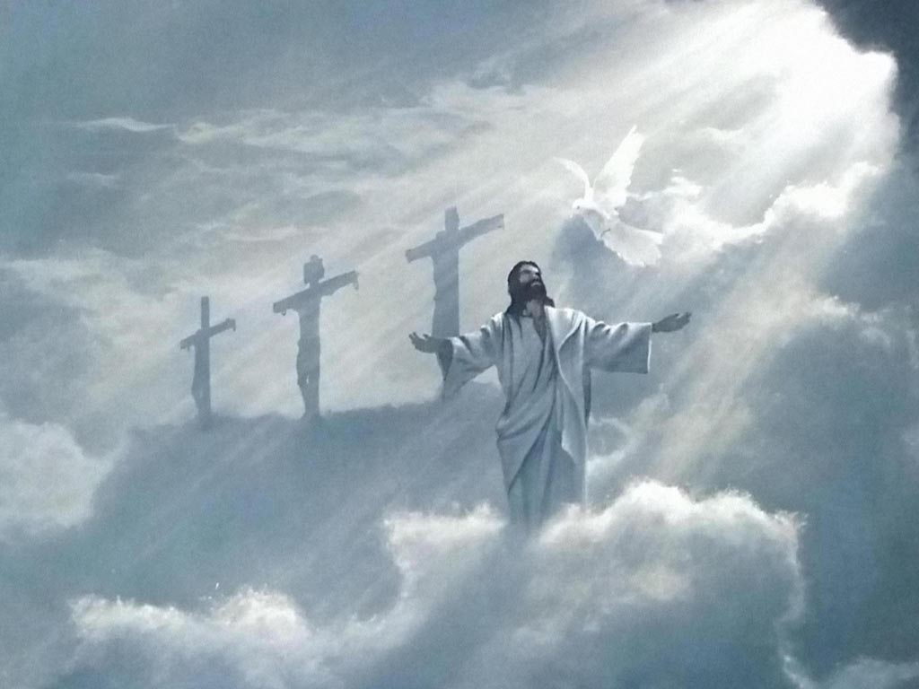
The best explanation for all four of these facts is that God raised Jesus from the dead by supernatural power.

Slide 42
Discussion
On Friday, Joseph of Arimathea wrapped Jesus in fresh linen and _b________ him in a tomb that belonged to Joseph.
Early Sunday morning, three women discovered that the tomb was _e__________ .
After he died and rose again, Jesus _a___________ to Mary Magdelene, two men on the road to Emmaus, the 11 disciples, a group of 500 people and several other people over a 40-day period.
Notes:
buried
empty
appeared

Slide 43
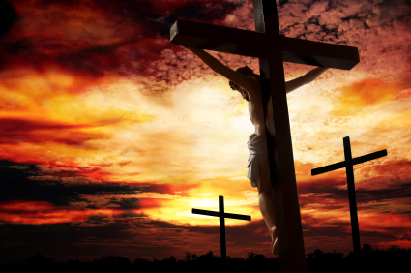
I Peter 2 (KJV):
For even hereunto were you called: because Christ also suffered for us . . .
24 Who his own self bare our sins in his own body on the tree, that we, being dead to sins, should live unto righteousness.
Notes:
If the majority of Bible scholars, who have spent their lives studying every aspect of scripture, have concluded that Jesus was buried, arose, and made post-resurrection appearances to eyewitnesses, then what could explain such a chain of events other than the supernatural power of God?
It suggests that Jesus might have been what he claimed: the Messiah.
It is the responsibility of believers to point everyone they meet to the cross of Jesus Christ.

Slide 44
