Slide 1
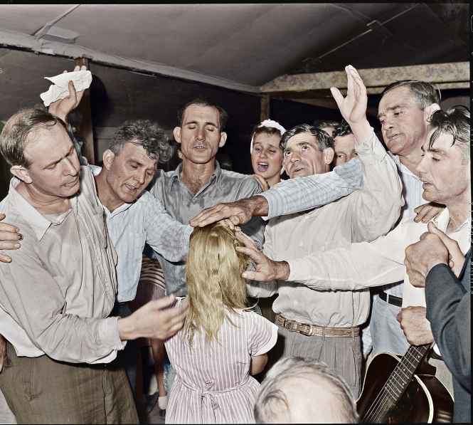
The "Priesthood of all “Believers"
Bible References are from the King James Version unless otherwise indicated.
Copyright © 2016 by Robert R. Bobbitt. Unauthorized use or duplication of this material without express and written permission from Robert R. Bobbitt is strictly prohibited.

Slide 2
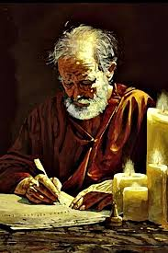
Paul's Key to Witnessing: Common Ground
1 Corinthians 9:20-23:
20 And unto the Jews, I became as a Jew, that I might gain the Jews;
To them that are under the law, as under the law, that I might gain them that are under the law;
Notes:
Verse 20 & 21 – "Secular Jews" – would not describe themselves as religious believers, but still identify as part of the Jewish people. They accept Jewish values, ethics and concerns.
"Orthodox Jews" – try to stay away from the world. They might not own a television, might not listen to non-Jewish music, might avoid non-Jewish magazines. Men still wear a yamulka, a skull cap they were forced to wear in Europe whenever they left their ghetto. Men and women sit separately in worship and women do not participate in some of the rituals. They respect the divine origin of the Old Testament law. This includes the codification of the "oral law" in the Talmud. Orthodox Judaism is not administered by some central authority. Synagogues are established by groups of Jews who raise their own funds and construct their own buildings. There are lots of different Orthodox synagogues organized around many different perspectives.
"Ultra-orthodox Jews" – which arose in the 1700s and 1800s, will not even live in a non-Jewish neighborhood, wear long black coats, flowing beards, wide-brim black hats and sometimes represent various minority groups within Orthodox Judaism. Ultra-orthodox who are Hassidic – look anxiously for the return of the Messiah, are more mystical, and search for ecstasy in their prayers. Hassidic – go back to Eastern Europe when Jews were living in conditions of despair – Hassidism was a way of infusing joy and hope into life, and some Jews say, emphasized the heart at the expense of the mind.
"Conservative Jews" – which arose in the 1900s, is a reaction to excesses of Reform Jews and objected to Reform Jews' reforming the commandments of the Torah (written law). Conservatives still consider the written law to be binding, but say we need to reconsider the oral law (Talmud) and how it applies to modern times. Men and women are not segregated in worship. It is in between Orthodoxy and Reform. It is intellectually liberal in matters of belief but conservative in matters of religious practice – commitment to Jewish observance. Conservative study of holy texts is combined with the belief that Judaism is constantly evolving. In 1960, the Rabbinical Assembly of America agreed to modify Orthodox "halacha" (Jewish law) to permit the use of electrical appliances on the Sabbath and to drive to synagogue in a car. In 1985, it permitted the ordination of women rabbis.

Slide 3
Paul's Key to Witnessing: Common Ground
21 To them that are without law, as without law, (being not without law to God, but under the law to Christ,) that I might gain them that are without law.
22 To the weak became I as weak, that I might gain the weak; I am made all things to all men, that I might by all means save some.
23 Paul’s Rationale: And this I do for the gospel’s sake, that I might be partaker thereof with you.
1 Corinthians 9:20-23
Notes:
Verse 20 & 21 – "Secular Jews" – would not describe themselves as religious believers, but still identify as part of the Jewish people. They accept Jewish values, ethics and concerns.
Verse 22 - "Progressive or Reform Jews" – Many progressives do not even wear a yarmulke. Temple services are shorter, conducted with a little more decorum (less individual praying and conversation), English is used for parts of their worship (Orthodox stick to Hebrew) and men and women sit together. In the early 1800s, a new movement, which is described as Progressive, Reform or Liberal, arose with the emancipation of the Jews of the various German states. Granted equal rights and released from the ghettos to which they had been confined for centuries, some embraced the Enlightenment which resulted in European Liberal Judaism and spread to North America where it became more radical and less traditional: embraced evolution, history and biblical scholarship, founding Non-orthodox rabbinical seminaries in Europe and the United States. Progressive Jews regard the "sacred heritage" of the Torah as evolving and adapting over the centuries. They still study the Hebrew language and sacred texts, are committed to Israel, support the full equality of women and accept any sexual orientation.

Slide 4
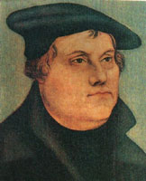
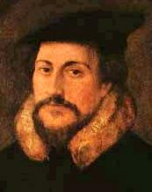
EVANGELICALS (USED TO BE CALLED “FUNDAMENTALISTS”)
1. Man is saved by grace through FAITH ALONE.
2. The Bible is the INFALLIBLE word of God (original autographs) and the ONLY word of God.
3. The “priesthood of all believers”REPLACED the Old Testament ministerial priesthood (i.e., Aaronic priesthood) at the cross.
Evangelical Christians frequently exhibit a missionary zeal!
This is not a denomination!

Slide 5
THE FOUR SOLAS (SALVATION)
1. CHRIST ALONE (sola Christos) – NOT human merit.
2. GRACE ALONE (sola gratia) – NOT our power.
3. FAITH ALONE (sola fidé) – NOT of works.
4. BIBLE ALONE (sola Scriptura) – NOT holy tradition.

Slide 6
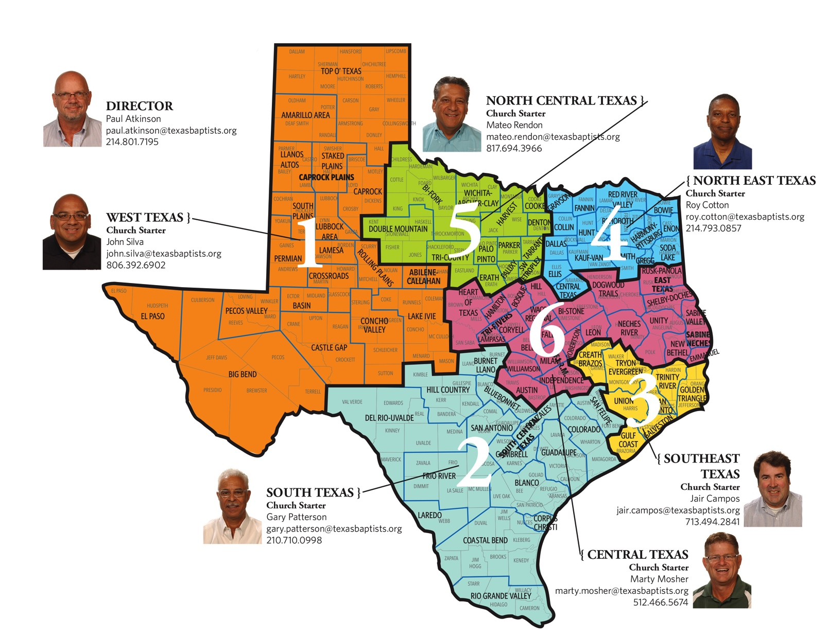
Evangelical Growth
This is a ratio of Christians and evangelical Christians to the world population over a period of centuries:
100 AD: One Christian to 360
non-Christians in the world.
1000 AD: One Christian to 220
non-Christians in the world.
1900 AD: One evangelical Christian to 27 non-evangelicals in the world.
1989 AD: One evangelical Christian to 7 non-evangelicals in the world.
This is a map at texasbatptists.org showing coordinators who will help you start a new Baptist Church in six different areas of Texas.
Notes:
Philip Johnstone's missions handbook entitled Operation World.

Slide 7
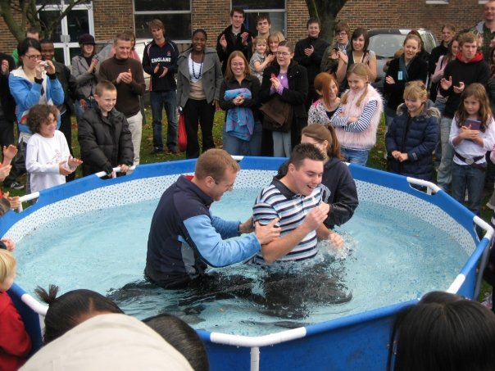
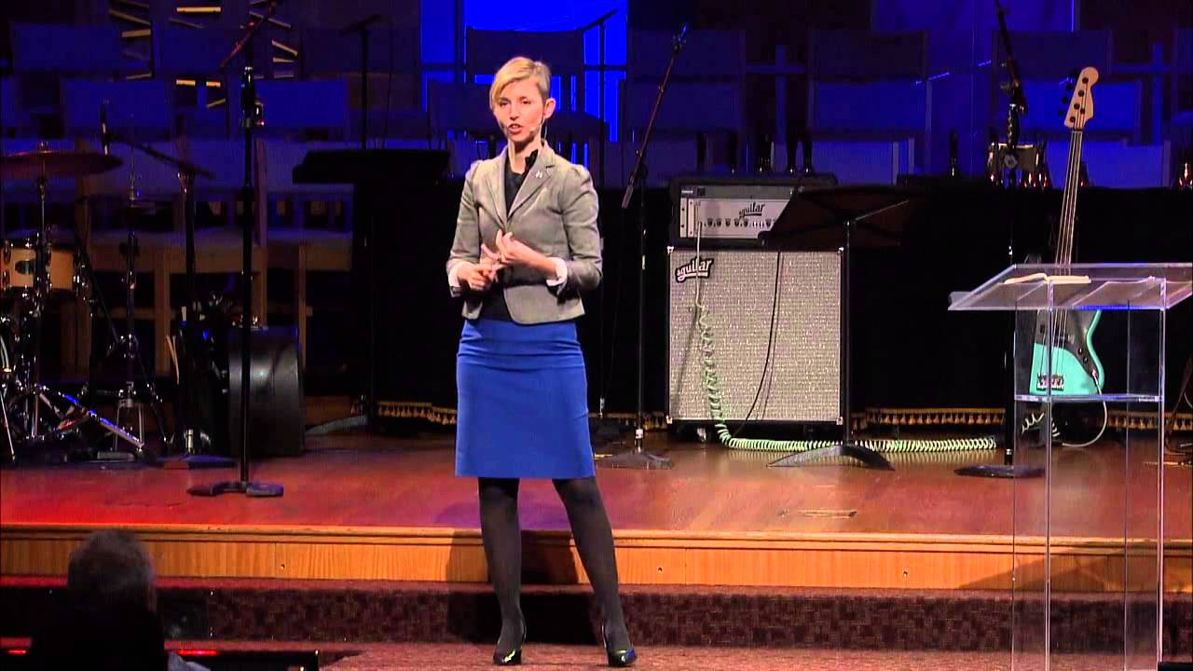
A "PRIESTHOOD OF ALL BELIEVERS" REPLACED THE MINISTERIAL PRIESTHOOD
AT THE CROSS

Slide 8
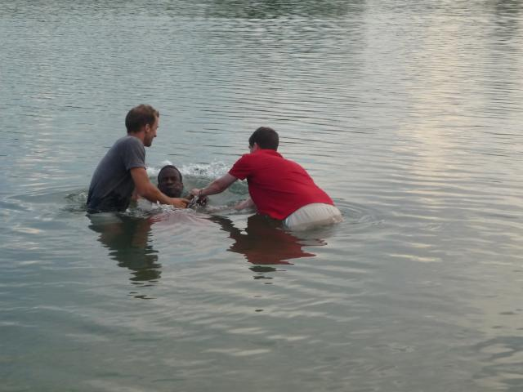
Priesthood of all Believers
EVANGELICAL VIEW
"Priesthood of All Believers"
Evangelicals say a "priesthood of all believers" is empowered to perform holy ordinances:
"Ye also, as lively stones, are built up a spiritual house, an holy priesthood, to offer up spiritual sacrifices, acceptable to God by Jesus Christ . . . But ye are a chosen generation, a royal priesthood, an holy nation, a peculiar people; that ye should show forth the praises
of him who hath called you out of darkness into his marvelous light."
1 Peter 2:5 & 9

Slide 9
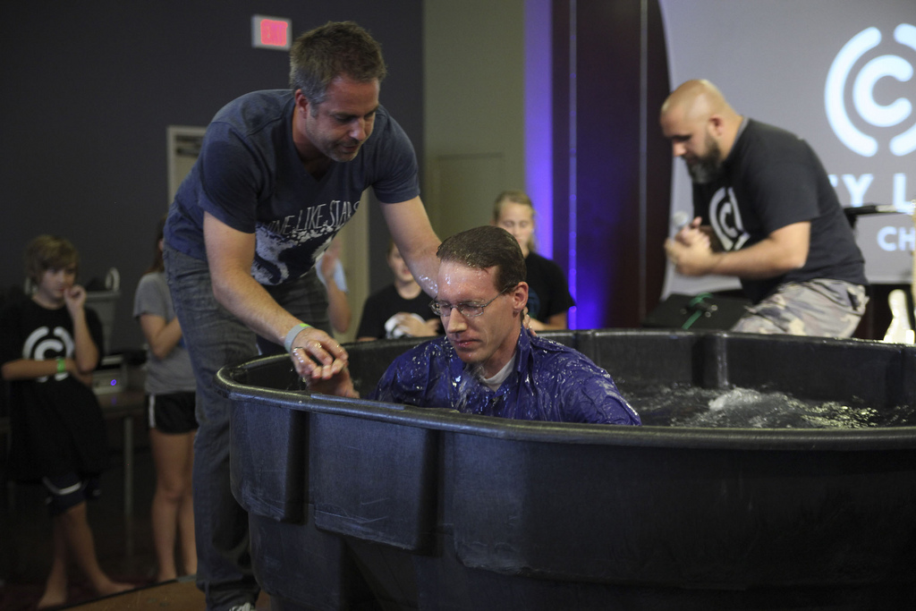
Priesthod of all Believers
EVANGELICAL VIEW
"One Mediator = No Need for Priesthood"
Evangelicals say that there is no need for a mediator (priesthood) between God and man besides Jesus:
For there is one God, and one mediator between God and men, the man Christ Jesus.
1 Timothy 2:5

Slide 10
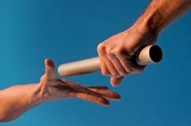
Priesthood of all Believers
EVANGELICAL VIEW
Priesthood Orders and High Priest’s Office
"For the priesthood being changed, there is made of necessity a change also of the law."
Hebrews 7:12
Restoration response: Yes, there was a change in the nature and duties of priesthood at the cross. But that does not mean that priesthood ended.

Slide 11
Priesthood of all Believers
EVANGELICAL VIEW
Priesthood Orders and High Priest’s Office
"But this man, because he continueth ever, hath an unchangeable [aparabatos] priesthood." Hebrews 7:24
Restoration response:
"Aparabatos is used of the priesthood of Christ, in Heb. 7:24, 'unchangeable,' 'unalterable, inviolable,' RV, marg. (a meaning found in the papyri); the more literal meaning in KJV and RV margins, 'that doth not pass from one to another,' is not to be preferred. This active meaning is not only untenable, and contrary to the constant usage of the word, but does not adequately fit with either the preceding or the succeeding context."
Vine's Expository Dictionary
Thomas Nelson Publishers
Camden, NY, 1984, p. 649

Slide 12
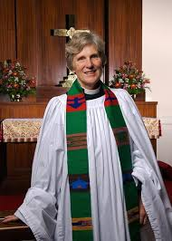
Priesthood of all Believers
BOB’S EXPERIENCE
United Methodist Church (Not Evangelical)
I spoke to a lady who was a minister for the United Methodist Church (not considered a cult) in Montana. Contrary to most evangelicals, she said that ministers in the United Methodist Church have responsibility for three areas that normal members are not allowed to administer:
Word (preaching function)
Sacrament (administering the holy ordinances)
Order (administrative governance)
Conclusion: Even though United Methodists are not evangelical, they are not a "cult." Believing that there are functions exclusive to the ministry does not constitute a “cult.”

Slide 13
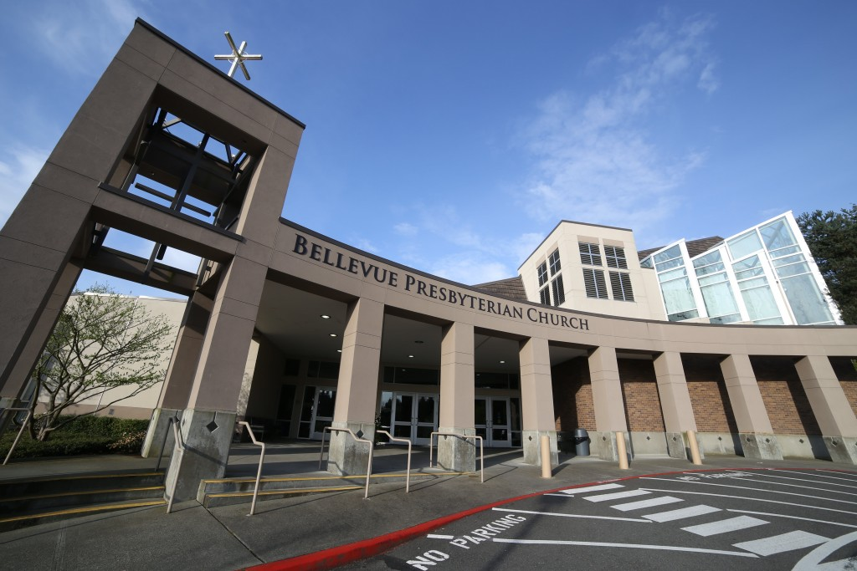
Priesthood of all Believers
BOB’S EXPERIENCE
Presbyterian Church (Not Evangelical)
I asked a theologian at "First Pres" in Bellevue, WA “What's a Presbyterian?”
She said that each local Presbyterian church chooses its minister rather than having them assigned by a central governing body as the Lutherans, Episcopalians and Methodists do. They have elders and deacons.
I asked if there were duties that only a minister could perform. She replied that administering “communion” would be an exclusive duty of a minister.
I asked if they were “evangelical,” and she said they try to appeal to various audiences (In other words, “No.")

Slide 14
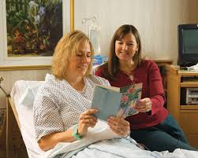
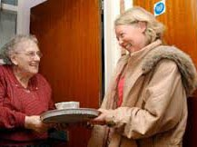
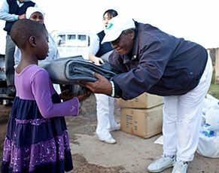
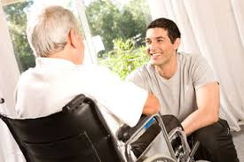
Priesthod of all Believers
RESTORATION VIEW
Priesthood of All Believers & Ministerial Priesthood
Even though we would not call it that, the Restoration would affirm a holy and sacred calling to the “office of member” with special responsibilities (see Romans 12, Mosiah 2, D&C 11:4,17:18c). However, the Restoration differs on two points:
the priesthood of all believers can exist simultaneously with ministerial priesthoods; and
the priesthood of all believers is not called to perform holy ordinances.

Slide 15
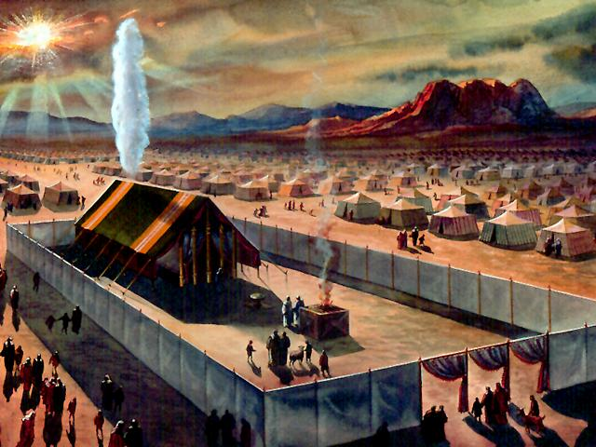
Priesthood of all Believers
RESTORATION VIEW
Priesthood of All Believers & Ministerial Priesthood
Acts 7:37 (KJV) tells us that God’s church existed under Moses:
“This is he, that was in the church in the wilderness with the angel which spake to him in the mount Sinai, and with our fathers: who received the lively oracles to give unto us.”

Slide 16
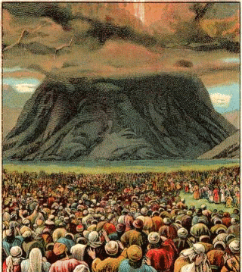
Priesthood of all Believers
RESTORATION VIEW
Priesthood of All Believers & Ministerial Priesthood
Exodus 19:6 tells us that God called a priesthood of all believers in the Old Testament Church (prior to ordaining Aaronic priesthood in Exodus 28) just as he did in the New Testament Church (1 Peter 2:5 & 9):
“And ye shall be unto me a kingdom of priests, and an holy nation.”
Why say this when the high priest Jethro was already with them
(Exodus 3:1)?
Who were the priests in Exodus 19:24?

Slide 17
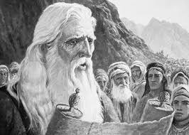
Priesthood of all Believers
RESTORATION VIEW
The Old Testament Church Knew of Christ’s Gospel
"Search the scriptures [the Old Testament]; for in them ye think ye have eternal life: and they are they which testify of me....."
"For had ye believed Moses, ye would have believed me: for he wrote of me. But if ye believe not his writings, how shall ye believe my words?"
John 5:39 & 46

Slide 18
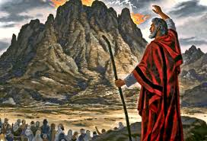
Priesthood of all Believers
RESTORATION VIEW
The Old Testament Church Knew of Christ’s Gospel
"Moreover, brethren, I would not that ye should be ignorant, how that all our fathers were under the cloud, and all passed through the sea; And were all baptized unto Moses in the cloud and in the sea; And did all eat the same spiritual meat; And did all drink the same spiritual drink: for they drank of that spiritual Rock that followed them: and that Rock was Christ."
1 Corinthians 10:1-4

Slide 19
Priesthood of all Believers
RESTORATION VIEW
Called of God as was Aaron
"And no man taketh this honour [ministerial calling] unto himself, but he that is called of God, as was Aaron."
Hebrews 5:4

Slide 20
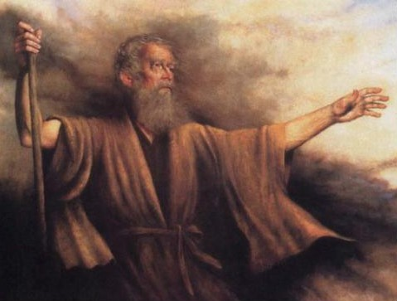
Priesthood of all Believers
RESTORATION VIEW
How was Aaron called?
In Exodus 28:1, there were five things that occurred as part of Aaron’s calling to ministry:
God was speaking
Through one in authority
God named a specific candidate
From among the children of Israel
Indicated a specific office

Slide 21
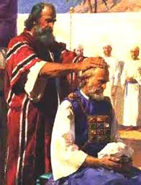
Priesthood of all Believers
RESTORATION VIEW
Calling and Ordaining
John 15:16 in KJV:
"Ye have not chosen me, but I have chosen you, and ordained you . . ." (appear more like two separate things)
John 15:16 in NIV:
"You did not choose me, but I chose you and appointed you . . ." (no distinction: choose, appoint, ordain)

Slide 22
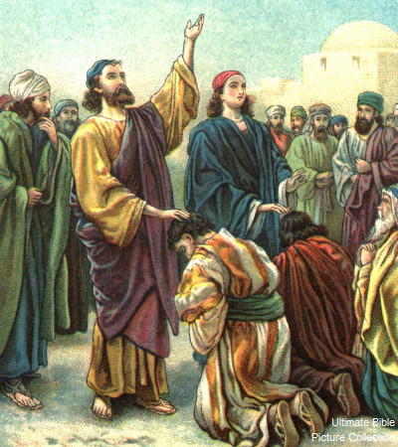
Priesthood of all Believers
RESTORATION VIEW
Calling and Ordaining (Acts 13:1-3)
1 Now there were in the church that was at Antioch certain prophets and teachers; as Barnabas, and Simeon that was called Niger, and Lucius of Cyrene, and Manaen, which had been brought up with Herod the tetrarch, and Saul.
2 As they ministered to the Lord, and fasted, the Holy Ghost said, Separate me Barnabas and Saul for the work whereunto I have called them.
3 And when they had fasted and prayed, and laid their hands on them they sent them away.
Note: We call this "ordination" to an office with specific functions. Evangelicals call this "infilling" for service, which can happen multiple times in your life, more like what we would call "endowment."

Slide 23
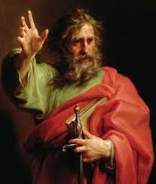
Priesthood of all Believers
RESTORATION VIEW
Minister of Christ
Romans 15 in KJV:
15 "Nevertheless, brethren, I have written the more boldly unto you in some sort, as putting you in mind, because of the grace that is given to me of God."
16 "That I should be the minister of Jesus Christ to the Gentiles, ministering the gospel of God, that the offering up of the Gentiles might be acceptable, being sanctified by the Holy Ghost."

Slide 24
Priesthood of all Believers
RESTORATION VIEW
Minister of Christ – Priesthood
Romans 15 in NIV:
15 I have written you quite boldly on some points, as if to remind you of them again, because of the grace God gave me
16 to be a minister of Christ Jesus to the Gentiles with the priestly duty of proclaiming the gospel of God, so that the Gentiles might become an offering acceptable to God, sanctified by the Holy Spirit.
What is that “priestly duty”?
Where there is a "priest," there is "priesthood."

Slide 25
Priesthood of all Believers
RESTORATION VIEW
Minister of Christ – Priestly Duty
Read D & C 17 for a list of duties that are exclusive to ministerial priesthood.

Slide 26
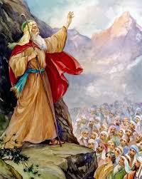
Priesthood of all Believers
RESTORATION VIEW
Korah’s Rebellion
Korah's Rebellion refers to a revolt in Moses' time in which 250 famous leaders among the priesthood of all believers attempted to replace the ministerial priesthood that God had called.

Slide 27
Priesthood of all Believers
RESTORATION VIEW
Korah’s Rebellion
"And they rose up before Moses, with certain of the children of Israel, two hundred and fifty princes of the assembly, famous in the congregation, men of renown. And they gathered themselves together against Moses and against Aaron, and said unto them, Ye take too much upon you, seeing all the congregation are holy, every one of them, and the Lord is among them. Wherefore then lift ye up yourselves above the congregation of the Lord?"
Numbers 16:2-3
(The very same argument that evangelicals use today)

Slide 28
Priesthood of all Believers
RESTORATION VIEW
Korah’s Rebellion
These men failed to see divinely-appointed authority as a source of direction for their lives (Deuteronomy 17:12-13).
They became proud and wanted to assume authority that was not theirs (2 Chronicles 26:16-21 – Uzziah tried to usurp priests’ duty and got leprosy).
They did not want to wait on the Lord to call them as Aaron did (Hebrews 5:4; Exodus 28:1).

Slide 29
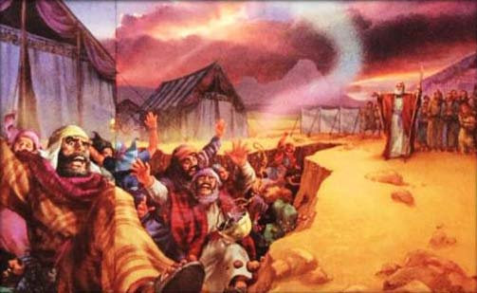
Priesthood of all Believers
RESTORATION VIEW
Korah’s Rebellion
Much like today, they usurped the authority of God's ministers by calling themselves to minister. How did God respond to their demand that all believers administer holy ordinances? All 250 were swallowed by the earth, and 14,700 of their supporters were stricken by a plague (Numbers 16:31-50).

Slide 30
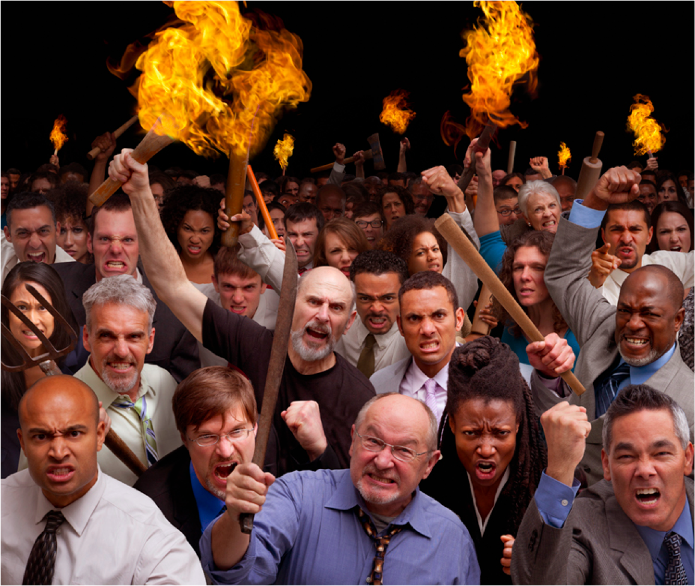
Priesthood of all Believers
RESTORATION VIEW
Korah’s Rebellion in New Testament Church
In Jude, the NIV Bible talks about what happened in the NT Church:
v. 4 “godless men, who change the grace of our God into a license for immorality . . .”
v. 10 “Yet these men speak abusively against whatever they do not understand; and what things they do understand by instinct, like unreasoning animals – these are the very things that destroy them.”
v. 11 “Woe to them! They have taken the way of Cain; they have rushed for profit into Balaam’s error; they have been destroyed in Korah’s rebellion.”
(This is missed in the IV and KJV which say “Core’s rebellion.”)

Slide 31
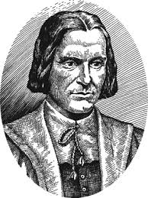
Priesthood of all Believers
RESTORATION VIEW
Rushing for Profit into Balaam's Error
Roger Williams said:
"He who haggles over his wages, who bargains for his keep, who makes the cure of Souls, and the charge of men's eternal welfare, a trade, a maintenance, and living was never sent of God to be a laborer in his vineyard, Like servants hired by the year, today's clergy leave one parish for another the minute they hear offers of more Ease and better Wages."
(Liberty of Conscience: Roger Williams in America, Edwin S. Gaustad, Eerdmans Publishing Co., 1991, page 93)

Slide 32
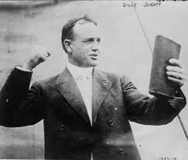
Priesthood of all Believers
RESTORATION VIEW
The Need for a Preacher
"For whosoever shall call upon the name of the Lord shall be saved. How shall they call on him in whom they have not believed? And how shall they believe in him of whom they have not heard? And how shall they hear without a preacher?"
Romans 10:13-14

Slide 33
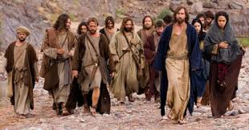
Priesthood of all Believers
RESTORATION VIEW
Not Everyone is an Apostle, Prophet or Teacher
"And God hath set some in the church, first apostles, secondarily prophets, thirdly teachers, after that miracles, then gifts of healings, helps, governments, diversities of tongues. Are all apostles? Are all prophets? Are all teachers? Are all workers of miracles? Have all the gifts of healing? Do all speak with tongues? Do all interpret?" 1 Corinthians 12:28-29
(Mentions offices, not orders of priesthood)

Slide 34
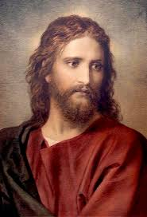
Priesthood of all Believers
RESTORATION VIEW
Apostles, Prophets, Evangelists, Pastors & Teachers
"And he gave some, apostles; and some, prophets; and some, evangelists; and some, pastors and teachers;"
"For the perfecting of the saints, for the work of the ministry, for the edifying of the body of Christ:"
"Till we all come in the unity of the faith, and of the knowledge of the Son of God, unto a perfect man, unto the measure of the stature of the fulness of Christ."
Ephesians 4:11-13
(Mentions offices, not orders of priesthood)

