Slide 1
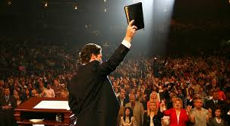
The Bible: "Infallible” and "Only" Word Of God
Bible References are from the King James Version unless otherwise indicated
Copyright © 2016 by Robert R. Bobbitt. Unauthorized use or duplication of this material without express and written permission from Robert R. Bobbitt is strictly prohibited.

Slide 2
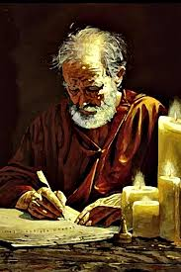
Paul's Key to Witnessing: Common Ground
1 Corinthians 9:20-23:
20 And unto the Jews, I became as a Jew, that I might gain the Jews;
To them that are under the law, as under the law, that I might gain them that are under the law;
Notes:
Verse 20 & 21 – "Secular Jews" – would not describe themselves as religious believers, but still identify as part of the Jewish people. They accept Jewish values, ethics and concerns.
"Orthodox Jews" – try to stay away from the world. They might not own a television, might not listen to non-Jewish music, might avoid non-Jewish magazines. Men still wear a yamulka, a skull cap they were forced to wear in Europe whenever they left their ghetto. Men and women sit separately in worship and women do not participate in some of the rituals. They respect the divine origin of the Old Testament law. This includes the codification of the "oral law" in the Talmud. Orthodox Judaism is not administered by some central authority. Synagogues are established by groups of Jews who raise their own funds and construct their own buildings. There are lots of different Orthodox synagogues organized around many different perspectives.
"Ultra-orthodox Jews" – which arose in the 1700s and 1800s, will not even live in a non-Jewish neighborhood, wear long black coats, flowing beards, wide-brim black hats and sometimes represent various minority groups within Orthodox Judaism. Ultra-orthodox who are Hassidic – look anxiously for the return of the Messiah, are more mystical, and search for ecstasy in their prayers. Hassidic – go back to Eastern Europe when Jews were living in conditions of despair – Hassidism was a way of infusing joy and hope into life, and some Jews say, emphasized the heart at the expense of the mind.
"Conservative Jews" – which arose in the 1900s, is a reaction to excesses of Reform Jews and objected to Reform Jews' reforming the commandments of the Torah (written law). Conservatives still consider the written law to be binding, but say we need to reconsider the oral law (Talmud) and how it applies to modern times. Men and women are not segregated in worship. It is in between Orthodoxy and Reform. It is intellectually liberal in matters of belief but conservative in matters of religious practice – commitment to Jewish observance. Conservative study of holy texts is combined with the belief that Judaism is constantly evolving. In 1960, the Rabbinical Assembly of America agreed to modify Orthodox "halacha" (Jewish law) to permit the use of electrical appliances on the Sabbath and to drive to synagogue in a car. In 1985, it permitted the ordination of women rabbis.

Slide 3
Paul's Key to Witnessing: Common Ground
21 To them that are without law, as without law, (being not without law to God, but under the law to Christ,) that I might gain them that are without law.
22 To the weak became I as weak, that I might gain the weak; I am made all things to all men, that I might by all means save some.
23 Paul’s Rationale: And this I do for the gospel’s sake, that I might be partaker thereof with you.
1 Corinthians 9:20-23
Notes:
Verse 20 & 21 – "Secular Jews" – would not describe themselves as religious believers, but still identify as part of the Jewish people. They accept Jewish values, ethics and concerns.
Verse 22 - "Progressive or Reform Jews" – Many progressives do not even wear a yarmulke. Temple services are shorter, conducted with a little more decorum (less individual praying and conversation), English is used for parts of their worship (Orthodox stick to Hebrew) and men and women sit together. In the early 1800s, a new movement, which is described as Progressive, Reform or Liberal, arose with the emancipation of the Jews of the various German states. Granted equal rights and released from the ghettos to which they had been confined for centuries, some embraced the Enlightenment which resulted in European Liberal Judaism and spread to North America where it became more radical and less traditional: embraced evolution, history and biblical scholarship, founding Non-orthodox rabbinical seminaries in Europe and the United States. Progressive Jews regard the "sacred heritage" of the Torah as evolving and adapting over the centuries. They still study the Hebrew language and sacred texts, are committed to Israel, support the full equality of women and accept any sexual orientation.

Slide 4
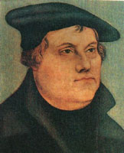
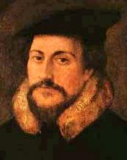
EVANGELICALS (USED TO BE CALLED “FUNDAMENTALISTS”)
1. Man is saved by grace through FAITH ALONE.
2. The Bible is the INFALLIBLE word of God (original autographs) and the ONLY word of God.
3. The “priesthood of all believers” REPLACED the Old Testament ministerial priesthood (i.e., Aaronic priesthood) at the cross.
Evangelical Christians frequently exhibit a missionary zeal!
This is not a denomination!

Slide 5
THE FOUR SOLAS (SALVATION)
1. CHRIST ALONE (sola Christos) – NOT human merit.
2. GRACE ALONE (sola gratia) – NOT our power.
3. FAITH ALONE (sola fide) – NOT of works.
4. BIBLE ALONE (sola Scriptura) – NOT “holy tradition” (additional insight that is conveyed by the teaching magesterium of the Catholic Church).

Slide 6
Bible infallibility

Slide 7
THE BIBLE
According to evangelicals, the original autographa of the entire Bible were:
"Infallible" – true and reliable in every matter it addresses,
"Inerrant" – free of any falsehood, error or deceit, and
"Only" word of God (sola scriptura).
Note: Arguing that different "versions" of the Bible somehow undermines this position has no impact because the versions all follow text found in the original manuscripts.

Slide 8
THE BIBLE
EVANGELICAL VIEW
"The entire Bible is literally God-breathed"
"All scripture is given by inspiration of God, and is profitable for doctrine, for reproof, for correction, for instruction in righteousness: That the man of God may be perfect, thoroughly furnished unto all good works."
2 Timothy 3:16-17
NIV Bible says “All Scripture is God-breathed."

Slide 9
THE BIBLE
EVANGELICAL/RESTORATION VIEW
The Nature of Inspiration
A General Introduction to the Bible by Geisler and Nix:
“Sometimes God spoke in an audible voice. No doubt the most common method God used was the inner voice of the individual’s conscience and communion with God. That is probably what is most often meant when the prophets write, ‘And the word of the Lord came unto me saying . . .’” p. 37
“The very words of the prophets were God-given, not by dictation but by the Spirit-directed employment of the prophet’s own vocabulary and style.” p. 192

Slide 10
THE BIBLE
EVANGELICAL VIEW
The Nature of Inspiration
An honest question that undermines infallibility and inerrancy:
“A final question concerns the means, or process, of inspiration. What means did God’s causality employ to produce scriptural authority without interfering with the personality, freedom, and individuality of the prophetic agents? Or, how did God produce an infallible book through fallible men? A frank and forthright answer, yet one often very reluctantly given by biblical scholars, is ‘We don’t know.’” A General Introduction to the Bible,
Geisler and Nix, p. 45

Slide 11
THE BIBLE
EVANGELICAL VIEW
The Nature of Inspiration
Evangelicals believe that:
The distinct writing styles of various Bible writers are clearly evident in scripture because God probably did not always provide word-for-word dictation.
The original autographs, though written in the distinct writing styles of various men, were infallible and inerrant (2 Timothy 3:16).

Slide 12
THE BIBLE
EVANGELICAL VIEW
Infallibility and Inerrancy
The 1978 Chicago Statement on Scripture published by the International Council on Biblical Inerrancy said:
“Article XI – We affirm that Scripture, having been given by divine inspiration, is infallible, so that, far from misleading us, it is true and reliable in all the matters it addresses . . ."
"Article XII – We affirm that Scripture in its entirety is inerrant, being free from all falsehood, fraud, or deceit.”

Slide 13
THE BIBLE
RESTORATION VIEW
Infallibility and Inerrancy
In 1842, Joseph Smith wrote a letter to John Wentworth, editor of the Chicago Democrat. Some evangelicals deride the following statement by Joseph Smith because they think it undermines their inerrancy position:
"We believe the bible [King James Version] to be the word of God as far as it is translated correctly."

Slide 14
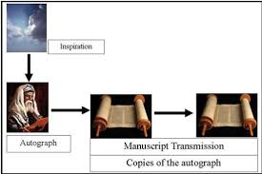
THE BIBLE
EVANGELICAL VIEW
Only Original Autographs were Infallible & Inerrant
However, evangelicals’ 1978 Chicago Statement on Scripture provides an escape clause from their own inerrancy position that directly parallels Smith’s statement in 1842 (allows for possibility that the transmission process might have had errors):
“Article X – We further affirm that copies and translations of Scripture are the word of God to the extent that they faithfully represent the original.”

Slide 15
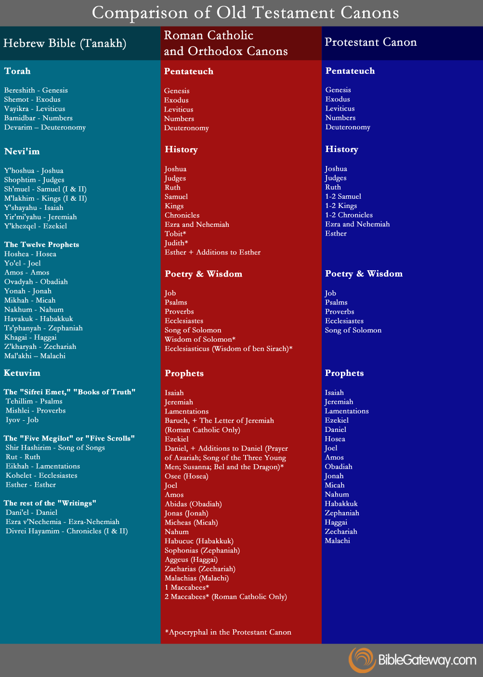
The Bible canon

Slide 16
THE BIBLE
EVANGELICAL VIEW
Criteria for Canonicity
How did they determine that a book should be included in the Bible?
Was the book written by a prophet or apostle of God?
(only criterion used by the early Fathers)
Was the writer confirmed by acts of God (miracles)?
Did the message tell the truth of God (no contradictions)?
Does it come with the power of God (edifying effect)?
Was it accepted by the people of God (contemporaries)?
A General Introduction to the Bible, p. 223-234

Slide 17
THE BIBLE
EVANGELICAL VIEW
Closed Canon
“God has inspired only so many books and they were all completed by the end of the apostolic period (first century A.D.) God used to speak through the prophets of the Old Testament, but in the ‘last days’ he spoke through Christ (Heb. 1:1) and the apostles whom He empowered with special ‘signs’ (miracles). But because the apostolic age ended with the death of the apostles (Acts 1:22), and because no one since apostolic times has had the ‘signs of a true apostle’ (2 Cor. 12:12) whereby they can raise the dead (Acts 20:10-12) and perform other unique supernatural events (Acts 3: 1-10; 28:809), it may be concluded that God's ‘last day’ revelation is complete (Acts 2:16-18).”
A General Introduction to the Bible, p. 217

Slide 18
THE BIBLE
EVANGELICAL VIEW
Closed Canon
God no longer provides revelation worthy of being canonized. Instead, we should rely solely on already existing scripture (sola Scriptura):
"God, who at sundry times and in divers manners spake in time past unto the fathers by the prophets, hath in these last days spoken unto us by his Son . . ."
Hebrews 1:1

Slide 19
THE BIBLE
EVANGELICAL VIEW
Closed Canon
“Ample evidence confirms that all the books of the New Testament are apostolic or prophetic. The question that remains is whether all the apostolic books are in the New Testament. Two books in particular have been called into question: the so-called Epistle of the Laodiceans (Col. 4:16) and a Corinthian epistle some believe was written before
1 Corinthians (see 1 Cor. 5:9). These books pose a problem concerning canonicity because they were both prophetic and yet are allegedly not in the canon.”
A General Introduction to the Bible, p. 213

Slide 20
THE BIBLE
EVANGELICAL VIEW
Luther Questioned James’ Canonicity
Martin Luther wrote:
“In a word, St. John’s Gospel and his first epistle, St. Paul’s epistles, especially Romans, Galatians and Ephesians, and St. Peter’s first epistle are the books that show you Christ and teach you all that is necessary and good for you to know, even though you were never to see or hear any other book or doctrine. Therefore St. James’ epistle is really an epistle of straw, compared to them; for it has nothing of the nature of the Gospel about it.”

Slide 21
THE BIBLE
EVANGELICAL VIEW
Luther Questioned James’ Canonicity
“Martin Luther questioned the full canonicity of James because he thought the book taught salvation by works, and that teaching was contrary to the doctrine of salvation by faith as it was clearly taught in other Scriptures . . . Luther placed James at the end of the New Testament, saying, ‘I do not regard it as the writing of an apostle; and my reasons follow. In the first place it is flatly against St. Paul and all the rest of Scripture in ascribing justification to works . . .’”
A General Introduction to the Bible, p. 227-228

Slide 22
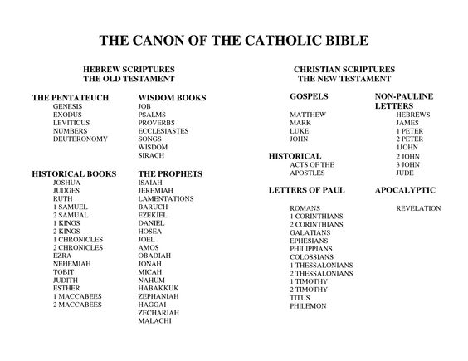
THE BIBLE
Additional Books in Catholic Canon
In the Council of Trent (northern Italy 1545 to 1563), as part of the Counter-Reformation, the Roman Catholic Church held an ecumenical council that inserted what some have called “apocryphal” books:

Slide 23
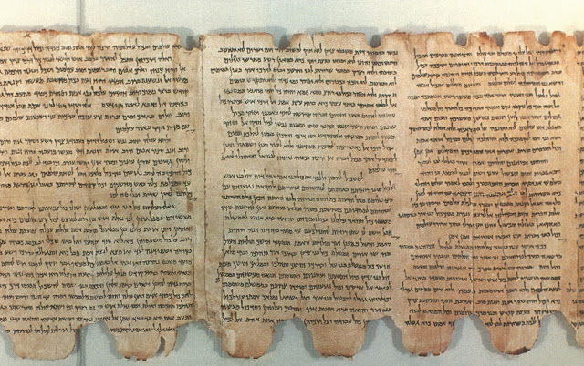
old testament manuscripts

Slide 24
THE BIBLE
Old Testament Manuscripts
By 500 BC, all 39 books of the OT had been written in Hebrew. Preserving the OT in Greek -- the Septuagint:
Between 250 BC and 150 BC, in Alexandria, Egypt, 72 scholars worked to translate the OT into Greek.
This Greek OT was the scripture that Jesus and the apostles used and quoted from and that influenced the early Christian church.
Instead of chronological order, it arranged the OT by subject matter: 5 books of Law, 12 books of History, 5 books of Poetry, 17 books of Prophecy. In 382 AD, Jerome followed this same order in writing the Latin Vulgate (OT & NT).
Today, when we refer to “Septuagint,” there is no original manuscript from 200 AD. It is a generic term for Greek translations of the OT.
Greek translations of the OT handed down through time seem to indicate only about 16 minor differences from the Hebrew Masoretic text.
I.V. changes in Genesis do not appear in the Greek or Hebrew texts or the Dead Sea scrolls kept by the Essenes in 100 BC to 100 AD (oldest OT that exists today).

Slide 25
THE BIBLE
Old Testament Manuscripts
1450 BC – original Penteteuch written during the Exodus
500 BC - all 39 books of the OT had been written in Hebrew.
200 BC – Greek OT translated by 72 scholars in Alexandria, Egypt (Septuagint – LXX)
100 BC – 100 AD – Essenes wrote Dead Sea Scrolls in Qumran
382 AD – Jerome translated the Bible into Latin (the Bible for 1000 years)
500 – 950 AD – Masoretes maintain strict discipline in keeping OT text.
950 AD – Last of the Masoretes (Jewish scribes), Moses ben Asher, in Tiberias, Galilee
1300s AD – The first English translations
1455 AD – Gutenberg’s printing press
1611 AD – King James Version of the entire Bible in print form was published

Slide 26
THE BIBLE
Old Testament Manuscripts
Translation Process
200 BC – Hebrew OT translated into Greek
382 AD - Hebrew OT translated into Latin (not first time this occurred)
1300s AD – Hebrew OT translated into English
Hebrew was in all consonants with no spaces between letters and no inflection marks for pronunciation (at least not until the Masoretes). How would you translate the following examples?
HEISNOWHERE
DIDYOUEVERSEEABUNDANCEONATABLE
These two examples are easier because they contain vowels. Look at the above two examples and take out the vowels. Consonantal Hebrew was a lot harder to translate. We owe a great deal to the translators for preserving what they did.

Slide 27
THE BIBLE
Old Testament Manuscripts
Hebrew OT: By 500 BC, all 39 books of the OT had been written in Hebrew. These were continuously preserved by Hebrew scholars until about 950 AD (ending with Moses ben Asher in Tiberias, Galilee).
Greek OT: Around 200 BC, the Greek OT (Septuagint) was completed. This was the scripture of the NT church. It is what they quoted in their NT writings. However, we only have copies of Greek OT translations passed down through time. We do not have the original Greek OT.
LATIN VULGATE
Latin: In 382 AD, Jerome used the Hebrew text of the Jewish scholars to translate the OT into Latin. However, he followed the Septuagint's order of arranging books by topic , instead of chronology (like the Hebrew text). The Vulgate also contained the 27 books of the NT and the Apocrypha. The Latin Vulgate was the Bible of the Christian church for 1000 years.

Slide 28
THE BIBLE
Age of Old Testament Manuscripts
1. Masoretic Text (500 AD to 1000 AD) ---> King James Old Testament that is translated in 1611.
2. Dead Sea Scrolls (100 BC to 100 AD) are found in 1947.
In other words, the original KJV Old Testament was based on manuscripts that originated from between 500 to 1000 AD.
Today, however, we have Old Testament manuscripts that go all the way back to the time of Christ, more specifically 100 BC to 100 AD.
In the 1830s, Joseph Smith used KJV Old Testament (based on manuscripts that were dated 500 AD to 1000 AD) as a basis to write the Inspired Version. IV version of Genesis does not appear in Masoretic text or the Essene’s Dead Sea Scrolls.

Slide 29
THE BIBLE
Age of Old Testament Manuscripts
A General Introduction to the Bible:
“Nevertheless, the period from about 500 to 1000 [A.D.] produced scholars who were revising the Old Testament and adding finer points to the Hebrew text. Those scholars, the Masoretes, produced the Masoretic text, which is still the authoritative text of the Hebrew Scriptures.” P. 447
"The Dead Sea Scrolls, discovered in March 1947, include “thousands of fragments, which together represent every Old Testament book except Esther. . .” p. 360
“There can be no reasonable doubt that the Qumran manuscripts came from the century before Christ and the first century A.D. Thus, they are one thousand years older than the Masoretic manuscripts of the tenth century.” p. 366

Slide 30
THE BIBLE
Timeframe for Removing Text from OT Manuscripts
So manuscripts that scholars used to create the 1611 King James Version of the Old Testament were dated around 1,000 A.D.
In 1842, when Joseph Smith told John Wentworth that we believe the Bible is the word of God as far as it is translated correctly and when 1 Nephi 3 said plain and precious truths had been removed from a book, if actual text was removed from the Old Testament, there was a timeframe from 1450 BC to 1000 AD to possibly remove text from the Old Testament.
Later, men discovered the Essenes’ Dead Sea Scrolls. If text was removed from the OT (e.g., story of Enoch), it would now have to be between 1450 BC and the time of Christ.

Slide 31
THE BIBLE
Old Testament
The OT was translated from a small number, but accurate Hebrew manuscripts.
vs.
New Testament
The NT was translated from a large number, but less accurate Greek manuscripts.

Slide 32
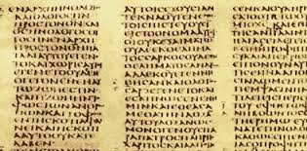
new testament manuscripts

Slide 33
THE BIBLE
New Testament Manuscripts
50 AD to 100 AD – The 27 books of the NT are written on papyrus
90 AD – Because papyrus disintegrates rapidly, copies started to be made.
302 AD – Diocletian started to persecute Christians and destroy manuscripts.
325 AD – Constantine – manuscripts began to abound and the Council of Nicaea (Complete NT available through Eusebius) – James, 2 Peter, 2 and 3 John and Jude were “spoken against” (out of canon)
367 AD – Athanasius’ Easter Letter (the father of orthodoxy) clearly and emphatically settled the matter by listing all 27 books as being acceptable.
382 AD – Jerome writes the entire Bible in Latin – the Latin Vulgate
1455 AD – Gutenberg printed the Latin Vulgate
1516 AD – Erasmus printed first Greek NT (became the Textus Receptus)
1611 AD – KJV scholars used the Textus Receptus to make KJV NT.

Slide 34
THE BIBLE
New Testament Manuscripts
A General Introduction to the Bible:
“Most of the New Testament books were written during the second half of the first century . . . They were undoubtedly written on papyrus and have all subsequently been lost . . . copies were made as early as A.D. 95.” (p. 445)
Today, there are 5,366 partial and complete New Testament manuscripts written between the second and fifteenth centuries. (p. 355)
“Hence, whereas the fidelity of the Old Testament is based on relatively few but good manuscripts, the integrity of the New Testament is derived by a critical comparison of many manuscripts that are of poorer quality (i.e., they possess more variant readings).” (p. 466)

Slide 35
THE BIBLE
EVANGELICAL VIEW
New Testament Manuscripts
A General Introduction to the Bible:
“In fact, if there were no biblical manuscripts available today, the entire New Testament could be reconstructed from the writings of the church Fathers of the first three centuries with the exception of eleven verses.” p. 466
“The number of manuscripts of the New Testament, of early translations from it, and of quotations from it in the oldest writers of the Church, is so large that it is practically certain that the true reading of every doubtful passage is preserved in some one or other of these ancient authorities. This can be said of no other ancient book in the world.”
p. 355

Slide 36
THE BIBLE
New Testament Manuscripts
Today, there are four families of NT manuscripts: Byzantine, Alexandrian, Western and Caesarean.
“Majority text” refers to the fact the KJV and NKJV were taken from the Byzantine family that comprises 80% of existing NT manuscripts. Basis for the Textus Receptus.
“Textus Receptus” or “Received Text” – In order: Cardinal Ximenes, Erasmus, Beza and Estienne (Stephanus) made a lot of errors (primarily Erasmus) in successively translating Greek New Testaments between 1514 and 1611 to create Textus Receptus.
In 1611, the KJV scholars used Textus Receptus to create their New Testament.

Slide 37
THE BIBLE
New Testament Manuscripts
KJV NT Based on 12th Century Manuscripts
“Since Erasmus could not find a manuscript which contained the entire Greek Testament, he utilized several for various parts of the New Testament. For most of the text he relied on two rather inferior manuscripts in the university library at Basle, one of the Gospels and one of the Acts and Epistles, but dating from about the twelfth century. . . Erasmus depended upon the Latin Vulgate, translating this into Greek. As would be expected from such a procedure, here and there in Erasmus’ self-made Greek text are readings which have never been found in any known Greek manuscript but which are still perpetuated today in printings of the so-called Textus Receptus of the Greek New Testament.”
Bruce Metzger
The Text of the New Testament
p. 99-100

Slide 38
THE BIBLE
Timeframe for Removing Text from NT Manuscripts
The Greek New Testament was first published in printed form in 1516 by Erasmus, who used 12th century manuscripts he found in a library in Basle, Switzerland. Even though it contained hundreds of errors, this became the Textus Receptus or Received Text that the King James scholars used to create the New Testament that they published in 1611.
In 1842, when Joseph Smith told John Wentworth that we believe the Bible is the word of God so far as it is translated correctly and when 1 Nephi 3 was saying that plain and precious truths had been removed from a book, there was a timeframe from 50 AD to the 1100s AD for text to possibly be removed from the New Testament.
Later, men discovered Codex Sinaiticus going back to 340 A.D, older than any manuscript existing in Joseph Smith’s day – window to remove text is reduced down to between 50 AD and 340 AD.

Slide 39
THE BIBLE
New Testament Manuscripts
Received Text: Ximenes, Erasmus, Beza, Estienne
In 1516, Erasmus published the first Greek NT ever in PRINT. It contained hundreds of errors.
Because there were so many errors, he issued a new edition in 1519. Martin Luther probably used this one to create his German NT translation.
“In 1522, Erasmus printed his third edition, in which he reluctantly inserted 1 John 5:7.” This one was used by Tyndale for his English NT and by Coverdale for his Bibles. (p. 450)
In 1527, Erasmus used the Complutensian Polyglot (by Cardinal Ximenes) to publish his fourth edition. Theodore Beza used this fourth edition as a basis to publish his nine editions of the Greek NT.

Slide 40
THE BIBLE
New Testament Manuscripts
Received Text: Ximenes, Erasmus, Beza, Estienne
Theodore Beza used Erasmus' fourth edition of the Greek New Testament as a basis to publish his nine editions of the Greek NT.
Robert Estienne, royal printer in Paris, published the Greek NT in 1546, 1549, 1550 and 1551, and for the first time inserted what are the modern verse divisions of the NT. This was used for the Geneva Bible and KJV. This Greek text of Estienne held sway in England.
Received Text “regarded as ‘the only true text’ of the NT.’” (p. 452)

Slide 41
THE BIBLE
New Testament Manuscripts
Count Constantin von Tischendorf from Russia made 3 trips to the monastery of St. Catherine at Mt. Sinai:
In 1844, he found the Russian monks had 43 pages of the Septuagint in a basket of scraps they were using to light fires (retrieved 4 books of OT).
Went again in 1853, but was unfruitful.
Returned again in 1859 under authority of Czar Alexander II. Just as he was about to return home empty-handed, the monastery steward showed him an almost complete copy of the Scriptures – later acquired as a “conditional gift” to the czar.
Known today as Codex Sinaiticus (circa 340 AD). It contained over half of the OT and all of the NT except for Mark 16:9-20 and John 7:53-8:11. Written on vellum made from antelope skins. The text-type is Alexandrian. In 1933, the Communists sold it to the British Museum. It is there today. Geisler and Nix, p. 392-394

Slide 42
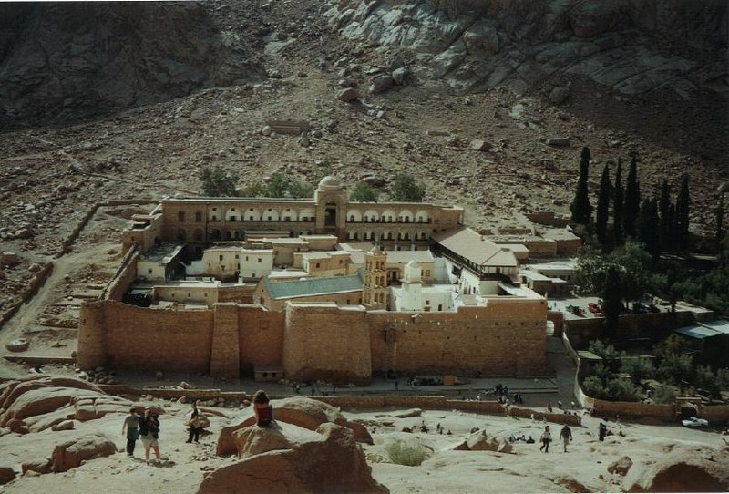
ST. CATHERINE’S MONASTERY ON MT. SINAI
EVANGELICAL VIEW
New Testament Manuscripts

Slide 43
THE BIBLE
EVANGELICAL VIEW
New Testament Manuscripts
In 1881, Westcott and Hort (Cambridge scholars) published The New Testament in the Original Greek based on Alexandrian manuscripts (older, more reliable) – today called “Critical Text.”
Today, most King James Only advocates (e.g., Zane Hodges):
do not even try to defend Textus Receptus errors that crept in with Ximenes, Erasmus, Estienne and Beza from 1514 to 1611,
but they do defend the Majority Text (Byzantine that are 80% of manuscripts), largely based on the overwhelming number of manuscripts.

Slide 44
THE BIBLE
EVANGELICAL VIEW
New Testament: Majority Text vs. Critical Text
King James Version’s New Testament, published in 1611, came from the Byzantine family. Erasmus used 12th century manuscripts. Today, there are King James Only (KJO) advocates who believe the KJV is the only version that should be used. Some extremists claim verbal inspiration (word-for-word revelation).
New International Version’s New Testament, published in 1973, came from the Alexandrian family and used “eclectic method” (variant-by-variant) to translate, rather than just sticking to Alexandrian. Variant example: when Mark 16:9-20 did not appear in Alexandrian manuscript, they used Byzantine to insert that text and included a footnote.

Slide 45
THE BIBLE
EVANGELICAL VIEW
New Testament: KJV (12th Century) vs. NIV (4th Century)
King James Version’s New Testament: In 1516, Erasmus used a handful of 12th century Greek manuscripts he found in the library at Basle to publish the first PRINTED Greek NT.
Since that time, we have discovered older NT manuscripts:
1. Codex Vaticanus (325 AD) – parchment copy of the whole Bible that was not made known to textual scholars until after 1475 AD. For the next 400 years, scholars were still prohibited from studying it. It is missing 1 Timothy through Philemon and Hebrews 9:14 to the end of the NT. It does not have Mark 16:9-20 or John 7:53-8:11. It is in the Vatican Library today.
2. Codex Sinaiticus (340 AD) – From the St. Catherine’s monastery on Mt. Sinai. It contains over half the OT (LXX), and all of the NT, with the exception of Mark 16:9-20 and John 7:53-8:11. Written on parchment. It also has the Apocrypha, Epistle of Barnabas and a large portion of the Shepherd of Hermas. It is in the British Museum today.

Slide 46
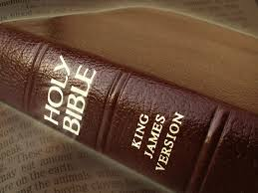
the “King james only” controversy

Slide 47
THE BIBLE
EVANGELICAL VIEW
“King James Only” Controversy
1 John 5:7-8
1. Textus Receptus (KJV and IV) says, “For there are three that bear record in heaven, the Father, the Word, and the Holy Ghost; and these three are one. And there are three that bear witness in earth. . .”
2. Critical Text (NIV) does not have verse 8. Regarding this passage, a footnote in the NIV Bible says that verse 8 was “not found in any Greek manuscript before the sixteenth century.”
The bolded wording, which is verse 8 in the KJV and IV, did not appear in hundreds of Greek manuscripts that existed in Erasmus' time, nor was it in Erasmus’ 1516 NT, but it did appear in his 1522 version of the NT and it was subsequently included in the KJV (p. 483).
KJV adherents say this was an inspired emendation.

Slide 48
THE BIBLE
EVANGELICAL VIEW
“King James Only” Controversy
John 7:53 -8:11
Regarding the story of the adulterous woman in John 8:1-11, the NIV Bible says in a footnote: “The earliest and most reliable manuscripts and other ancient witnesses do not have John 7:53 – 8:11.”
Geisler and Nix: “It should be regarded as an addition to John’s gospel with no fixed place in the ancient witnesses that include it.” This passage did not appear in manuscripts until about the fifth or sixth century AD.
Bruce Metzger: “The evidence for the non-Johannine origin of the pericope of the adultress is overwhelming.” (p.485)
Result: KJV and IV include it, but the NIV does not.
KJV adherents say this was another inspired emendation.
NIV adherents argue that is was a conjectural emendation.

Slide 49
THE BIBLE
EVANGELICAL VIEW
“King James Only” Controversy
Mark 16:9-20
This passage describes resurrection appearances of Jesus to Mary Magdelene, two others while walking, and the 11 disciples while eating. He instructed them to preach and baptize saying, “He that believeth and is baptized shall be saved; but he that believeth not shall be damned.”
In a footnote, the NIV Bible says: “The most reliable early manuscripts and other ancient witnesses do not have Mark 16:9-20.”
Bruce Metzger said this longer ending “had no claim to be original.” p. 486
However, the early church fathers quote some of these last 12 verses. So most Bible versions keep it in the text, but add footnotes.
The gospel of Mark originally ended at Mark 16:8.
KJV adherents say this was another inspired emendation.
NIV adherents argue that is was a conjectural emendation.

Slide 50
What is meant by “plain and precious truths” being removed from the gospel?

Slide 51
THE BIBLE
RESTORATION VIEW
Plain and Precious Parts of the Gospel Taken from the Book
1 Nephi 3:
147 - Columbus and v. 148 – Gentiles cross the ocean
149 And it came to pass that I beheld many multitudes of the Gentiles upon the land of promise . . .
157 And I beheld a book, and it was carried forth among them.
160 Behold it proceedeth out of the mouth of a Jew

Slide 52
THE BIBLE
RESTORATION VIEW
Plain and Precious Parts of the Gospel Taken from the Book
1 Nephi 3:
161 The book that thou beholdest is a record of the Jews . . .
165 . . . it contained the plainness of the gospel of the Lord, of whom the twelve apostles bear record . . .
166 Wherefore, these things go forth from the Jews in purity unto the Gentiles . . .
167 And after they go forth by the hand of the twelve apostles of Lamb, from the Jews unto the Gentiles, thou seest the foundation of a great and abominable church, which is most abominable above all other churches.
168 For behold, they have taken away from the gospel of the Lamb many parts which are plain and most precious.
169 And also many covenants of the Lord have they taken away.

Slide 53
THE BIBLE
INSPIRED EMENDATION
So why do we not find the IV version of Genesis in the Masoretic text or the Essene’s Dead Sea Scrolls?
Was Erasmus inspired by God to insert 1 John 5:7, or was that merely conjecture on his part? King James Only advocates say that he was inspired.
Was a scribe back in the fifth century AD inspired by God to insert the story of the adulterous woman, or was that conjecture?
Since the story of Enoch does not appear in any OT manuscripts, was it an inspired emendation?

Slide 54
THE BIBLE
TRUTH CAN BE REMOVED BY "HOW WE TEACH"
THE SCRIPTURES
As I grew up in the church, I was always given the impression that the way that “plain and precious” truths were taken from “the book” was that actual text was removed by the great and abominable church.
But there is an alternative to that. You and I can look at the same passage of scripture, but we can each explain its meaning in a completely different way. In teaching what the scriptures mean, we can, intentionally or unintentionally, remove plain and precious truths by the way we teach something. It doesn't always have to be actual scriptural text that is removed.

Slide 55
THE BIBLE
BOB’S VIEW: INSPIRED VERSION
For the first 30 years of our church, the KJV was the official Bible.
The Inspired Version is entirely distinct from any other translation of the Bible (manuscript evidence).
NT: There are differences in the text of the IV compared to the KJV.
OT: The IV's Genesis makes significant changes -- not corroborated by the Septuagint, the Masoretic text, or the Dead Sea Scrolls at Qumran.
The Inspired Version is not a restoration of the original text of the Bible; however, it restores plain and precious truths.

Slide 56
THE BIBLE
BOB’S VIEW: INSPIRED VERSION
OT: Dead Sea Scrolls are 1000 years older than what the KJV used and do not corroborate text found in the IV’s version of Genesis.
NT: The KJV’s and IV’s New Testaments both originate from the Textus Receptus.
The IV retains King James English.
The IV could be thought of as inspired emendation, but the changes are very extensive – difficult for skeptics who are focused on manuscript evidence to believe.
Should there be a modern-language version of the I.V. that shows exactly where changes were made? (perhaps use NKJV as a basis since it’s NT also came from the KJV or Byzantine family of manuscripts).

Slide 57
THE BIBLE
KING JAMES ENGLISH
Here are a few of the archaic words found in both the KJV and IV. Tell me if you know the definition of any of these:
amerce astonied avouch beeves bier
calkers clouts caul chapiter choler
collops cracknel dandled daysman euroclydon
execration fen firkin fitches habergon
haft knops laver neesings osee
phylactery ribband rie satyr tabering

Slide 58
THE BIBLE
EVANGELICAL VIEW
Trying to Apply Modern Standard of Plagiarism
A few evangelicals attempt to retroactively apply a modern standard of plagiarism to the Book of Mormon. Yet Geisler and Nix say the following about the Bible:
“The Bible often uses human sources for its material: Luke may have used written sources for his gospel (Luke 1:1-4); the Old Testament often used non-canonical writings as sources (cf. Josh. 10:13); Paul quoted non-Christian poets three times (Acts 17:28; 1 Cor. 15:33; Titus 1:12); Jude cited material contained in non-canonical books (Jude 9, 14).”
A General Introduction to the Bible, p. 187

Slide 59
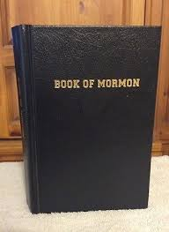
material sufficiency vs. formal sufficiency

Slide 60
THE BIBLE
RESTORATION VIEW
The Bible is Materially Sufficient
The Restoration would say that the Bible is “materially sufficient,” meaning that:
all the elements of Christ’s gospel can be found in the Bible; and
it is possible for a person who reads to the Bible to be saved.

Slide 61
THE BIBLE
RESTORATION VIEW
The Bible Lacks Formal Sufficiency
The Restoration would say that the Bible lacks "formal sufficiency," meaning it is not written in such a way that it is easy for the average reader to fully comprehend all the elements of Christ’s gospel (i.e., not delivered in a form that is easy to understand). It requires a lot of detective work.
Thus, the need for the Book of Mormon.

Slide 62
WHAT DO YOU PLAN TO DO?
“When they had dined, Jesus saith to Simon Peter, Simon, son of Jonas, lovest thou me more than these? He saith unto him, Yea, Lord; thou knowest that I love thee. He saith unto him, Feed my lambs.
He saith to him again the second time, Simon, son of Jonas, lovest thou me? He saith unto him, Yea, Lord; thou knowest that I love thee. He saith unto him, Feed my sheep.
He saith unto him the third time, Simon, son of Jonas, lovest thou me? Peter was grieved because he said unto him the third time, Lovest thou me? And he said unto him, Lord, thou knowest all things; thou knowest that I love thee. Jesus saith unto him, Feed my sheep.”
John 21:15-17

Slide 63
APPENDIX

Slide 64
ESCHATOLOGY (PAROUSIA)
Historic Pre-millenialism
The Jewish people will convert to a belief in Christ just prior to his second coming.
This was the prevailing view of the early church fathers.

Slide 65
ESCHATOLOGY
Dispensational Pre-millenialism
This is the most common perspective today.
There will be a 7-year tribulation and a rapture.
Subsets within this view concern the timing of the rapture:
Pre-tribulation
Mid-tribulation
Post-tribulation
Jesus will then rule from Jerusalem for 1000 years.

Slide 66
ESCHATOLOGY
Amillenialism
There will be no millenium.
In actuality, Jesus is reigning today; we are in the midst of it.
This was the view of St. Augustine.
It is also the perspective of Catholics, and many Presbyterians and Lutherans.
Most evangelicals feel that Romans 11 presents an argument against this perspective.

Slide 67
ESCHATOLOGY
Post-millenialism
The world is constantly getting better.
More people are converting to a belief in Christ.
It was thought that this would usher in Christ’s return.
This view fell out of favor very early on, among adherents of Christianity, for obvious reasons.

