Slide 1
WHAT IS THE “FULLNESS”OF THE GOSPEL?
Bible References are from the King James Version unless otherwise indicated
Copyright © 2016 by Robert R. Bobbitt. Unauthorized use or duplication of this material without express and written permission from Robert R. Bobbitt is strictly prohibited.

Slide 2
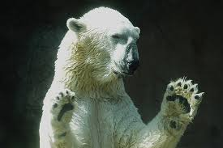
"Fullness"? "Restored"?
If someone asked you these questions, what would you say to them?
What is the "fullness" of the gospel?
What do you mean by "the gospel was restored"?
"How full is it? Well, it's about this full!"

Slide 3
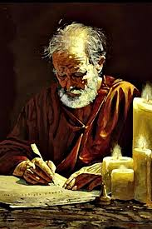
Paul's Key to Witnessing: Common Ground
1 Corinthians 9:20-23:
20 And unto the Jews, I became as a Jew, that I might gain the Jews;
To them that are under the law, as under the law, that I might gain them that are under the law;
(next slide)
Notes:
Verse 20 & 21 – "Secular Jews" – would not describe themselves as religious believers, but still identify as part of the Jewish people. They accept Jewish values, ethics and concerns.
"Orthodox Jews" – try to stay away from the world. They might not own a television, might not listen to non-Jewish music, might avoid non-Jewish magazines. Men still wear a yamulka, a skull cap they were forced to wear in Europe whenever they left their ghetto. Men and women sit separately in worship and women do not participate in some of the rituals. They respect the divine origin of the Old Testament law. This includes the codification of the "oral law" in the Talmud. Orthodox Judaism is not administered by some central authority. Synagogues are established by groups of Jews who raise their own funds and construct their own buildings. There are lots of different Orthodox synagogues organized around many different perspectives.
"Ultra-orthodox Jews" – which arose in the 1700s and 1800s, will not even live in a non-Jewish neighborhood, wear long black coats, flowing beards, wide-brim black hats and sometimes represent various minority groups within Orthodox Judaism. Ultra-orthodox who are Hassidic – look anxiously for the return of the Messiah, are more mystical, and search for ecstasy in their prayers. Hassidic – go back to Eastern Europe when Jews were living in conditions of despair – Hassidism was a way of infusing joy and hope into life, and some Jews say, emphasized the heart at the expense of the mind.
"Conservative Jews" – which arose in the 1900s, is a reaction to excesses of Reform Jews and objected to Reform Jews' reforming the commandments of the Torah (written law). Conservatives still consider the written law to be binding, but say we need to reconsider the oral law (Talmud) and how it applies to modern times. Men and women are not segregated in worship. It is in between Orthodoxy and Reform. It is intellectually liberal in matters of belief but conservative in matters of religious practice – commitment to Jewish observance. Conservative study of holy texts is combined with the belief that Judaism is constantly evolving. In 1960, the Rabbinical Assembly of America agreed to modify Orthodox "halacha" (Jewish law) to permit the use of electrical appliances on the Sabbath and to drive to synagogue in a car. In 1985, it permitted the ordination of women rabbis.

Slide 4
Paul's Key to Witnessing: Common Ground
21 To them that are without law, as without law, (being not without law to God, but under the law to Christ,) that I might gain them that are without law.
22 To the weak became I as weak, that I might gain the weak; I am made all things to all men, that I might by all means save some.
23 And this I do for the gospel's sake, that I might be partaker thereof with you.
1 Corinthians 9:20-23
Notes:
Verse 20 & 21 – "Secular Jews" – would not describe themselves as religious believers, but still identify as part of the Jewish people. They accept Jewish values, ethics and concerns.
Verse 22 - "Progressive or Reform Jews" – Many progressives do not even wear a yarmulke. Temple services are shorter, conducted with a little more decorum (less individual praying and conversation), English is used for parts of their worship (Orthodox stick to Hebrew) and men and women sit together. In the early 1800s, a new movement, which is described as Progressive, Reform or Liberal, arose with the emancipation of the Jews of the various German states. Granted equal rights and released from the ghettos to which they had been confined for centuries, some embraced the Enlightenment which resulted in European Liberal Judaism and spread to North America where it became more radical and less traditional: embraced evolution, history and biblical scholarship, founding Non-orthodox rabbinical seminaries in Europe and the United States. Progressive Jews regard the "sacred heritage" of the Torah as evolving and adapting over the centuries. They still study the Hebrew language and sacred texts, are committed to Israel, support the full equality of women and accept any sexual orientation.

Slide 5
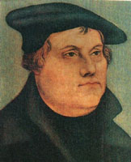
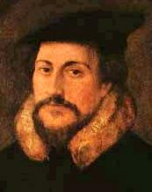
EVANGELICALS (USED TO BE CALLED “FUNDAMENTALISTS”)
1. Man is saved by grace through faith ALONE.
2. The Bible is the INFALLIBLE word of God (original autographs) and the ONLY word of God.
3. The “priesthood of all believers” REPLACED the Old Testament ministerial priesthood (i.e., Aaronic priesthood) at the cross.
Evangelical Christians frequently exhibit a missionary zeal!
This is not a denomination!

Slide 6
Sharing The Gospel

Slide 7
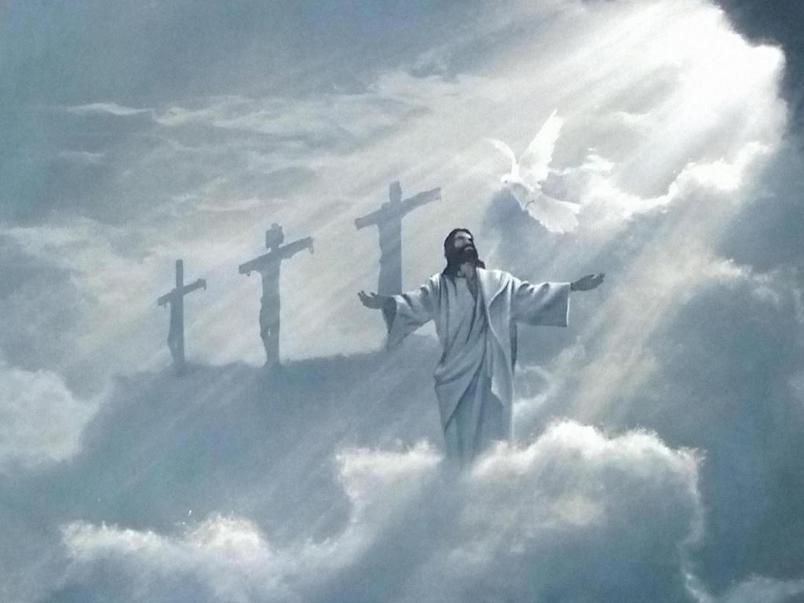
COMMON GROUND: Same Jesus
Restoration: The object of our faith is the same as other Christian denominations. We believe in the same Jesus:
For behold, the time cometh, and is not far distant, that with power, the Lord Omnipotent who reigneth, who was, and is from all eternity to all eternity, shall come down from heaven, among the children of men, and shall dwell in a tabernacle of clay . . . And he shall be called Jesus Christ, the Son of God, the Father of heaven and earth, the Creator of all things, from the beginning; and his mother shall be called Mary.
Mosiah 1:97 & 102

Slide 8
SHARING THE GOSPEL
Every witnessing opportunity should begin by establishing common ground. For our evangelical friends:
1) We worship the same Jesus (Mosiah 1:97).

Slide 9
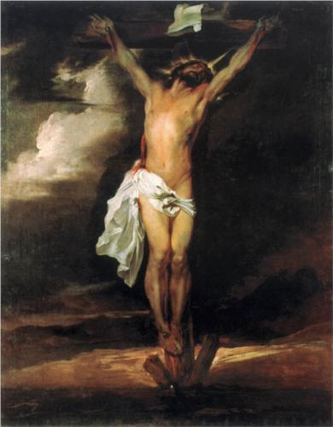
we are saved by christ alone

Slide 10
Common Ground: Christ Alone
Restoration: We are saved by Christ alone.
And now, my beloved brethren, after ye have gotten into this strait and narrow path, I would ask, if all is done? Behold, I say unto you, Nay; for ye have not come thus far, save it were by the word of Christ, with unshaken faith in him, relying WHOLLY upon the merits of HIM who is mighty to save.
2 Nephi 13:27-28
. . . relying alone upon the merits of Christ, who was the author and the finisher of their faith.
Moroni 6:5

Slide 11
Common Ground: Christ Alone
And if ye believe on his name, ye will repent of all your sins, that thereby ye may have a remission of them through HIS merits.
Helaman 5:67
And now my son, I have told you this, that ye may learn wisdom, that ye may learn of me that there is no other way nor means whereby man can be saved, ONLY in and through Christ.
Alma 18:11

Slide 12
Sharing the Gospel
Every witnessing opportunity should begin by establishing common ground. For our evangelical friends:
1) We worship the same Jesus (Mos. 1:97).
2) We are saved by the merits of Christ alone (2 Ne. 13:27-28).

Slide 13
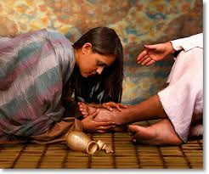
we are saved by grace alone

Slide 14
Common Ground: Grace Alone
Restoration: We are saved by grace alone.
And remember after ye are reconciled unto God, that it is ONLY in and through the grace of God that ye are saved.
2 Nephi 7:42

Slide 15
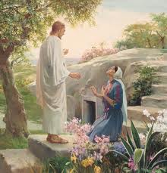
Common Ground: Grace Alone
[Wife of King Lamoni] O blessed Jesus, who has saved me from an awful hell! O blessed God, have mercy upon this people.
Alma 12:170

Slide 16
Common Ground: Grace Alone
Verily, verily, I say unto you, He that heareth my word, and believeth on him that sent me, hath everlasting life, and shall not come into condemnation; but is passed from death unto life. John 5:24
“Faith” is the axiom. “Repentance and baptism” are the corollary.
Every true believer when given the opportunity will then repent, surrender to Christ as Lord, and be baptized.

Slide 17
Sharing the Gospel
Every witnessing opportunity should begin by establishing common ground. For our evangelical friends:
1) We worship the same Jesus (Mos. 1:97).
2) We are saved by the merits of Christ alone (2 Ne. 13:27-28).
3) We are saved by his grace alone (2 Ne. 7:42).

Slide 18
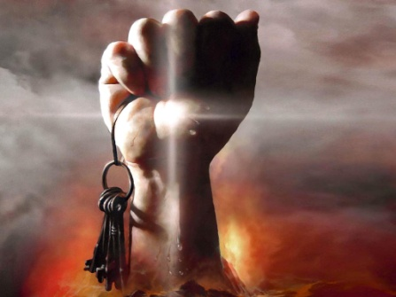
"Grace”: the key that unlocks God’s power in our lives

Slide 19
Grace: Unlocking God’s Power
What is grace?
Most evangelicals say grace is: “unmerited favor.”
Strong’s Concordance gives a literal definition: Charis means “the divine influence upon the heart and its reflection in the life.”
Baptist minister Bill Gothard uses 1 Corinthians 15:10 to derive an operational definition of grace: “the desire and power to do God's will.”

Slide 20
Grace: Desire/Power - Do God's Will
The definition of "grace" that says it's "the desire and power to do God's will" is derived from the following verse:
But by the grace of God I am what I am: and his grace which was bestowed upon me was not in vain; but I laboured more abundantly than they all: yet not I,
but the grace of God which was with me.
1 Corinthians 15:10

Slide 21
Grace: Desire/Power - Do God's Will
Nevertheless, the Lord God showeth us our weakness, that we may know that it is by his grace, and his great condescensions unto the children of men, that we have power to do these things.
Jacob 3:8

Slide 22
Grace: Desire/Power - Do God's Will
God resisteth the proud, but giveth grace unto the humble.
James 4:6

Slide 23
Grace: Desire/Power - Do God's Will
I give unto men weakness, that they may be humble; and my grace is sufficient for all men that humble themselves before me; for if they humble themselves before me, and have faith in me, then will I make weak things become strong unto them.
Ether 5:28

Slide 24
Grace: Desire/Power - Do God's Will
. . . continue to work out your salvation with fear and trembling, for it is God who works in you to will and to act according to his good purpose.
Philippians 2:12-13

Slide 25
Grace
Common Grace (Prevenient Grace)
"Common grace" is given to all people.
“Common grace” imposes moral constraints on people’s behavior, maintains order, and helps to instill a sense of right and wrong.
But it does not forgive sin (justifying grace) or sanctify the sinner (sanctifying grace). Here are scriptures on “common grace”:
That was the true Light, which lighteth every man that cometh into the world. John 1:9
And the Spirit giveth light to every man that cometh into the world; D & C 83:7c
For behold, the Spirit of Christ is given to every man, that they may know good from evil. Moroni 7:14

Slide 26
Sharing the Gospel
For our evangelical friends:
We worship the same Jesus (Mos. 1:97).
We are saved by the merits of Christ alone (2 Ne. 13:27-28).
We are saved by grace alone (2 Ne. 7:42) .
Grace is the desire and power to do God's will (1 Cor 15:10).

Slide 27
What is “Justification”?

Slide 28
Justified By Grace Alone
Salvation - has to do with being saved from hell to
eternal life (Alma 12:170).
Justification – relates to being forgiven and receiving the “imputed” [credited] righteousness of Christ, an undeserved crediting to our account (Romans 4:11, 22-24, James 2:23).
The last segment covered the fact that salvation is by grace alone:
And remember after ye are reconciled unto God, that it is only in and through the grace of God that ye are saved.
2 Nephi 7:42

Slide 29
Two Types of Grace
Justifying Grace and Sanctifying Grace
D & C 17:6 a-c:
a. And we know that all men must repent and believe on the name of Jesus Christ and worship the Father in his name, and endure in faith on his name to the end, or they cannot be saved in the kingdom of God.
b. And we know that justification through the grace of our Lord and Savior Jesus Christ, is just and true;
c. And we know, also, that sanctification through the grace of our Lord and Savior Jesus Christ, is just and true, to all those who love and serve God with all their mights, minds, and strength.

Slide 30
Justifying Grace
What is Justification?
Evangelical Concept of "Justification” is Crediting
To be “forgiven and declared righteous.”
A judicial declaration that occurs at the moment of initial belief in which Christ’s righteousness is credited to our account. Good works are “signs.”
Catholic Concept of "Justification” is Moral Transformation
Justification: At the moment of baptism, instead of a “crediting to the believer’s account,” God somehow transforms the believer himself into a righteous person. Even a baby’s moral character is transformed at baptism.
“Justification” is a process (that includes sanctification) in which the believer gradually becomes more and more like Christ (Council of Trent in 1546 said the believer becomes “more and more justified” by partaking of “sacraments”.)

Slide 31
Justifying Grace
What is Justification?
Evangelical Concept of "Justification”:
To be “forgiven and declared righteous.”
A judicial declaration at the moment a sinner first believes in which Christ’s righteousness is “imputed” (credited) to his account.
It’s as if we were condemned (an enemy to God) but then pardoned, and our sins not counted against us, even though we didn’t deserve it.
It’s described in Romans 8:1 & 33-34 as a forensic declaration in which it appears that there are two possibilities: justification or condemnation.

Slide 32
Justifying Grace
What is Justification?
Catholic Concept of "Justification" (Roman & Orthodox)
JUSTIFICATION - Rather than an undeserved crediting to his account, Catholicism says that a believer is sanctified or “made righteous” by God at baptism and transformed from a fallen state to a state of grace:
A moral transformation in which righteousness is actually imparted to the believer (internal), not credited (external).
Even a baby is sanctified or “made righteous” at baptism.
SANCTIFICATION (a subset of Justification) - Catholicism says that “justification” is a process of:
the believer becoming “more and more justified” by partaking of the “sacraments” of the church, and
gradually becoming more like Christ.
Notes:
The Protestant Reformation was ignited by Martin Luther in 1517.
In reaction to this, the Catholic Church launched a Counter-Reformation in which they fought back against Protestants.
The Catholic Church’s Council of Trent (1546-1563) was a Counter-Reformation response that resulted in their official position on “justification” that you see on this slide.

Slide 33
Justifying Grace
What is Justification?
The Restoration View of “Justification”
“Justification” is both an event and process initiated by “God’s grace” in which the righteousness of Christ that we don’t deserve is credited to our account:
by a forensic declaration at initial belief as described in John 5:24 and
Romans 8:1, 33-34 (an “event”), and
as we allow “God’s justifying grace” to accomplish repentance, faith and baptisms as described in Hebrews 6:1-3 and James 2:24 (a “process”).
Justified by “Christ alone” (2 Ne. 13:27-28) through “grace alone” (2 Ne. 7:42).
Rather than only two possibilities of condemnation or justification, there are three possible scenarios: condemnation, justification or ignorance (Romans 5:13, Romans 4:15, James 4:17, Romans 10:14, Luke 12:47-48, 2 Nephi 6:51-53).
Notes:
So we believe that this concept of “justification” is the best way to

Slide 34
Justification Begins with Faith
Verily, verily, I say unto you, He that heareth my word, and believeth on him that sent me, hath everlasting life, and shall not come into condemnation; but is passed from death unto life. John 5:24
“Faith” is the axiom. “Repentance and baptism” are the corollary.
Every true believer, when given the opportunity, will repent, surrender to Christ as Lord, and be baptized.

Slide 35
Justification Begins with Faith
In Romans 3:20 (NIV), Paul says no one is justified by
observing the law:
“Therefore no one will be declared righteous [justified] in his sight by observing the law; rather, through the law we become conscious of sin.”
In Romans 4:2-3 (NIV), Paul quotes Genesis 15:6 as evidence that Abraham was justified by faith:
“If, in fact, Abraham was justified by works, he had something to boast about – but not before God. What does the scripture say? “Abraham believed God, and it was credited to him as righteousness.”
The author of Hebrews 11:6 tells us:
“But without faith it is impossible to please him . . .”
[Note: Just going through the motions of keeping the Mosaic law is not enough. The works of the law by themselves accomplish nothing, if not accompanied by a genuine saving faith.]
Notes:
Here we have two scriptures that indicate we are justified (declared righteous) by faith, not works that we might perform.
However, faith is just the beginning of “justification.”
Romans 3:20 says “No one is justified by observing the law” if they don’t also have faith in God.
Hebrews 11:6 -

Slide 36
Justification Completed By Works
In Romans 2:13 (NIV), Paul says those who obey the law are justified:
For it is not those who hear the law who are righteous in God’s sight, but it is those who obey the law who will be declared righteous [justified].
[Note: Paul is not contradicting what he said on the last slide. The point is that both faith and obedience must be evident in the life of the true believer. Justification begins with faith and is completed by works that are initiated and sustained by God’s justifying grace.]
Notes:
On its face, Paul appears to be contradicting Romans 3:20 that we quoted on the last slide.
However, faith is the beginning of justification, and works are the completion of justification.
So we are justified, not just by faith, but by works also.

Slide 37
Justification Completed By Works
James 2:21-24 (KJV) tells us that we are justified by both faith and works:
²¹ Was not Abraham our father justified by works, when he had offered Isaac his son upon the altar?
²² Seest thou how faith wrought with his works, and by works was faith made perfect?
²³ And the scripture was fulfilled which saith, Abraham believed God, and it was imputed [credited] unto him for righteousness: and he was called the Friend of God.
²⁴ Ye see then how that by works a man is justified, and not by faith only.
[Note: James is not contradicting what Paul stated on the last two slides. Abraham was justified by faith, but he was also justified by works. Justification begins with faith and repentance and is completed by waterbaptism and receiving the gift of the Holy Spirit.]
Notes:
This writing by James the apostle appears to contradict what Paul told us about Abraham two slides back in Romans 4.
However, James points to BOTH faith AND works as reasons for justification.
We have to keep in mind that any good work we might do is only due to the grace of God operating in us. As his servants, we simply submit to his direction and obey as he commands.
So justification is a process that begins with faith and is completed by works. In James 2:24, we can see that they both play a role in justification.
Justification involves faith, repentance and baptism of water and the Spirit. It starts with faith and is complete when we are born of water and born of the Spirit.

Slide 38
Justification Begins with Faith
In Romans 4:2-3, Paul quotes Genesis 15:6 as evidence that Abraham was justified by faith:
² For if Abraham were justified by works, he hath whereof to glory; but not before God.
³ For what saith the scripture? Abraham believed God, and it was counted unto him for righteousness.

Slide 39
Justifying Grace
The Restoration View of “Justification” (continued):
So “justification” is both an event or forensic declaration at initial belief and a process guided and initiated by “justifying grace” (2 Ne. 7:42) in which there is:
Repentance - realizing the problem of our own sin nature.
Faith - relying on Christ’s atoning sacrifice and committing our lives to him.
Baptism:
Every “true” believer who has received these gifts will be baptized, or else they never had a genuine saving faith to begin with (Acts 22:16).
Therefore, refusing baptism could jeopardize a person’s saved condition if he does so against the witness of the Holy Spirit (Rom. 4:13, 5:13).
Confirmation: When we’re born of water and Spirit, our justification is complete; we have an assurance of salvation (John 3:3-5 & Romans 5:1).

Slide 40
Justifying Grace
The Restoration View of “Justification”:
So the Restoration differs from the rest of Christianity in five major ways:
1. We agree with evangelicals that “justification” is initiated at the moment we first believe (John 5:24), but it is not just an event, justification is also a process (Acts 22:16, Acts 8:12-17, Acts 19:1-7).
2. We agree with “sacramentalists” that baptism saves (Acts 22:16), but we do not believe that everyone who is baptized receives the “gift of the Holy Spirit” at water baptism (Acts 8:12-17, Acts 19:5-6).
3. Every true believer, when they receive the witness of the Holy Spirit that they should be baptized, will be baptized. A refusal to be baptized against the witness of the Spirit could place that person’s spiritual condition in jeopardy (Acts 10:48, Acts 22:16, 1 Peter 3:20-21). (next slide)
Notes:
This will be explained further in the section on baptism that follows.
Sacramentalists are denominations such as Catholics, Anglicans, Eastern Orthodox, Reformed Churches, Restorationist Churches (like Church of Christ) that all believe the sinner receives the gift of the Holy Spirit at water baptism rather than at initial belief. They also believe in infant baptism.
Regarding Acts 19 and the 12 men at Ephesus who had been baptized by John but not received the gift of the HS, there was another man in Ephesus who had been baptized by John but DID appear to have the gift of the Holy Spirit, and that was Apollos who was described in Acts 18:24-28.

Slide 41
Justifying Grace
The Restoration View of “Justification”:
Five major differences from the rest of Christianity (continued):
4. Like evangelicals, we believe that being born of water and being born of the Spirit can be two separate events. However, baptism saves, and the baptism of the Holy Spirit can follow, rather than precede, water baptism. (Matthew 3:16-17, Acts 8:12-17, Acts 19:5-6)
5. With water and Spirit baptisms, justification and regeneration are complete (John 3:3-5), and though he must endure to the end (Matthew 24:13), a believer in that state of grace can have a full assurance of salvation (John 3:3-5 and Romans 5:1).
Notes:
This will be explained further in the section on baptism that follows.

Slide 42
Sanctifying Grace
Restoration View
Restoration View of “Sanctification”:
Sanctification: the process of becoming more like Christ.
It is the gift of God’s sanctifying grace, that gives us the desire and power to do God’s will (1 Corinthians 15:10, D&C 17:6c).
It is only by a power outside ourselves, a supernatural act, that we could ever arrive at the “measure of the stature of the fullness of Christ.” (Ephesians 4:11-13)
Notes:
So we believe that “justification”For the purpose of clarity for our evangelical friends, their term “surrender” is included here, but we would normally refer to a “covenant to obey” as described in the Book of Mormon.

Slide 43
Grace
Justifying Grace and Sanctifying Grace
D & C 17:6 a-c:
a. And we know that all men must repent and believe on the name of Jesus Christ and worship the Father in his name, and endure in faith on his name to the end, or they cannot be saved in the kingdom of God.
b. And we know that justification through the grace of our Lord and Savior Jesus Christ, is just and true;
c. And we know, also, that sanctification through the grace of our Lord and Savior Jesus Christ, is just and true, to all those who love and serve God with all their mights, minds, and strength.

Slide 44
a false assurance of salvation

Slide 45
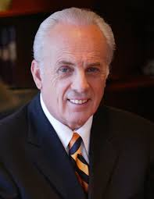
MacArthur: Distorted Gospel
John MacArthur:
“Not everyone who calls himself a Christian really is. Unbelievers do make false professions of faith in Christ, and people who are not truly Christians can be deceived into thinking they are believers . . . The cheap grace and easy faith of a distorted gospel are ruining the purity of the church.”

Slide 46
MacArthur: Distorted Gospel
MacArthur continued:
“The softening of the New Testament message has brought with it a putrefying inclusivism that in effect sees almost any kind of positive response to Jesus as tantamount to saving faith. Christians today are likely to accept anything other than utter rejection as authentic faith in Christ.” John MacArthur The Gospel According to Jesus, p. 37

Slide 47
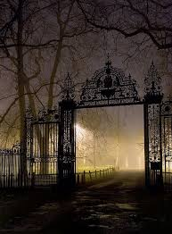
A Distorted Gospel and a False Assurance of Salvation
Matthew 7:13-14:
13 Enter ye in at the strait gate: for wide is the gate, and broad is the way, that leadeth to destruction, and many there be which go in thereat.
14 Because strait is the gate, and narrow is the way, which leadeth unto life, and few there be that find it.

Slide 48
Using Grace to Excuse Lifestyle
Antinomianism (i.e., not subject to law)
"For there are certain men crept in unawares, who were before of old ordained to this condemnation, ungodly men, turning the grace of our God into lasciviousness [indecency, absence of restraint], and denying the only Lord God, and our Lord Jesus Christ." Jude 1:4
[Note: There are some evangelicals who say that, because they are saved by grace, their actions or lifestyle have no bearing on their eternal destiny.]

Slide 49
Grace: "Spiritual & Carnal"
E.I. Schofield used 1 Corinthians 2:14 to 3:3 to identify two types of Christians (i.e., "spiritual" Christians and "carnal" Christians) that he said would both ultimately be saved. Starting in chapter 2:
14 "But the natural man receiveth not the things of the Spirit of God: for they are foolishness unto him: neither can he know them, because they are spiritually discerned.
15 But he that is spiritual judgeth all things, yet he himself is judged of no man.
16 For who hath known the mind of the Lord, that he may instruct him? But we have the mind of Christ." (next slide)

Slide 50
Grace: "Spiritual & Carnal"
Schofield continues with chapter 3 of 1 Corinthians to
suggest that we can live a life of unmitigated sin and still be saved:
1 "And I brethren, could not speak unto you as unto spiritual, but as unto carnal, even as unto babes in Christ.
2 I have fed you with milk, and not with meat: for hithterto ye were not able to bear it, neither yet now are ye able.
3 For ye are yet carnal: for whereas there is among you envying, and strife, and divisions, are ye not carnal, and walk as men?"
[Note: Because this passage refers to those who are "carnal" as "babes in Christ," Schofield believes that they are saved as well, but there are even evangelicals who disagree with this view!]

Slide 51
Grace: "Spiritual & Carnal"
The Schofield Bible has a footnote for this passage in
1 Corinthians, chapters 2 & 3 that says:
“Paul divides men into three classes . . .
natural, i.e. the Adamic man, unrenewed [as described in 2:14]
...The renewed man...walking in the Spirit in full communion with God
Carnal, fleshly, i.e., the renewed man who, walking ‘after the flesh,’ remains a babe in Christ (I Cor. 3:1-4). . . Able to comprehend only its simplest truths, 'milk’ (I Cor.3:2).”
[Note: Schofield is wrong. 1 Cor. 3 calls the "carnal" men “brethren” because they attend church, but they have not yet truly comprehended the gospel in its fullest sense – their lives have not changed!]

Slide 52
We Must "Surrender" to Christ
"Antinomianism" vs. "Lordship Salvation"
Two Evangelical Perspectives:
"Antinomian View" - E.I. Schofield and Chuck Swindoll both say:
"It is possible to be a 'carnal Christian,' accept Christ as your Savior, but never submit to him as Lord (i.e., not willing to obey as Lord)."
"Anything more than 'faith alone' undermines the sovereignty of God."
"Lordship Salvation View" - John MacArthur says:
"It is impossible to be a saved Christian unless you surrender to Christ as Lord (i.e., willingness to obey), not just as Savior."
[Note: MacArthur is correct on this issue!]

Slide 53
Grace Results in Faith & Works
"Saved by Grace After All We Can Do"
This passage causes evangelicals to accuse us of being a “cult” because they claim that we are "mixing grace with works" to be saved:
For we know that it is by grace that we are saved, after all we can do. 2 Nephi 11:44
Restoration Response:
You cannot read a passage in isolation. It must be understood in the context of other passages of scripture such as 2 Nephi 7:42.
There is “grace” that:
intercedes for us to save us when we fall short of God's best for our lives (“justifying grace”), and
works with us to do good works (“sanctifying grace”).

Slide 54
Grace Results in Faith & Works
God’s “justifying grace” works within us to accomplish his purpose for our lives:
. . . continue to work out your salvation with fear and trembling, for it is God who works in you to will and to act according to his good purpose.
Philippians 2:12-13

Slide 55
A Distorted Gospel and a False Assurance of Salvation
Matthew 7:13-14:
13 Enter ye in at the strait gate: for wide is the gate, and broad is the way, that leadeth to destruction, and many there be which go in thereat.
14 Because strait is the gate, and narrow is the way, which leadeth unto life, and few there be that find it.

Slide 56
Sharing the Gospel
For our evangelical friends:
We worship the same Jesus (Mos. 1:97).
We are saved by the merits of Christ alone (2 Ne. 13:27-28).
We are saved by grace alone (2 Ne. 7:42) .
Grace is the desire and power to do God’s will (1 Cor 15:10).
It's possible to have false assurance of salvation (Mat 7:13-14).

Slide 57
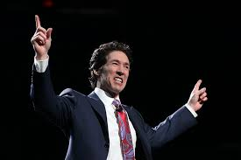
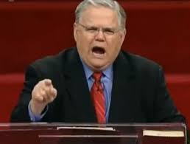
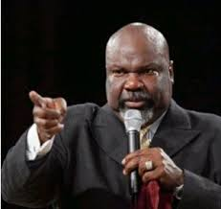
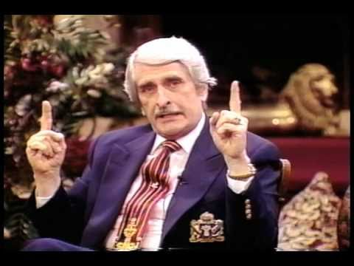
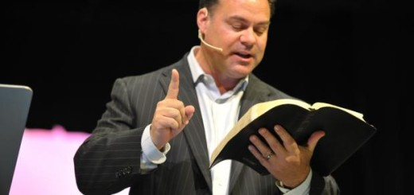
More Than One Evangelical Gospel

Slide 58
More Than One Evangelical Gospel
Gospels
1) Easy-
believism
2) Faith +
Nothing
3) Faith +
Repentance
4) Faith,
Repent,
Surrender
5) Baptism
incl. faith,
repent,
surrender
6) Restored
Gospel

Slide 59
1) Easy-Believism
Gospels
Easy-
believism

Slide 60
1) Easy-Believism
EASY BELIEVISM – “Accepting Christ as my Savior” or "faith" consists of:
Knowledge – I understand that Christ saves; and
Assent – I recognize that that Christ’s salvation applies to me personally.
Example: Chuck Swindoll
Dallas Theological Seminary
Restoration Response: It is actually Christ who must accept us, and saving "faith" is more than simply knowledge and assent.

Slide 61
2) Faith + Nothing
Gospels
2) Faith +
Nothing

Slide 62
2) "Faith Plus Nothing": Trust
FAITH PLUS NOTHING – “Accepting Christ as my Savior” or "faith" consists of:
Knowledge – I understand that Christ saves;
Assent – I recognize that Christ’s salvation applies to me;
Trust – I make a commitment to Christ
Example: Charles Stanley
Restoration Response: A “commitment to Christ” is good, but the restored gospel refers a little more explicitly to a “covenant to obey” in which the believer seeks God’s grace, strengthening his resolve to walk in obedience to God’s commandments – faith being a principle that leads to God-directed actions that are aided by his grace (Galatians 5:6).
Notes:
We say this based on the definition that “grace” gives us “the desire and power to do God’s will.”

Slide 63
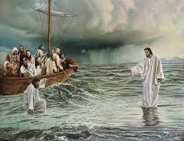
True Faith leads to action

Slide 64
True Faith Leads to Action
Lectures on Faith:
[Lec 1:9] From this we learn that faith is the assurance which men have of the existence of things which they have not seen, and the principle of action in all intelligent beings.
[Lec 1:11e] In a word, is there anything that you would have done, either physical or mental, if you had not previously believed? Are not all your exertions of every kind dependent on your faith?

Slide 65
The Elements of Faith
Faith is comprised of:
Restoration Evangelical
Belief Knowledge
Action vs. Assent
Assurance Trust
Power

Slide 66
True Faith Leads to Action
Matthew 14:26-29:
And when the disciples saw him walking on the sea, they were troubled, saying, It is a spirit; and they cried out for fear.
But straightway Jesus spake unto them, saying, Be of good cheer; it is I; be not afraid.
And Peter answered him and said, Lord, if it be thou, bid me come unto thee on the water [belief].
And he said, Come [assurance]. And when Peter was come down out of the ship, he walked on the water, to go to Jesus [action and power].

Slide 67
True Faith Leads to Action
What is a true, saving “faith”?
For in Jesus Christ neither circumcision availeth any thing, nor uncircumcision; but faith which worketh by love.
Galatians 5:6

Slide 68
Sharing the Gospel
For our evangelical friends:
1) We worship the same Jesus (Mos. 1:97).
2) We are saved by the merits of Christ alone (2 Ne. 13:27-28).
3) We are saved by grace alone (2 Ne. 7:42) .
4) Grace is the desire and power to do God’s will (1 Cor 15:10).
5) It’s possible to have a false assurance of salvation (Mat 7:13-14).
6) True faith always leads to action (Mat. 14:26-29).

Slide 69
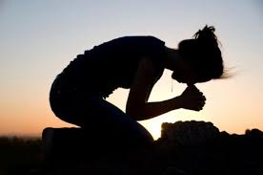
repentance Saves

Slide 70
3) Faith & Repentance
Gospels
3) Faith +
Repentance

Slide 71
What is "Repentance"?
Definition of “Repentance”:
Evangelicals: “a change of mind about who Christ is”
Strong's: “to think differently or to reconsider”
Restoration: “a remorse for sin that alters the pattern of sin in our lives”

Slide 72
Must Repentance Bear Fruit?
Bring forth therefore fruits worthy of repentance . . .
Luke 3:8
Whosoever is born of God doth not commit [continue in] sin;
1 John 3:9

Slide 73
Is "Faith Alone" Enough?
No, repentance is also necessary for salvation:
Repent ye therefore, and be converted, that your sins may be blotted out, when the times of refreshing shall come from the presence of the Lord.
Acts 3:19

Slide 74
Sharing the Gospel
For our evangelical friends:
1) We worship the same Jesus (Mos. 1:97).
2) We are saved by the merits of Christ alone (2 Ne. 13:27-28).
3) We are saved by grace alone (2 Ne. 7:42) .
4) Grace is the desire and power to do God’s will (1 Cor 15:10).
5) It’s possible to have false assurance of salvation (Mat 7:13-14).
6) True faith always leads to action (Mat. 14:26-29).
7) Repentance is more than a change of mind (Luke 3:8).
8) Repentance saves (Acts 3:19).

Slide 75
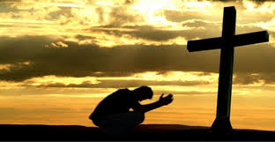
surrender (willingness to obey) Saves

Slide 76
4) Faith, Repentance & Surrender
Gospels
4) Faith,
Repent,
Surrender

Slide 77
"Surrender" To Christ As Lord
Is it possible to be a “carnal” Christian?
Is surrender (i.e., a willingness to obey) really necessary?
Therefore let all the house of Israel know assuredly, that God hath made that same Jesus, whom ye have crucified, both Lord and Christ.
Acts 2:36

Slide 78
Sharing the Gospel
For our evangelical friends:
1) We worship the same Jesus (Mos. 1:97).
2) We are saved by the merits of Christ alone (2 Ne. 13:27-28).
3) We are saved by grace alone (2 Ne. 7:42) .
4) Grace is the desire and power to do God’s will (1 Cor 15:10).
5) It’s possible to have false assurance of salvation (Mat 7:13-14).
6) True faith always leads to action (Mat. 14:26-29).
7) Repentance is more than a change of mind (Luke 3:8).
8) Repentance saves (Acts 3:19).
9) Surrender to Christ as "Lord," not just Savior (Acts 2:36).

Slide 79
Obedience (not just a "wilingness to obey") Saves

Slide 80
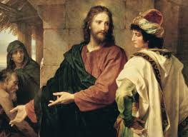
Does "Obedience" Save?
Matthew 19:16-26:
And, behold, one came and said unto him, Good Master, what good thing shall I do, that I may have eternal life?
And he said unto him, Why callest thou me good? there is none good but one, that is, God: but if thou wilt enter into life, keep the commandments.
He saith unto him, Which? Jesus said, Thou shalt do no murder, Thou shalt not commit adultery, Thou shalt not steal, Thou shalt not bear false witness,
Honor thy father and thy mother: and, Thou shalt love thy neighbor as thyself.

Slide 81
Does "Obedience" Save?
The young man saith unto him, All these things have I kept from my youth up: what lack I yet?
Jesus said unto him, If thou wilt be perfect, go and sell that thou hast, and give to the poor, and thou shalt have treasure in heaven: and come and follow me.
But when the young man heard that saying, he went away sorrowful: for he had great possessions.

Slide 82
Does "Obedience" Save?
Then said Jesus unto his disciples, Verily I say unto you, That a rich man shall hardly enter into the kingdom of heaven.
And again I say unto you, It is easier for a camel to go through the eye of a needle, than for a rich man to enter into the kingdom of God.
When his disciples heard it, they were exceedingly amazed, saying, Who then can be saved?
But Jesus beheld them, and said unto them, With men this is impossible; but with God all things are possible.
Matthew 19:16-26
Notes:
Salvation is only possible by God's grace alone. It cannot be done in our own strength.

Slide 83
"Eye of the Needle" (David Gilmore)
Notes:
It's not impossible for a rich man to be saved.

Slide 84
Does "Obedience" Save?
Not every one that saith unto me, Lord, Lord, shall enter into the kingdom of heaven; but he that doeth the will of my Father which is in heaven.
Matthew 7:21

Slide 85
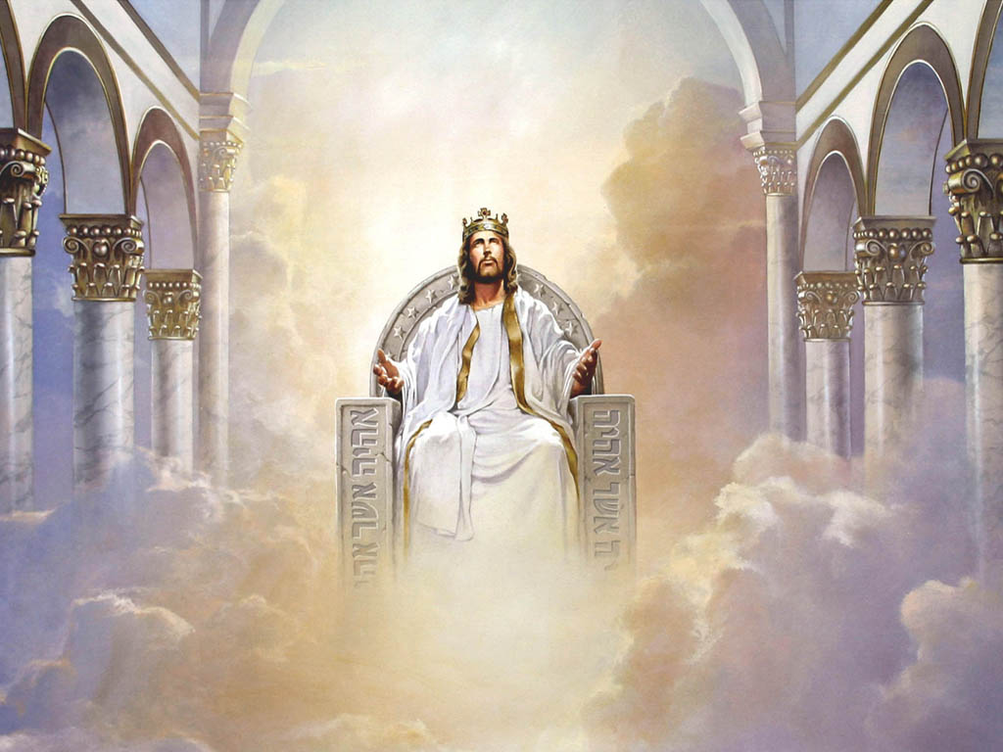
Does "Obedience" Save?
Matthew 25:32-46:
³¹ When the Son of man shall come in his glory, and all the holy angels with him, then shall he sit upon the throne of his glory:
³² And before him shall be gathered all nations: and he shall separate them one from another, as a shepherd divideth his sheep from the goats:
³³ And he shall set the sheep on his right hand, but the goats on the left. (next slide)

Slide 86
Does "Obedience" Save?
Matthew 25:32-46 (continued):
³⁴ Then shall the King say unto them on his right hand, Come, ye blessed of my Father, inherit the kingdom prepared for you from the foundation of the world:
³⁵ For I was an hungered, and ye gave me meat: I was thirsty, and ye gave me drink: I was a stranger, and ye took me in:
³⁶ Naked, and ye clothed me: I was sick, and ye visited me: I was in prison, and ye came unto me. (next slide)
Notes:
"For" denotes causation, that there is a direct relationship between entering the kingdom and doing good works.

Slide 87
Does "Obedience" Save?
Matthew 25:32-46 (continued):
³⁷ Then shall the righteous answer him, saying, Lord, when saw we thee an hungered, and fed thee? or thirsty, and gave thee drink?
³⁸ When saw we thee a stranger, and took thee in? or naked, and clothed thee?
³⁹ Or when saw we thee sick, or in prison, and came unto thee?
⁴⁰ And the King shall answer and say unto them, Verily I say unto you, Inasmuch as ye have done it unto one of the least of these my brethren, ye have done it unto me. (next slide)

Slide 88
Does "Obedience" Save?
Matthew 25:32-46 (continued):
⁴¹ Then shall he say also unto them on the left hand, Depart from me, ye cursed, into everlasting fire, prepared for the devil and his angels:
⁴² For I was an hungered, and ye gave me no meat: I was thirsty, and ye gave me no drink:
⁴³ I was a stranger, and ye took me not in: naked, and ye clothed me not: sick, and in prison, and ye visited me not.

Slide 89
Does "Obedience" Save?
Matthew 25:32-46 (continued):
⁴⁴ Then shall they also answer him, saying, Lord, when saw we thee an hungered, or athirst, or a stranger, or naked, or sick, or in prison, and did not minister unto thee?
⁴⁵ Then shall he answer them, saying, Verily I say unto you, Inasmuch as ye did it not to one of the least of these, ye did it not to me.
⁴⁶ And these shall go away into everlasting punishment: but the righteous into life eternal.

Slide 90
Does "Obedience" Save?
We believe that through the atonement of Christ all mankind may be saved by obedience to the laws and ordinances of the gospel.
Joseph Smith, Jr.
Epitome of Faith

Slide 91
Sharing the Gospel
For our evangelical friends:
1) We worship the same Jesus (Mos. 1:97).
2) We are saved by the merits of Christ alone (2 Ne. 13:27-28).
3) We are saved by grace alone (2 Ne. 7:42) .
4) Grace is the desire and power to do God's will (1 Cor 15:10).
5) It's possible to have false assurance of salvation (Mat 7:13-14).
6) True faith always leads to action (Mat. 14:26-29).
7) Repentance is more than a change of mind (Luke 3:8).
8) Repentance saves (Acts 3:19).
9) Surrender to Christ as Lord, not just Savior (Acts 2:36).
10) Obedience saves (Mat. 7:21; Mat. 19:16-26; Mat. 25:31-46).

Slide 92
Baptism Saves

Slide 93
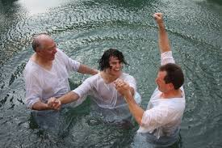
5) A Non-Evangelical Gospel
Gospels
5) Baptism
incl. faith,
repent,
surrender

Slide 94
Does "Baptism" Save?
Jesus to Nicodemus in John 3:3-5:
Jesus answered and said unto him, Verily, verily, I say unto thee, Except a man be born again, he cannot see the kingdom of God.
Nicodemus saith unto him, How can a man be born when he is old? Can he enter the second time into his mother’s womb, and be born?
Jesus answered, Verily, verily, I say unto thee, Except a man be born of water and of the Spirit, he cannot enter into the kingdom of God.
Notes:
The main question that arises: What is “born of water”?
Some evangelicals say that it is the breaking of the amniotic sac at birth.
Evangelicals believe that works have nothing to do with salvation, that we are saved by “faith alone.”
So how does an amniotic sac breaking have anything to do with salvation and entering the kingdom of God?
“Born of water” must be referring to water baptism, the kind that Jesus entered into in Matthew 3.

Slide 95
Does "Baptism" Save?
And now why tarriest thou? arise, and be baptized, and wash away thy sins, calling on the name of the Lord.
Acts 22:16
Which sometime were disobedient, when once the longsuffering of God waited in the days of Noah, while the ark was a preparing, wherein few, that is, eight souls were saved by water.
The like figure whereunto even baptism doth also now save us (not the putting away of the filth of the flesh, but the answer of a good conscience toward God,) by the resurrection of Jesus Christ.
1 Peter 3:20-21

Slide 96
Baptism: Sacrament or Ordinance
Christianity has conflicting beliefs about water baptism:
Sacramentalists: Catholics, Eastern Orthodox and "mainline Protestants" say that water baptism is a "sacrament" conducted by God by which they are:
saved – forgives infant's "original sin" (vs. a "believer's baptism" for ALL sin.)
receive the gift of the Holy Spirit, (we separate this into "confirmation")
born again (fulfilling the "water and Spirit" requirement in John 3:3-5).
Ordinance View: Evangelicals say that water baptism is an "ordinance" conducted by man (i.e., human effort only):
simply an “ordinance” that does not save,
just a "memorial" or "sign" of a "born again" experience that already occurred at initial belief.
Notes:
Saying that baptism is “conducted by God,” means that any good work that we might do is entirely dependent on God’s grace to make it possible.

Slide 97
Believer's Baptism vs. Baptism of Little Children
Christians disagree with one another regarding:
"Believer's baptism" – which says that, before he can be baptized, a person must be mature enough to understand morality, God, sin, salvation, etc. in order to make a conscious choice for Christ (we & evangelicals agree on this as a requirement).
"Pēdo-baptism" - baptizing infants/little children to forgive original sin and receive the gift of the Holy Spirit in their hearts (we believe is wrong)
Pēdo-baptists use "household conversions" (Acts 16:31) to justify this.
They have a "confirmation" later when those who were baptized are mature enough to understand what was done in their infancy.

Slide 98
Baptism: Sacrament or Ordinance
So the entire Christian community is divided into:
"sacramentalists" who believe that, even in infancy, "water baptism":
saves, and
grants the gift of the Holy Spirit.
an "ordinance view" of water baptism that says:
water baptism has nothing to do with salvation,
water baptism is simply a "memorial" of something that already happened (i.e., receiving the gift of the HS at initial belief).
infants should NOT be baptized.

Slide 99
Baptism: Sacrament or Ordinance
"Sacramentalists" include:
Catholics,
Eastern Orthodox,
Anglicans,
Lutherans,
Methodists,
Reformed Churches, and
Restorationist Churches (like Churches of Christ).
"Ordinance View" – is held by evangelicals (.e.g, Baptists).

Slide 100
Baptism: Sacrament or Ordinance
The Restored Gospel:
Regarding "sacramentalism," we agree that, if properly administered, water baptism saves, but:
water baptism doesn't save infants or give them the gift of the Holy Spirit (a child's blessing should be provided instead as described in Mark 10:13-16),
a "believer's baptism" is required for salvation (Acts 2:37-38),
water baptism is normally a separate phenomenon from spirit baptism.

Slide 101
Baptism: Sacrament or Ordinance
The Restored Gospel:
Regarding the "ordinance view" of water baptism:
We AGREE with evangelicals that:
water baptism is normally a separate event from spirit baptism.
water baptism should be a "believer's baptism."
However, we DISAGREE with evangelicals on the following:
water baptism is NOT simply a "memorial" of having already received the gift of the Holy Spirit (Acts 8:12-17; Acts 19:1-5)
water baptism has a direct bearing on salvation (Acts 22:16; 1 Peter 3:20-21).

Slide 102
Being "Born Again" (Regeneration)
“Baptismal Regeneration” (being born again at water baptism)
Sacramentalists - maintain that they are born again (regenerated) at water baptism (when they receive the gift of the Holy Spirit).
Evangelicals - argue that being born again (regenerated) does NOT happen at water baptism, but instead it occurs when we first believe.
Therefore, evangelicals argue against "baptismal regeneration."
See Appendix for evangelical arguments against "baptismal regeneration."

Slide 103
Being “Born Again” (Regeneration)
The Restoration View of “Regeneration”:
So the Restoration differs from the rest of Christianity in five major ways:
1. We agree with evangelicals that “regeneration” is initiated at the moment we first believe (John 5:24), but it is not just an event, regeneration is also a process that is concluded when we’ve been born of water and the Spirit (Acts 22:16, Acts 8:12-17, Acts 19:1-7).
2. We agree with “sacramentalists” that baptism saves (Acts 22:16), but we do not believe that everyone who is baptized receives the “gift of the Holy Spirit” at water baptism (Acts 8:12-17: Acts 19:5-6).
(next slide)
Notes:
This will be explained further in the section on baptism that follows.

Slide 104
Being “Born Again” (Regeneration)
The Restoration View of “Regeneration”:
Five major differences from the rest of Christianity (continued):
3. Every true believer, when they receive the witness of the Holy Spirit that they should be baptized, will be baptized. A refusal to be baptized against the witness of the Spirit could place that person’s spiritual condition in jeopardy (Acts 10:48; Acts 22:16, 1 Peter 3:20-21).
4. Like evangelicals, we believe that being born of water and being born of the Spirit can be two separate events. However, baptism saves, and the baptism of the Holy Spirit can follow water baptism, rather than always occurring before or during baptism (Matthew 3:16-17, Acts 8:12-17, Acts 19:5-6).
(next slide)
Notes:
This will be explained further in the section on baptism that follows.

Slide 105
Being “Born Again” (Regeneration)
The Restoration View of “Regeneration”:
Five major differences from the rest of Christianity (continued):
5. With water and Spirit baptisms, justification and regeneration are complete (John 3:3-5), and though he must endure to the end (Matthew 24:13), a believer in that state of grace can have a full assurance of salvation (John 3:3-5 and Romans 5:1).
Notes:
This will be explained further in the section on baptism that follows.

Slide 106
Three Purposes of Baptism
In the Restoration, baptism involves three things:
remission of sin – Acts 2:38; Mosiah 9:40 & 44.
method of entrance into the church – Acts 2:41; Mosiah 9:50.
covenant to obey God's commands – Acts 2:44-47; Mosiah 9:41.

Slide 107
Does "Baptism" Save?
John 3:5:
Jesus answered, Verily, verily, I say unto thee, Except a man be born of water and of the Spirit, he cannot enter into the kingdom of God.
Notes:
The main question that arises: What is “born of water”?
Some evangelicals say that it is the breaking of the amniotic sac at birth.
Evangelicals believe that works have nothing to do with salvation, that we are saved by “faith alone.”
So how does an amniotic sac breaking have anything to do with salvation and entering the kingdom of God?
“Born of water” must be referring to water baptism, the kind that Jesus entered into in Matthew 3.

Slide 108
Does "Baptism" Save?
In his book Baptism in the New Testament, Baptist theologian
G.R. Beasley-Murray takes exception with most of his fellow
Baptists in teaching a concept of water baptism as a “sacrament”
that impacts a person’s salvation rather than simply being a sign or symbol:
“In the light of the foregoing exposition of the New Testament representations of baptism the idea that baptism as a purely symbolic rite must be pronounced not alone unsatisfactory, but out of harmony with the New Testament itself. The apostolic writers make free use of the symbolism of the baptismal action, but they go further and view the act as a symbol with power, that is a sacrament. The grace available to man in baptism is said by the New Testament writers to include the following elements:
forgiveness of sin (Acts 2:38)
cleansing from sins (Acts 22:16; 1 Corthinians 6:11)”
(next slide)
Notes:
The main question that arises: What is “born of water”?
Some evangelicals say that it is the breaking of the amniotic sac at birth.
Evangelicals believe that works have nothing to do with salvation, that we are saved by “faith alone.”
So how does an amniotic sac breaking have anything to do with salvation and entering the kingdom of God?
“Born of water” must be referring to water baptism, the kind that Jesus entered into in Matthew 3.

Slide 109
Does "Baptism" Save?
Beasley-Murray’s list of baptismal benefits continued:
“union with Christ (Galatians 3:27) and particularly union with him in his death and resurrection (Romans 6:3+, Colossians 2:11-12).
with all that implies of release from sin’s power as well as guilt and the sharing of the risen life of the Redeemer (Romans 6:1-11),
participation in Christ’s sonship (Galatians 3:26-27),
consecration to God (1 Corinthians 6:11),
hence membership in the Church, the body of Christ (1 Corinthians 12:13; Galatians 3:27-29),”
(next slide)
Notes:
The main question that arises: What is “born of water”?
Some evangelicals say that it is the breaking of the amniotic sac at birth.
Evangelicals believe that works have nothing to do with salvation, that we are saved by “faith alone.”
So how does an amniotic sac breaking have anything to do with salvation and entering the kingdom of God?
“Born of water” must be referring to water baptism, the kind that Jesus entered into in Matthew 3.

Slide 110
Does "Baptism" Save?
Beasley-Murray’s list of baptismal benefits continued:
“possession of the Spirit (Acts 2:38; 1 Corinthians 6:11 and I Corinthians 12:13), and therefore new life in the Spirit that is regeneration (Titus 3:5; John 3:5),
grace to live according to the will of God (Romans 6:1+ and Colossians 3:1+)
deliverance from the evil powers of this world (Colossians 1:13)
the inheritance of the kingdom of God (John 3:5),
and the pledge of the resurrection of the body (Ephesians 1:13-14; Ephesians 4:30).”
Notes:
The main question that arises: What is “born of water”?
Some evangelicals say that it is the breaking of the amniotic sac at birth.
Evangelicals believe that works have nothing to do with salvation, that we are saved by “faith alone.”
So how does an amniotic sac breaking have anything to do with salvation and entering the kingdom of God?
“Born of water” must be referring to water baptism, the kind that Jesus entered into in Matthew 3.

Slide 111
The Gift of the Holy Spirit
D & C 17:18 instructs elders and priests to:
Baptize – by immersion in water, and then
Confirm – lay on hands to grant the gift of the Holy Spirit.
Sacramentalists – claim to receive the Holy Spirit at water baptism.
Evangelicals – claim to receive the Holy Spirit upon initial belief.
The Restoration – stands apart from most, but not all other Christian traditions in that we grant the gift of the Holy Spirit in a separate ordinance:
AFTER water baptism, and
through the laying on of hands.
Notes:
There are many exceptions to this pattern in the Book of Mormon and New Testament of the Bible.
It is possible for a sovereign God to accomplish in whatever order he chooses.
However, he has instructed his servants on earth to follow a prescribed order of water baptism and then laying on hands to impart the gift of the Holy Spirit.
Receiving the gift of the Holy Spirit after water baptism and laying on hands to do so used to be a very mainstream practice among Baptists in Europe.

Slide 112
Does "Baptism" Save?
Once again, our scriptures showing that baptism has a
bearing on salvation:
And now why tarriest thou? arise, and be baptized, and wash away thy sins, calling on the name of the Lord.
Acts 22:16
Which sometime were disobedient, when once the longsuffering of God waited in the days of Noah, while the ark was a preparing, wherein few, that is, eight souls were saved by water.
The like figure whereunto even baptism doth also now save us (not the putting away of the filth of the flesh, but the answer of a good conscience toward God,) by the resurrection of Jesus Christ.
1 Peter 3:20-21

Slide 113
Evangelicals: “Baptism is a Work of Man”
In response to the idea that baptism saves, our evangelical friends will say that we are trying to “mix God’s works with our efforts” to achieve salvation and quote the following:
For by grace are ye saved through faith; and that not of yourselves: it is the gift of God. Not of works, lest any man should boast.
Ephesians 2:8-9
Notes:
It is

Slide 114
Baptism: Only By God’s Grace
It is only by God’s justifying grace that any of us are given the ability to repent, believe and be baptized. So God receives 100% of the credit:
. . . continue to work out your salvation with fear and trembling, for it is God who works in you to will and to act according to his good purpose.
Philippians 2:12-13
Notes:
It is

Slide 115
Sharing the Gospel
For our evangelical friends:
1) We worship the same Jesus (Mos. 1:97).
2) We are saved by the merits of Christ alone (2 Ne. 13:27-28).
3) We are saved by grace alone (2 Ne. 7:42) .
4) Grace is the desire and power to do God's will (1 Cor 15:10).
5) It's possible to have false assurance of salvation (Mat 7:13-14).
6) True faith always leads to action (Mat. 14:26-29).
7) Repentance is more than a change of mind (Luke 3:8).
8) Repentance saves (Acts 3:19).
9) Surrender to Christ as Lord, not just Savior (Acts 2:36).
10) Obedience saves (Mat. 7:21; Mat. 19:16-26; Mat. 25:31-46).
11) Baptism saves (Acts 22:16; 1 Peter 3:20-21).

Slide 116
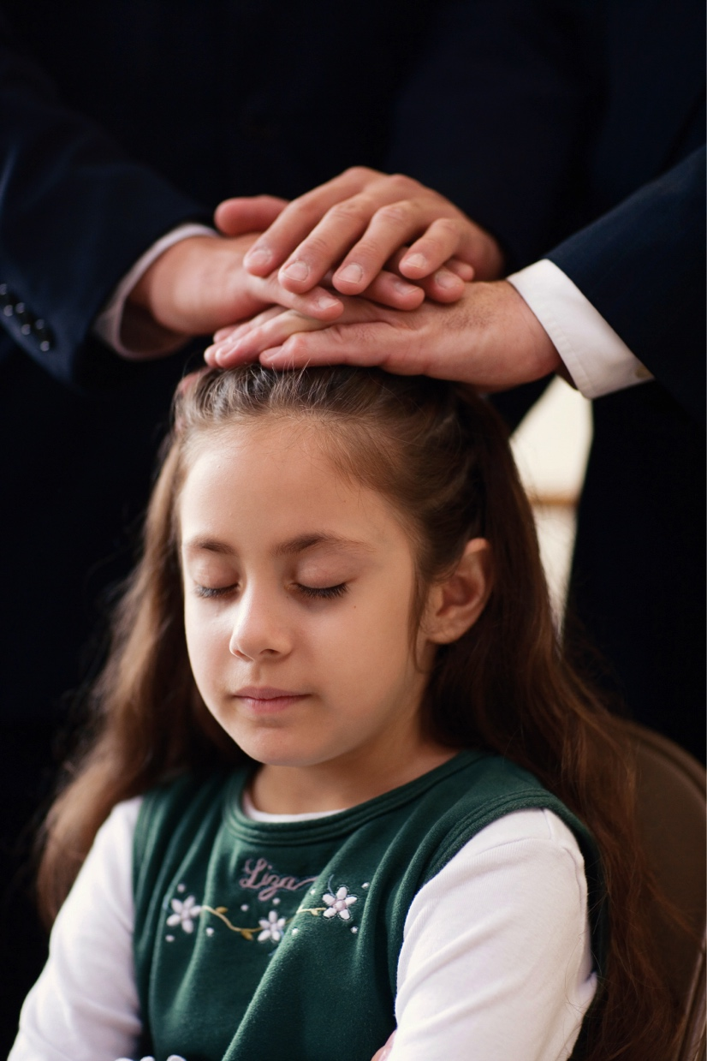
Laying on Hands to Convey the Gift of the Holy Spirit

Slide 117
Lay on Hands to Receive Gift of H.S.
Acts 8:12-17 is an instance of laying on hands to convey the gift of the Holy Spirit after water baptism:
¹² But when they believed Philip preaching the things concerning the kingdom of God, and the name of Jesus Christ, they were baptized . . .
¹⁴ Now when the apostles which were at Jerusalem heard that Samaria had received the word of God, they sent unto them Peter and John:
¹⁵ Who, when they were come down, prayed for them, that they might receive the Holy Ghost:
¹⁶ (For as yet he was fallen upon none of them: only they were baptized in the name of the Lord Jesus.)
¹⁷ Then laid they their hands on them, and they received the Holy Ghost.
Notes:
It is

Slide 118
Lay on Hands to Receive Gift of H.S.
Acts 19:1-6 is another instance of laying on hands to convey the gift of the Holy Spirit after water baptism:
¹ . . . Paul having passed through the upper coasts came to Ephesus . . .
² He said unto them, Have ye received the Holy Ghost since ye believed? And they said unto him, We have not so much as heard whether there be any Holy Ghost . . .
⁵ When they heard this, they were baptized in the name of the Lord Jesus.
⁶ And when Paul had laid his hands upon them, the Holy Ghost came on them; and they spake with tongues, and prophesied.
Notes:
It is

Slide 119
Lay on Hands to Receive Gift of H.S.
Acts 9:17 describes another example of laying on hands to convey the
gift of the Holy Spirit, but this time before water baptism:
And Ananias went his way, and entered into the house; and putting his hands on him said, Brother Saul, the Lord, even Jesus, that appeared unto thee in the way as thou camest, hath sent me, that thou mightest receive thy sight, and be filled with the Holy Ghost.
Acts 22:16 tells us that Ananias then instructed Saul to be baptized and wash away his sins:
And now why tarriest thou? arise, and be baptized, and wash away thy sins, calling on the name of the Lord.
Notes:
It is

Slide 120
Laying on Hands to Receive Gift of H.S.
So in the New Testament there are only three recorded instances where
the gift of the Holy Spirit was conveyed via laying on hands: Acts 8:12-17,
Acts 19:1-7 and Acts 9:10-17.
Commenting on this fact, Baptist theologian G.R. Beasley-Murray asked this question and quoted Silva New:
“Can it be that the failure to mention the laying on of hands when other baptisms are described is due to its general recognition as an integral part of the baptismal initiation? We recall the well known dictum of Silva New: ‘Belief in Jesus, baptism, remission of sins, laying on of Apostolic hands and reception of the Spirit formed a single complex of associated ideas, any one of which might in any single narrative be either omitted or emphasized.’”
G.R. Beasley-Murray, Baptism in the New Testament (Eugene, OR: Wipf & Stock Publishers, 2006), 123 & 125.

Slide 121
Laying on hands to Receive Gift of H.S.
According to Beasley-Murray, it is likely that there were other New Testament instances of laying on hands to convey the gift of the Spirit:
“ . . . It is not to be assumed that the Samaritans [Acts 8] were the only people on whom Peter and John laid hands that they might receive the blessing of the Spirit and it is similarly conceivable that Paul sometimes used the rite in administering baptism . . . That it was the normal accompaniment of baptism in the circle from which the Letter to the Hebrews emanated is certain (Heb. 6:1-2) . . . The laying on of hands in immediate connection with baptism was widely practiced among Baptists in the seventeenth century, both in Britain and in the American colonies . . .”
G.R. Beasley-Murray, Baptism in the New Testament (Eugene, OR: Wipf & Stock Publishers, 2006), 123 & 125.
(next slide)

Slide 122
Laying on Hands to Receive Gift of H.S.
Commenting further on Baptists’ historical tradition of laying on hands to convey the gift of the Holy Spirit, Beasley-Murray continues:
“ . . . The [Baptists] Standard Confession of 1660 was more positive and more explicit as to its significance: ‘It is the duty of all such who are believers baptized to draw nigh unto God in submission to that principle of Christ’s doctrine, to wit, Prayer and Laying on of Hands, that they may receive the promise of the Holy Spirit.’ . . . The practice has been retained to this day among Baptists in Denmark and Sweden, and it is being revived among other Continental Baptist groups. As an aid to the recovery of the full significance of baptism, it is to be desired that Baptists should give earnest consideration as to whether they should not once more incorporate the rite in their administration of baptismal initiation into Christ and the Church.”
G.R. Beasley-Murray, Baptism in the New Testament (Eugene, OR: Wipf & Stock Publishers, 2006), 123 & 125.

Slide 123
Laying on Hands to Receive Gift of H.S.
In a footnote on page 125, Beasley-Murray elucidates further:
“On the relation of Baptists to the practice of laying on of hands, see the article by E.A. Payne, ‘Baptists and the Laying on of Hands,’ The Baptist Quarterly, 1953-54, pp. 203 ff., to which I am indebted for much of the above information. It is an indication of the current tendency of Baptist thought in England that the service book, Orders and Prayers for Church Worship by E.A. Payne and S.F. Winward, 1960, contains directions for ‘The Laying on of hands with prayer, upon those who have been baptized,’ and recommends the observance of the rite either as part of the baptismal service or ‘as soon afterwards as is convenient’ (page 135).”
G.R. Beasley-Murray, Baptism in the New Testament (Eugene, OR: Wipf & Stock Publishers, 2006), 123 & 125.

Slide 124
Laying on Hands to Receive Gift of H.S.
Regarding the restored gospel:
The holy ordinance of “confirmation” (laying on hands after baptism) is NOT specifically mentioned as an element of salvation, but “receiving the gift of the Holy Spirit” is mentioned many times and there are three recorded instances in the New Testament where such an ordinance was used to grant the gift of the Holy Spirit (John 3:3-5, Acts 2:37-38; Acts 8:12-17; Acts 19:1-7; Acts 9:17).
In fact, there are many instances in the past where receiving the Holy Spirit did NOT occur through “laying on hands” after baptism (Acts 10:44-48, Alma 12:170, Mosiah 2:1-6, 12-17, Mosiah 3:2-3, 6 , 8-9, Mosiah 11:186-191, Mosiah 9:41-48, Alma 12:134-135, 170 and Helaman 2:109-114).

Slide 125
Laying on Hands to Receive Gift of H.S.
However, all Christian faiths believe we must be “born of the Spirit,” but they disagree as to how and when that happens:
at the point of initial belief,
at the moment of water baptism or
through laying on hands after baptism.
In the Restoration, the ordinance of “confirmation” is the point at which “regeneration” (being born again) and “justification” (being declared to have received the righteousness of Christ) are complete and we can have an assurance of our salvation.

Slide 126
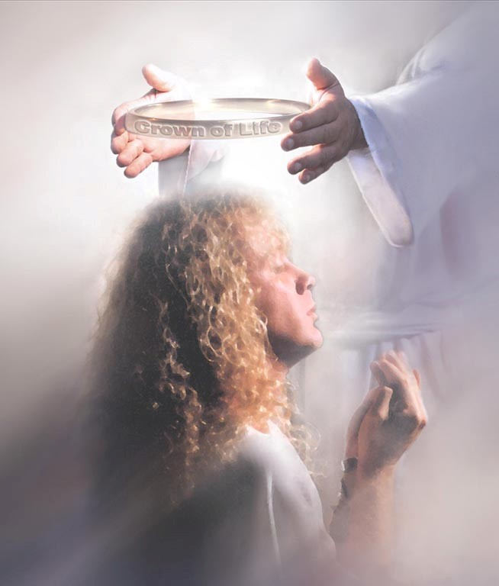
Endure to the End

Slide 127
Restored Gospel
Gospels
6) Restored
Gospel

Slide 128
Eternal Security: "Once Saved, Always Saved"
Does John 10:27-29 refer to “eternal security”?
27 My sheep hear my voice, and I know them, and they follow me;
28 And I give unto them eternal life; and they shall never perish, neither shall any man pluck them out of my hand.
29 My Father, which gave them me, is greater than all; and no man is able to pluck them out of my Father’s hand.

Slide 129
We Must Endure to the End
For it is impossible for those who were once enlightened, and have tasted of the heavenly gift, and were made partakers of the Holy Ghost,
And have tasted the good word of God, and the powers of the world to come,
If they shall fall away, to renew them again unto repentance; seeing they crucify to themselves the Son of God afresh, and put him to an open shame.
Hebrews 6:4-6
But he that shall endure unto the end, the same shall be saved.
Matthew 24:13

Slide 130
SHARING THE GOSPEL
For our evangelical friends:
1) We worship the same Jesus (Mos. 1:97).
2) We are saved by the merits of Christ alone (2 Ne. 13:27-28).
3) We are saved by grace alone (2 Ne. 7:42).
4) Grace is the desire and power to do God's will (1 Cor 15:10).
5) It's possible to have false assurance of salvation (Mat 7:13-14).
6) True faith always leads to action (Mat. 14:26-29).
7) Repentance is more than a change of mind (Luke 3:8).
8) Repentance saves (Acts 3:19).
9 )Surrender to Christ as Lord, not just Savior (Acts 2:36).
10) Obedience saves (Mat. 7:21; Mat. 19:16-26; Mat. 25:31-46).
11) Baptism saves (Acts 22:16; 1 Peter 3:20-21).
12) Endure to the end (Hebrews 6:4-6; Mat. 24:13).

Slide 131
More Than One Gospel
Gospels
Easy-
believism
2) Faith +
Nothing
3) Faith +
Repentance
4) Faith,
Repent,
Surrender
5) Baptism
incl. faith,
repent,
surrender
6) Restored
Gospel

Slide 132
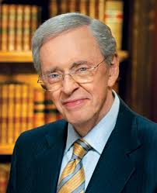
different position & Privileges in Heaven

Slide 133
Rewards: Position & Privileges
Baptist minister Charles Stanley says:
“Does our behavior really make any difference if we know that we've been saved and are eternally secure? You bet it does. Are there any eternal consequences in the life of a believer who sins after they are saved? Yes, there are. Will everybody in heaven be able to experience the same blessings and the same reward? No, they will not . . . Does it really make any difference, as far as eternity is concerned, how we live after we are saved? Makes an eternal difference. And is it possible that all of us are going to be able to experience heaven the same? It is absolutely not possible.”

Slide 134
Rewards: Position & Privileges
“And what I want you to see here is all through the Bible we are continually brought back to the idea of being rewarded . . . He’s going to judge us on the basis of how he equipped us, the opportunities he gave us, the privileges we had, and what we did with it, and the length of time we've had . . . Everybody is not going to have the same position in heaven . . . Secondly, nowhere does it indicate that everybody is going to have the same privileges in heaven. Nor does it indicate that everybody is going to be able to enjoy heaven to the same degree.”
Charles Stanley
"Eternal Security: What Do We Have to Lose?"

Slide 135
Sharing the Gospel
For our evangelical friends:
1) We worship the same Jesus (Mos. 1:97).
2) We are saved by the merits of Christ alone (2 Ne. 13:27-28).
3) We are saved by grace alone (2 Ne. 7:42) .
4) Grace is the desire and power to do God’s will (1 Cor 15:10).
5) It’s possible to have false assurance of salvation (Mat 7:13-14)
6) True faith always leads to action (Mat. 14:26-29).
7) Repentance is more than a change of mind (Luke 3:8).
8) Repentance saves (Acts 3:19).
9) Surrender to Christ as Lord, not just Savior (Acts 2:36).
10) Obedience saves (Mat. 7:21; Mat. 19:16-26; Mat. 25:31-46).
11) Baptism saves (Acts 22:16; 1 Peter 3:20-21).
12) Endure to the end (Hebrews 6:4-6; Mat. 24:13).
13) Different position & privileges in heaven (Charles Stanley).

Slide 136
True Test to Discern Who Is Saved
THE TRUE TEST OF SALVATION
We know that we have passed from death unto life, because we love the brethren. He that loveth not his brother abideth in death.
1 John 3:14

Slide 137
Those who have not been taught the gospel

Slide 138
Those Who Have Not Been Taught
EVANGELICAL VIEW
They have the light of "creation" as a witness
For the invisible things of him from the creation of the world are clearly seen, being understood by the things that are made, even his eternal power and Godhead; so that they are without excuse. Romans 1:20
They have the light of "conscience" as a witness
.... their conscience also bearing witness...
Romans 2:15

Slide 139
Those Who Have Not Been Taught
EVANGELICAL VIEW
“Therefore, the aborigine isolated in the jungle, who has never heard the gospel, will be condemned. Having had the witness of creation and conscience, he was given the ability to respond. We all rightly deserve hell. It is a gracious and sovereign God who, in mercy, chooses to save any of us.”

Slide 140
Those Who Have Not Been Taught
RESTORATION VIEW
"You are accountable for what you know"
But he that knew not and did commit things worthy of stripes, shall be beaten with few stripes. For unto whomsoever much is given, of him shall be much required: and to whom men have committed much, of him they will ask the more.
Luke 12:48

Slide 141
Those Who Have Not Been Taught
RESTORATION VIEW
"You are accountable for what you know"
Therefore to him that knoweth to do good, and doeth it not, to him it is sin. James 4:17
. . . for where no law is, there is no transgression.
Romans 4:15
But sin is not taken into account when there is no law.
Romans 5:13 (NIV)

Slide 142
Those Who Have Not Been Taught
RESTORATION VIEW
"You are accountable for what you know"
2 Nephi 6:51-53:
51 Wherefore he hath given a law; and where there is no law given there is no punishment;
52 And where there is no punishment, there is no condemnation;
53 And where there is no condemnation, the mercies of the Holy One of Israel have claim upon them, because of the atonement.

Slide 143
Those Who Have Not Been Taught
RESTORATION VIEW
"Must have a chance to hear and reject gospel"
"How, then, shall they call on him in whom they have not believed? And how shall they believe in him of whom they have not heard? And how shall they hear without a preacher?"
Romans 10:14

Slide 144
All Saved Except the "Sons of Perdition"
D&C 76:4g-i:
g. And this is the gospel, the glad tidings which the voice out of the heavens bore record unto us, that he came into the world, even Jesus to be crucified for the world, and to bear the sins of the world, and to sanctify the world, and to cleanse it from all unrighteousness;
h. That through him all might be saved, whom the Father had put into his power, and made by him; who glorifies the Father, and saves all the works of his hands, except those sons of perdition, who deny the Son after the Father has revealed him;
i. Wherefore he saves all except them . . .

Slide 145
Discuss Subjects in This Order
Attempt to present subjects in the following order:
Christ – What is your testimony?
Grace - Define
Faith - Define
Repentance – Define and show necessary to be saved
Surrender – Demonstrate that necessary for salvation
Obedience – More than “willingness” to obey
Baptism – must include right internal condition of heart
Endure to the End vs. “once saved, always saved”
Rewards or Glories – use Charles Stanley’s quote
Those who have not been taught the gospel

Slide 146
What Do You Plan to Do?
“When they had dined, Jesus saith to Simon Peter, Simon, son of Jonas, lovest thou me more than these? He saith unto him, Yea, Lord; thou knowest that I love thee. He saith unto him, Feed my lambs.
He saith to him again the second time, Simon, son of Jonas, lovest thou me? He saith unto him, Yea, Lord; thou knowest that I love thee. He saith unto him, Feed my sheep.
He saith unto him the third time, Simon, son of Jonas, lovest thou me? Peter was grieved because he said unto him the third time, Lovest thou me? And he said unto him, Lord, thou knowest all things; thou knowest that I love thee. Jesus saith unto him, Feed my sheep.”
John 21:15-17

Slide 147
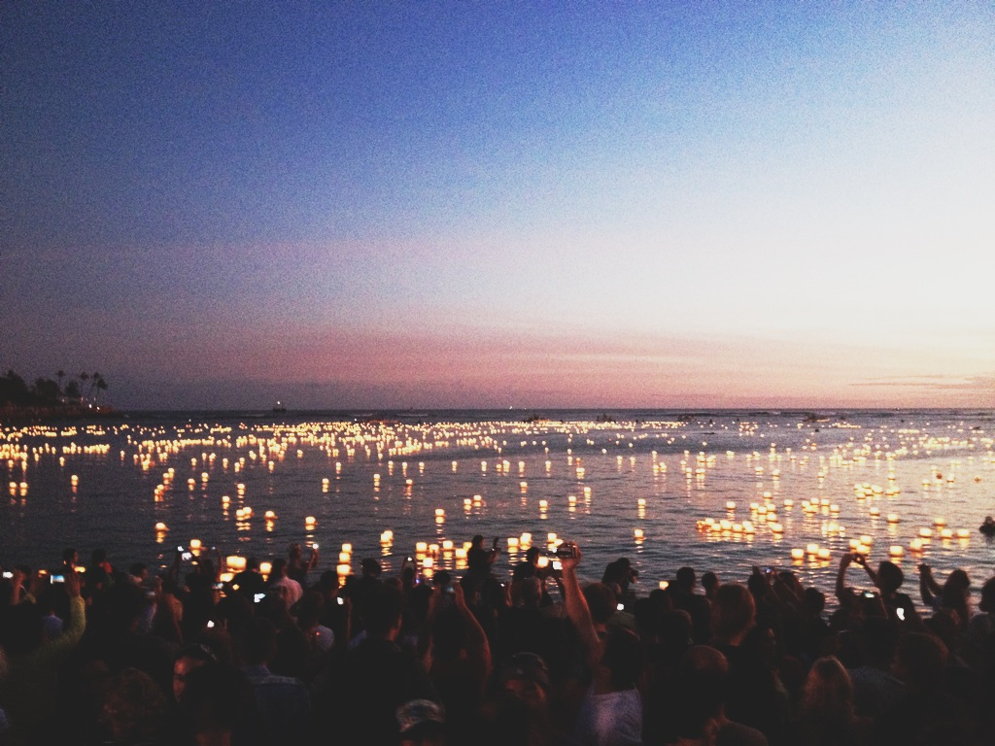
Each One Let Their Light Shine
What would happen if each person in Christ's restored church decided that they wanted to let their light shine before the world and witness to just one other person about the restored gospel?
“When they had dined, Jesus saith to Simon Peter, Simon, son of Jonas, lovest thou me more than these? He saith unto him, Yea, Lord; thou knowest that I love thee. He saith unto him, Feed my lambs.
He saith to him again the second time, Simon, son of Jonas, lovest thou me? He saith unto him, Yea, Lord; thou knowest that I love thee. He saith unto him, Feed my sheep.
He saith unto him the third time, Simon, son of Jonas, lovest thou me? Peter was grieved because he said unto him the third time, Lovest thou me? And he said unto him, Lord, thou knowest all things; thou knowest that I love thee. Jesus saith unto him, Feed my sheep.”
John 21:15-17

Slide 148
APPENDIX

Slide 149
Six Evangelical Arguments Against Baptismal Regeneration

Slide 150
Baptismal Regeneration
2 Nephi 6:48-49:
48 And he commandeth all men that they must repent and be baptized in his name, having perfect faith in the Holy One of Israel, or they cannot be saved in the kingdom of God.
49 And if they will not repent and believe in his name, and be baptized in his name, and endure to the end, they must be damned.

Slide 151
Six Evangelical Arguments Against Baptismal Regeneration
1) Acts 10:44-48
Evangelicals: “Baptism doesn't save. Peter didn't have to lay hands on the Gentile believers at Caesarea. They received the gift of the Holy Spirit prior to baptism.”
Our Response: These were the first Gentiles to be converted. God had to move in a miraculous way to convince Peter and the Jewish Christians who strongly opposed the idea. After this happened, Peter commanded them to be baptized. This is in keeping with Jesus’ teaching to be born of water and the Spirit.

Slide 152
Six Evangelical Arguments Against Baptismal Regeneration
2) Luke 23:39-43 (KJV)
Evangelicals: “If baptism is necessary for salvation, shouldn't Jesus have condemned the repentant thief on the cross?”
Our Response: No. We should go back to the slide about those who have never been taught the gospel. They are not condemned if they have not been taught in time to fully respond through the ordinance of baptism.

Slide 153
Six Evangelical Arguments Against Baptismal Regeneration
3) John 3:3-5
Evangelicals: “The phrase ‘born of water’ just refers to the breaking of the amniotic sac at birth; it has nothing to do with baptismal regeneration.”
Our Response: But the passage says that you must be born of water and the Spirit to be saved. Are you really suggesting that fluid flowing from the amniotic sac (a work, not faith) somehow saves us? What about Acts 22:16?

Slide 154
Six Evangelical Arguments Against Baptismal Regeneration
4) 1 Corinthians 1:17
Evangelicals: “This statement by Paul clearly demonstrates that baptism was not part of the gospel (the message of salvation).”
Our Response: This verse does not dissociate baptism from the gospel. In fact, v.14 tells us that Paul baptized two of them himself. It merely says that Paul’s primary work was to focus on preaching rather than baptizing.

Slide 155
Six Evangelical Arguments Against Baptismal Regeneration
5) Eph. 2:8-10
Evangelicals: “Baptism doesn’t save us. We are saved by grace through faith alone, not a work like baptism.”
Our Response: In I Cor. 15:10, we see that God’s grace gives us the desire and power to do his will. We are saved by grace through faith. “Not of works” means not by man’s effort. Baptism is not an act of human effort, but of yielding ourselves to God, allowing him to work in us by his grace.

Slide 156
Six Evangelical Arguments Against Baptismal Regeneration
6) Acts 2:37-41
Evangelicals: “In saying ‘be baptized for the remission of sins,’ the word for means ‘because of’ the remission of sins (and reception of the HS) that has already occurred prior to baptism.”
Our Response: Verse 37 indicates that the people already believed, yet v. 38 says “ye shall [future tense] receive the gift of the Holy Ghost.” Belief occurred prior to the reception of the Holy Spirit in Acts 2.

Slide 157
Calvinism

Slide 158
T.U.L.I.P.
TOTAL DEPRAVITY
Calvinists: suggest that man is in such bondage to sin that he is incapable of choosing to follow God because of passages like Jer. 17:9.
Response: The Inspired Version affirms that man is “carnal, sensual and devilish.” Humanity is depraved, but that depravity is not “total.” Per John 1:9, John 3:19, John 5:40, 2 Thess. 2:10, etc., a degree of God’s Spirit is given to every man who comes into the world enabling him to choose righteousness.

Slide 159
T.U.L.I.P.
UNCONDITIONAL ELECTION
Calvinists: “To suggest that we know why God chooses some and rejects others undermines his sovereignty. He simply loves some more than he loves others. We do not know why, in his mercy, he chooses to save anyone."
Response: Predestination, as described in Eph. 1:11 and Romans 8:28-30, means that God decided our eternal destiny long ago based on his foreknowledge of the choices we would make. Therefore “human free will” has more influence in determining our salvation. This is called “Arminianism."

Slide 160
T.U.L.I.P.
LIMITED ATONEMENT
Calvinists: “Christ died upon the cross for the purpose of saving only an elect few that he predestined to salvation. At the point of his death on the cross, their salvation was guaranteed. Nothing they did would alter that fact.”
Response: Christ’s death on the cross only provided a means for redemption for those who choose to follow him. Salvation was not locked into place at the cross. Christ died for the sins of the whole world. Arminians call this Universal Redemption or General Atonement (John 12:32; I Cor. 15:22; I John 2:2).

Slide 161
T.U.L.I.P.
IRRESISTIBLE GRACE
Calvinists: “When God elects you to be saved, his grace is an overwhelming, all-powerful force that cannot be resisted. Nothing man can do will alter his destiny once God has elected him for salvation.”
Response: According to John 1:9, God provides a degree of his grace to every person who comes into the world. Yet not everyone chooses to follow him. It is possible for man to resist the impulse of the Holy Spirit and choose to rebel against him. Grace is not irresistible.

Slide 162
T.U.L.I.P.
PERSEVERENCE or ETERNAL SECURITY
“Once saved, always saved”
Calvinists: “A true believer has the assurance of salvation. God would not give this assurance unless it were guaranteed, locked in, unalterable.”
Response: It is true that believers are given the assurance of salvation (Heb. 11:3; I John 5:10-13). However, the idea that the believer can never choose to reject God seems contrary to teachings in Heb. 6:4-6, Matt. 10:22, Matt. 24:13, Luke 8:13, Col. 1:23, 2 Peter 1:10 and 2 Peter 3:17. For someone who suggests that “those who deny Christ were never saved in the first place,” read these passages carefully. It is possible to fall away.

Slide 163
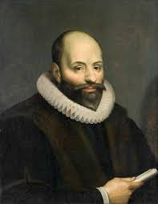
arminianism

Slide 164
Arminianism
In 1610, after his death, the followers of Jacob Arminius composed Five Articles of Remonstrance (reproof or correction):
1. Predestination is conditioned by God's foreknowledge of who would respond to the gospel.
2. Unlimited Atonement: Christ died for all men (not just for the elect), but no one except the believer has remission of sin.
3. Human Free Will: Man can neither of himself nor of his free will do anything truly good until he is born again of God, in Christ, through the Holy Spirit.

Slide 165
Arminianism
4. Grace: God gets the credit for every good deed that we might do, but his grace is not irresistible.
5. Perseverance/Eternal Security: Believers are given the power to persevere, but it is possible for a believer to fall from grace.

Slide 166
The Restoration
Even though Arminianism is a minority view among Protestants, Joseph Smith adopted that perspective on all five points:
Predestination – based on God’s foreknowledge
Unlimited Atonement – Christ died for all
Human Free Will (or “agency”)
God’s grace is not irresistible
Perseverance: It is possible to fall from grace.
There is doctrinal error in other churches, but there are also honest-hearted believers, such as Arminius, who have been responsive to the truth of God.

Slide 167
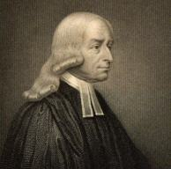
Wesleyan-Holiness-Nazarene
Many Christians like Wesleyan, Holiness, Nazarenes and
certain Methodists have an Arminian perspective.
Like us, they also believe that sanctification (i.e., holiness) is not only possible in this life, but will occur in every true believer.
They are largely critical of Calvinists for perpetuating false concepts such as “eternal security.”
They believe that faith, repentance, surrender to Christ’s Lordship, and obedience have a bearing on salvation.
Whereas, most evangelicals believe that salvation is an entirely different subject from sanctification or rewards.
John Wesley 1703-1791

Slide 168
Wesleyan-Holiness-Nazarene
Exercise
Let’s suppose that a Wesleyan believer shows an interest in this church.
He wants to join, but he has already been baptized, for example, in a Nazarene church. He was baptized into a church that believes just about everything we do about salvation and sanctification.
Why would he need to be re-baptized in your church?
John Wesley 1703-1791

Slide 169
Wesleyan-Holiness-Nazarene
Response
In the Restoration, baptism involves three things:
remission of sin – Acts 2:38; Mosiah 9:40 & 44.
method of entrance into the church – Acts 2:41; Mosiah 9:50.
covenant to obey God's commands – Acts 2:44-47; Mosiah 9:41.
The explanation would be, "You are entering a different church. In this church, you covenant to obey commandments in the Bible, but also commandments in the Book of Mormon and Doctrine & Covenants, as well as to be subject to church authority."
John Wesley 1703-1791

