Slide 1
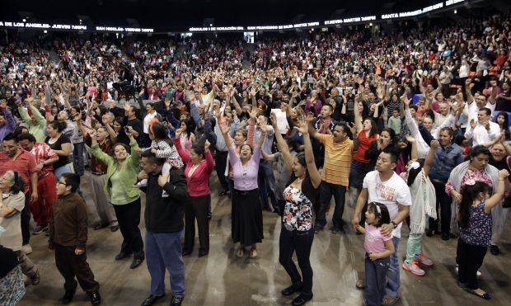
Who Are "Evangelical" Christians?
Bible References are from the King James Version unless otherwise indicated
Copyright © 2016 by Robert R. Bobbitt. Unauthorized use or duplication of this material without express and written permission from Robert R. Bobbitt is strictly prohibited.

Slide 2
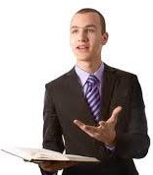
ALWAYS BE READY TO GIVE AN ANSWER
But sanctify the Lord God in your hearts: and be ready always to “give an answer” to every man that asketh you a reason of the hope that is in you with meekness and fear.
1 Peter 3:15-16
The Greek term “apologia” means to “give an answer.” That is where the term “apologetics” comes from.

Slide 3
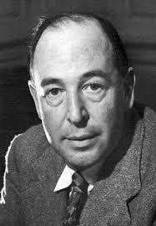
Is The "Restored Gospel" Important?
“One must keep on pointing out that Christianity [the restored gospel] is a statement which, if false, is of no importance, and if true, of infinite importance. The one thing it cannot be is moderately important.”
C.S. Lewis
God in the Dock: Essays on Theology and Ethics

Slide 4
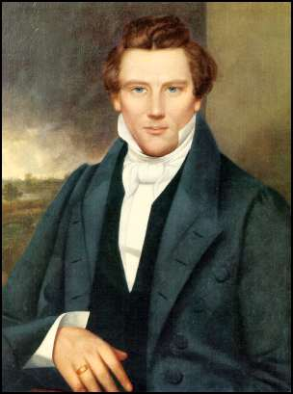
Existing Creeds: Some Degree of Error
“My object in going to inquire of the Lord was to know which of all the sects was right that I might know which to join. No sooner therefore did I get possession of myself, so as to be able to speak, than I asked the Personage who stood above me in the light, which of all the sects was right, (for at this time it had never entered into my heart that all were wrong,) and which I should join.”

Slide 5
Existing Creeds: Some Degree of Error
“I was answered that I must join none of them, for they were all wrong, and the Personage who addressed me said that all their creeds were an abomination in His sight; that those professors were all corrupt, ‘they draw near to me with their lips, but their hearts are far from me; they teach for doctrine the commandments of men, having a form of godliness, but they deny the power thereof.’ He again forbade me to join with any of them....”
Joseph Smith, Jr.
Times and Seasons (vol. 3 & 4) Nauvoo, Illinois, 1839- 1846

Slide 6
Existing Creeds: Some Degree of Error
"And also those to who these commandments were given might have power to lay the foundation of this church, and to bring it forth out of obscurity, and out of darkness, the only true and living church upon the face of the whole earth, with which I the Lord am well pleased, speaking unto the church collectively and not individually."
D & C 1:5e

Slide 7
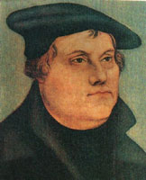
Reformed or Restored?
Evangelical Proof-text:
"And Jesus answered and said unto him, Blessed art thou, Simon Bar-jona: for flesh and blood hath not revealed it unto thee, but my Father which is in heaven; And I say also unto thee, That thou art Peter, and upon this rock I will build my church; and the gates of hell shall not prevail against it." Matthew 16: 17-18
Catholics & Evangelicals: "There never was an apostasy."
Evangelicals: "The gospel just needed ‘reforming’; it was never entirely lost."

Slide 8
"Fullness" and "Restored"?
Why does this gospel give you hope?
What do we mean by “fullness” of the gospel and “restored” gospel?
First, let’s look at what we have in common with other gospels.

Slide 9
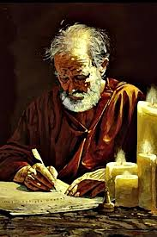
Paul's Key to Witnessing: Common Ground
1 Corinthians 9:20-23:
20 And unto the Jews, I became as a Jew, that I might gain the Jews;
To them that are under the law, as under the law, that I might gain them that are under the law;
Notes:
Verse 20 & 21 – "Secular Jews" – would not describe themselves as religious believers, but still identify as part of the Jewish people. They accept Jewish values, ethics and concerns.
"Orthodox Jews" – try to stay away from the world. They might not own a television, might not listen to non-Jewish music, might avoid non-Jewish magazines. Men still wear a yamulka, a skull cap they were forced to wear in Europe whenever they left their ghetto. Men and women sit separately in worship and women do not participate in some of the rituals. They respect the divine origin of the Old Testament law. This includes the codification of the "oral law" in the Talmud. Orthodox Judaism is not administered by some central authority. Synagogues are established by groups of Jews who raise their own funds and construct their own buildings. There are lots of different Orthodox synagogues organized around many different perspectives.
"Ultra-orthodox Jews" – which arose in the 1700s and 1800s, will not even live in a non-Jewish neighborhood, wear long black coats, flowing beards, wide-brim black hats and sometimes represent various minority groups within Orthodox Judaism. Ultra-orthodox who are Hassidic – look anxiously for the return of the Messiah, are more mystical, and search for ecstasy in their prayers. Hassidic – go back to Eastern Europe when Jews were living in conditions of despair – Hassidism was a way of infusing joy and hope into life, and some Jews say, emphasized the heart at the expense of the mind.
"Conservative Jews" – which arose in the 1900s, is a reaction to excesses of Reform Jews and objected to Reform Jews' reforming the commandments of the Torah (written law). Conservatives still consider the written law to be binding, but say we need to reconsider the oral law (Talmud) and how it applies to modern times. Men and women are not segregated in worship. It is in between Orthodoxy and Reform. It is intellectually liberal in matters of belief but conservative in matters of religious practice – commitment to Jewish observance. Conservative study of holy texts is combined with the belief that Judaism is constantly evolving. In 1960, the Rabbinical Assembly of America agreed to modify Orthodox "halacha" (Jewish law) to permit the use of electrical appliances on the Sabbath and to drive to synagogue in a car. In 1985, it permitted the ordination of women rabbis.

Slide 10
Paul's Key to Witnessing: Common Ground
21 To them that are without law, as without law, (being not without law to God, but under the law to Christ,) that I might gain them that are without law.
22 To the weak became I as weak, that I might gain the weak; I am made all things to all men, that I might by all means save some.
23 Paul’s Rationale: And this I do for the gospel’s sake, that I might be partaker thereof with you.
1 Corinthians 9:20-23
Notes:
Verse 20 & 21 – "Secular Jews" – would not describe themselves as religious believers, but still identify as part of the Jewish people. They accept Jewish values, ethics and concerns.
Verse 22 - "Progressive or Reform Jews" – Many progressives do not even wear a yarmulke. Temple services are shorter, conducted with a little more decorum (less individual praying and conversation), English is used for parts of their worship (Orthodox stick to Hebrew) and men and women sit together. In the early 1800s, a new movement, which is described as Progressive, Reform or Liberal, arose with the emancipation of the Jews of the various German states. Granted equal rights and released from the ghettos to which they had been confined for centuries, some embraced the Enlightenment which resulted in European Liberal Judaism and spread to North America where it became more radical and less traditional: embraced evolution, history and biblical scholarship, founding Non-orthodox rabbinical seminaries in Europe and the United States. Progressive Jews regard the "sacred heritage" of the Torah as evolving and adapting over the centuries. They still study the Hebrew language and sacred texts, are committed to Israel, support the full equality of women and accept any sexual orientation.

Slide 11
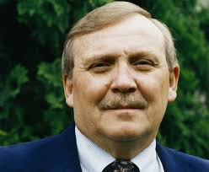
Common Ground
Ed Decker to an RLDS caller on a radio program:
“I understand very clearly the position of the RLDS church. I believe that you have a Christian theology, that you have an understanding of who Christ is. We have the same Jesus. We have the same God. We have the same Holy Spirit. You can have a born-again experience in the RLDS church as easily as you can anybody else's church. We don't have an argument.”
Ed Decker (Saints Alive in Jesus)
May 28, 1986
Guest on Marlin Maddoux’s Point of View

Slide 12
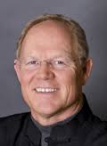
Common Ground: Same Jesus
On March 22, 1994, a caller on the Bible Answer Man radio program asked about the difference between the Mormon Church and RLDS Church. This was Hank Hanegraaff’s response:
“Yeah, well there are some significant differences. Mormons, of course, believe that there are many gods and that a man can become God.
The Reorganized Church maintains that there is only one God, and they hold what appears to be a Trinitarian view with regards to God.
Also, a typical Mormon would hold that God was once a man and had to work his way to godhood. The Reorganized Church, in distinction, teaches that God has always been God.”
Hank Hanegraaff
Bible Answer Man Radio Program
Christian Research Institute
Notes:
"Trinity," which is mentioned in many hymns in the gray hymnal that Arthur Oakman helped to create, has three simple aspects:
1. There is only one GOD (we are monotheistic).
2. Within the Godhead, there are three PERSONS (LDS or Mormons object to this idea and so does Islam).
3. All three persons in the Godhead have the same NATURE or ESSENCE.

Slide 13
Martin Luther
Family background
Law school and rainstorm
Augustinian monastery
Tower experience – Romans 3:28 changed his life!
In 1517 at Wittenburg Cathedral: 95 criticisms of Catholic Church.
Prolific writer
Launched the Reformation

Slide 14
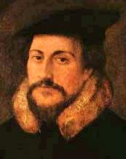
John Calvin and Reformed Theology
Raised in France (a thoroughly Catholic country)
Trained in the law, and a powerful intellect
Influenced by Luther’s writing
In 1530, he broke from Catholic Church and fled to Basel, Switzerland when Protestants were persecuted in France.
In 1536, he wrote The Institutes of Christian Religion, which was revised and expanded several times and became a primer to teach.
In the latter part of 1536, he moved to Geneva where he worked with the city council to reform the church in Switzerland. The city council expelled him and he went to Strasbourg, Germany for a time. In 1541, he was brought back to Geneva to continue the work of reformation.
Calvinism and Reformed Theology.
Notes:
"Reformed theology" has a very specific meaning that is narrower than simply protestantism, or even evangelicalism. It actually refers specifically to Calvinism.
While in Geneva, Calvin's enemies were eventually expelled and left the city.
Michael Servetus, a man who distorted the concept of the Trinity, was burned at the stake at Calvin's urging.
Geneva worked closely with Berne in its efforts to move together in reforming the church in Switzerland. In this regard, Berne suggested that they serve only "unleavened bread" at the Eucharist. Calvin refused to do this until a synod could be convened in Zurich to discuss this. The Geneva city council ordered Calvin, as the minister in their church to follow Berne's suggestion and serve unleavened bread. He refused and, in protest, did not serve the Eucharist at Easter. In that service a riot occurred that spread across the city because they were angry at Calvin for not serving communion to them. Calvin was ordered by the city council to leave Geneva.

Slide 15
EVANGELICALS (USED TO BE CALLED “FUNDAMENTALISTS”)
1. Man is saved by grace through FAITH ALONE.
2. The Bible is the INFALLIBLE word of God (original autographs) and the ONLY word of God.
3. The “priesthood of all believers” REPLACED the Old Testament ministerial priesthood (i.e., Aaronic priesthood) at the cross.
Evangelical Christians frequently exhibit a MISSIONARY ZEAL.
This is NOT A DENOMINATION!

Slide 16
THE FOUR SOLAS (SALVATION)
1. CHRIST ALONE (sola Christos) – NOT human merit.
2. GRACE ALONE (sola gratia) – NOT our power.
3. FAITH ALONE (sola fide) – NOT of works.
4. BIBLE ALONE (sola Scriptura) – NOT “holy tradition”
(additional learning that is conveyed by the “teaching magesterium” of the Catholic Church)

Slide 17
EVANGELICAL SCRIPTURES: SALVATION BY “FAITH ALONE”
“...whosoever believeth in Him should not perish, but have everlasting life.” John 3:16
“... believe on the Lord Jesus Christ, and thou shalt be saved...” Acts 16:31
“...he that heareth my word, and believeth on Him that sent me, hath everlasting life, and shall not come into condemnation; but is passed from death to life.” John 5:24
“... not of yourselves: it is the gift of God; Not of works...”
Ephesians 2:8-9
“Not by works of righteousness which we have done, but according to his mercy he saved us...” Titus 3:5

Slide 18
THE BIBLE
EVANGELICAL VIEW
"The entire Bible is literally God-breathed"
"All scripture is given by inspiration of God, and is profitable for doctrine, for reproof, for correction, for instruction in righteousness: That the man of God may be perfect, thoroughly furnished unto all good works."
2 Timothy 3:16-17
NIV Bible says “All Scripture is God-breathed."

Slide 19
Priesthod of all Believers
EVANGELICAL VIEW
"One Mediator = No Need for Priesthood"
Evangelicals say that there is no need for a mediator (priesthood) between God and man besides Jesus:
For there is one God, and one mediator between God and men, the man Christ Jesus.
1 Timothy 2:5

Slide 20
Priesthood of all Believers
EVANGELICAL VIEW
"Priesthood of All Believers"
Evangelicals say that the Aaronic priesthood ended at the cross and was replaced by a "priesthood of all believers" who are empowered to perform all holy ordinances:
Ye also, as lively stones, are built up a spiritual house, an holy priesthood, to offer up spiritual sacrifices, acceptable to God by Jesus Christ . . . But ye are a chosen generation, a royal priesthood, an holy nation, a peculiar people; that ye should show forth the praises of him who hath called you out of darkness into his marvelous light.
1 Peter 2:5 & 9

Slide 21
Christians in the World
To get some sense of proportion:
Catholics – 1.27 billion
Protestants – about 900 million
Evangelicals –about 600 million (most are Pentecostals and Charismatics)
Charismatics – believe spiritual gifts continue today.
Pentecostals – speaking in tongues is THE sign of conversion.
LDS - 15 million
Restoration – a few thousand

Slide 22
Mainline (Liberal) Protestants
“Mainline Protestants Churches” (Liberal Protestant, NOT Evangelical) – In the 1950s, evangelicals shot ahead of the old mainline protestant churches that used to dominate Protestantism. Examples of mainline Protestants include:
United Methodist Church
Lutheran Church
Presbyterian Church U.S.A. (PCUSA)
Episcopal Church
American Baptist Churches (used to be Northern Baptist Convention)
United Church of Christ
Disciples of Christ
Quakers
Reformed Church in America

Slide 23
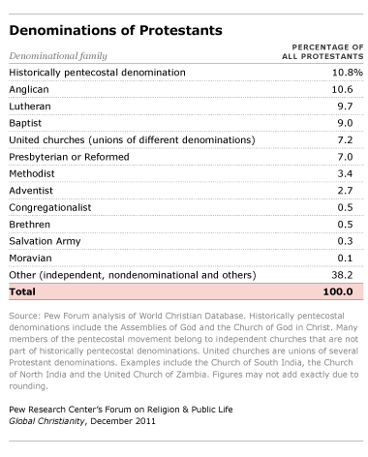
Protestant Denominations
Liberal and Evangelical Protestant Denominations:

Slide 24
Evangelical Denominations
National Association of Evangelicals (NAE) Web Site –
65 Denominations:
Advent Christian General Conference (7th Day Adventists)
Assemblies of God (largest pentecostal denomination, 68 million people worldwide, founded in 1914, baptism of HS and speaking in tongues, loose alliance of independent national and regional denominations).
Association of Life-Giving Churches
Bilingual Christian Fellowship
Brethren in Christ Church (German, anabaptist, pietistic, Wesleyan)
Christ Community Church
Christian Reformed Church in North America (Dutch, Calvinists)

Slide 25
Evangelical Denominations
National Association of Evangelicals (NAE):
Church of God (many different denominations are called this)
Church of God (Holiness) – Wesley's "second work of grace,” after we are saved, leading to "Christian perfection" (love others more than ourselves).
Church of God Mountain Assembly (holiness, pentecostal in TN, KY, OH)
Church of the Nazarene (largest Wesleyan holiness denomination at 2.3 million, mission to 159 "world areas," hdqrtrs: Kansas City, MO)
Churches of Christ in Christian Union (Wesleyan-holiness and Restorationist – belief that Christianity should be restored after NT pattern).
Congregational Holiness Church (withdrew from International Pentecostal Holiness church in 1921 because they believed in using doctors for healing)

Slide 26
Evangelical Denominations
National Association of Evangelicals (NAE):
Congregational Methodist Church (Wesleyan, Arminian, 14,000 people)
Conservative Baptist Assoc. of America (broke from Northern Baptist Convention in 1940s to fight "modernism" such as "Bible a myth")
Conservative Congregational Christian Conference
Conservative Lutheran Association
Converge Worldwide (Swedish baptist/pietist, changed name recently from Baptist General Conference, Hdqrtrs: Orlando, 200,000)
Elim Fellowship (pentecostal and spread revival)
Evangelical Assembly of Presbyterian Churches (evangelical & believe in presbyterian form of church government: local councils of elders)

Slide 27
Evangelical Denominations
National Association of Evangelicals (NAE):
Evangelical Church of North America (Wesleyan-holiness, dedicated to a life of holiness & sanctification, 12,000 members, hdqrtrs in OR)
Evangelical Congregational Church (Arminian Methodist but not part of the congregational churches that came from New England)
Evangelical Free Church of America ("Free" means affirms human free will, local independ. churches, 1950 merger: Swedish, Norwegian, Danish)
Evangelical Friends Church - Eastern Region ("Friends" or "Quakers" strongly emphasize "priesthood of all believers," being taught by a direct personal relationship with Christ rather than seminary, no need for clergy)
Evangelical Lutheran Conference

Slide 28
Evangelical Denominations
National Association of Evangelicals (NAE):
Evangelical Methodist Church (conservative Wesleyans)
Evangelical Presbyterian Church (Reformed theology, presbyterian governance, broke away from liberal Presbyterian Church USA in 1981, but EPC is more moderate than Presbyterian Church in America - PCA).
PCA – most conservative (second largest Presbyterian church)
EPC – moderate
PC – USA – liberal (largest Presbyterian church)
Evangelistic Missionary Fellowship
Fellowship of Evangelical Churches (Mennonite Evangelicals – In 1800s, Henry Egly withdrew from Amish, called "Egly Amish," 5,000 members)

Slide 29
Evangelical Denominations
National Association of Evangelicals (NAE):
Free Methodist Church of North America (Wesleyan-Arminian, "Free" means anti-slavery, pews in church to be “free” to all rather than sold or rented, allowing the “freedom” of the HS vs. stifling formality, and “freedom” from secret societies like Freemasons, 1860: expelled from Methodist Episcopal Church for too earnestly advocating "authentic Methodism.")
Foursquare Church (pentecostal, modern healing, emphasizes the 4-fold ministry of Jesus, believe in verbal inspiration of Bible, possible to backslide, Christian perfection possible,8,000,000 members, founded in 1923 by Aimee Semple McPherson in Los Angeles where their temple is)

Slide 30
Evangelical Denominations
National Association of Evangelicals (NAE):
General Association of General Baptist (Believe in "general atonement" that JC died for all persons, believe it is possible to turn away from a saved condition, headquarters: Poplar Bluff, MO, Stinson Press)
General Council Christian Union
Grace Communion International (formerly Worldwide Church of God, at Armstrong's death in 1986 completely reversed denominational doctrines)
Great Commission Churches - emphasize church planting & discipleship based on book of Acts ("The Blitz" formed by Jim McCotter in CO in 1965)
Hispanic World Harvest Churches

Slide 31
Evangelical Denominations
National Association of Evangelicals (NAE):
International Fellowship of Christian Assemblies (Italian-American, Pentecostal, healing, foods described in Acts 15, 7200 members)
International Pentecostal Church of Christ (opposition to racism in their statement of belief, foot washing and child dedication, 5,000 members)
International Pentecostal Holiness Church (Pentecostal, Wesleyan holiness and sanctification, Oral Roberts was a minister, Charles Stanley grew up in this church, 3,000,000 members)
Midwest Congregational Christian Fellowship (coordinating body for congregational churches, "Congregational" refers to independence of each congregation and arises from Reformed churches in New England)

Slide 32
Evangelical Denominations
National Association of Evangelicals (NAE):
Missionary Church, Inc.
Morningstar Ministries or Heritage International Ministries (founded by Rick Joyner and located in large complex in South Carolina, Joyner advocates for "dominion theology," a nation governed by Christians, based on Genesis 1:28)
Northern Pacific Latin American Assemblies of God
Open Bible Churches (Pentecostal, resist authoritarian leadership and a denomination's ownership of church property, left Foursquare Church in 1932 over this issue and Aimee McPherson's divorce, hdqtrs: Des Moines)
Pentecostal Church of God (broke away from Assemblies of God over doctrinal statement in 1916, Pentecostal, Trinitarian, possible to fall away)

Slide 33
Evangelical Denominations
National Association of Evangelicals (NAE):
Pentecostal Free Will Baptist Church, Inc. (broke away from Free Will Baptist Church to join Holiness movement and become more Pentecostal than Baptist, 28,000 members, meet annually in North Carolina).
Presbyterian Church in America (Reformed theology, Presbyterian in government, but evangelical as well, next largest Presbyterian church after Presbyterian Church (USA), several splits from PCUS over "modernism" such as PCUS's refusal to affirm virgin birth or bodily resurrection, biblical inerrancy, promoting ordination of women, concerned about this the PCA formed its own Reformed Theological Seminary in 1966 on which R.C. Sproul served as faculty)
Primitive Methodist Church USA

Slide 34
Evangelical Denominations
National Association of Evangelicals (NAE):
Reformed Episcopal Church (formed by George Cummins in 1800s in reaction to people in Anglican Church who were calling for return to pre-Reformation Catholic roots, four US dioceses in North America)
Reformed Presbyterian Church of North America (continued the historical practice of singing the Psalms exclusively in worship, in 1960s refused to vote or participate in the US government due to it not acknowledging Christ's authority over it, separate from other Presbyterians all the way back to 1600s in Scotland)
Southern Pacific Latin American Churches

Slide 35
Evangelical Denominations
National Association of Evangelicals (NAE):
The Brethren Church (anabaptist, three negatives: non-resistance, non-swearing (no oaths) and non-conformity, stand against oppression, stand for non-violence, many conscientious objectors, in 1708 escaped persecution at Schwarzenau, Germany, then escaped to Netherlands, 1729 to 1740 all emigrated and established first congregation in Germantown, Pennsylvania)
The Christian & Missionary Alliance
The Salvation Army (church, charitable organization, 1.5 million organized with officers and a military structure, arose from Methodism, founded in London in 1865 by William Booth, leader is a "general")
The Wesleyan Church Corporation
Third Day Worship Centers

Slide 36
Evangelical Denominations
National Association of Evangelicals (NAE):
Transformation Ministries - In 2006, broke away from American Baptist Churches (ABC), which used to be called the Northern Baptist Convention, over the issue of accepting practicing homosexuals.
United Brethren Church (Arminian, episcopal structure, roots from Mennonites and German Reformed, close ties to Methodism, merged with Evangelical Church in 1946 to form Evangelical United Brethren Church)
US Conference of the Mennonite Brethren Churches (started in Ukraine as Mennonite Brethren Church and migrated to Kansas, Minnesota, Nebraska, South Dakota, emphasize pietism, personal discipline, Sabbath)

Slide 37
Evangelical Denominations
National Association of Evangelicals (NAE):
Vineyard Movement (charismatic, modern worship, "come as you are," healing, spiritual gifts, lay leaders instead of seminary trained, John Wimber broke away from Calvary Chapel, Kansas City prophets)

Slide 38
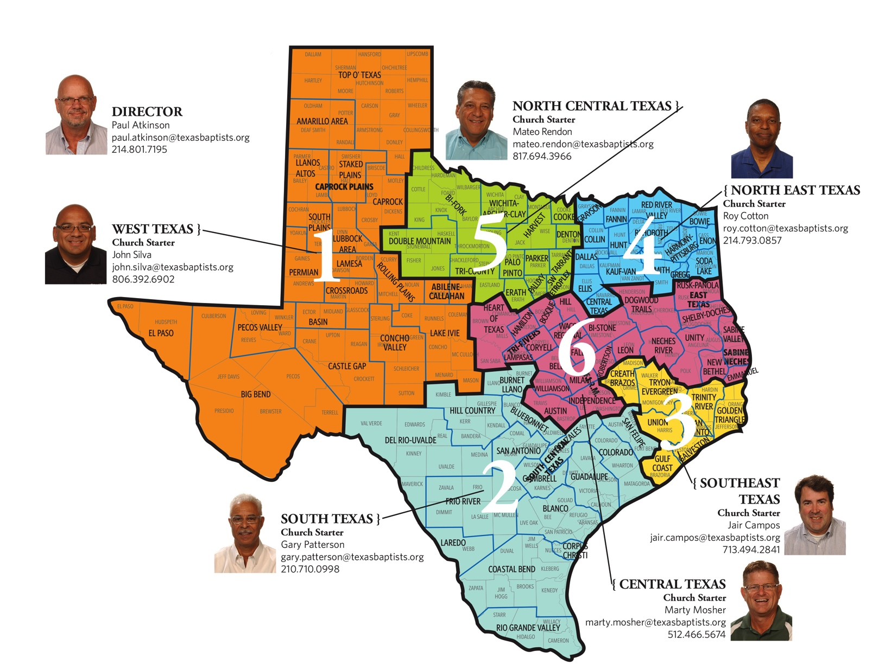
Evangelical Growth
This is a ratio of Christians and evangelical Christians to the world population over a period of centuries:
100 AD: One Christian to 360 non-Christians in the world.
1000 AD: One Christian to 220 non-Christians in the world.
1900 AD: One evangelical Christian to 27 non-evangelicals in the world.
1989 AD: One evangelical Christian to 7 non-evangelicals in the world.
This is a map at texasbatptists.org showing coordinators who will help you start a new Baptist Church in six different areas of Texas.
Notes:
Philip Johnstone's missions handbook entitled Operation World.

